Slide 1
Simplified Supplier Management and eProcurement
By Nogalis

Slide 2
Design by Industry
Healthcare
Retail
Public Sector
Food Service
Manufacturing

Slide 3
Three categories
Manual Process
Off-the-shelf application
Home-grown solution

Slide 4
Why your procurement system is broken
Inefficient manual processes
Ineffective communication tools
Lack of policy enforcement (Maverick buying)
Lack of integration with your business
Overcomplicated features that go unused

Slide 5
A Self-Evident Procurement Platform should …
Eliminate paper, email, and phone calls
Simplify Vendor Onboarding
Focus on essential functions
Enable your suppliers to do the work
Support transparency and auditability
Encourage effortless communication
Integrate seamlessly with your business

Slide 6
Why Vendor-centric?
Encourages vendor/supplier participation
Enables vendors to perform self-service tasks
Reduces phone calls and emails
Enhances audit capability and communication
Document compliance begins with vendor

Slide 7
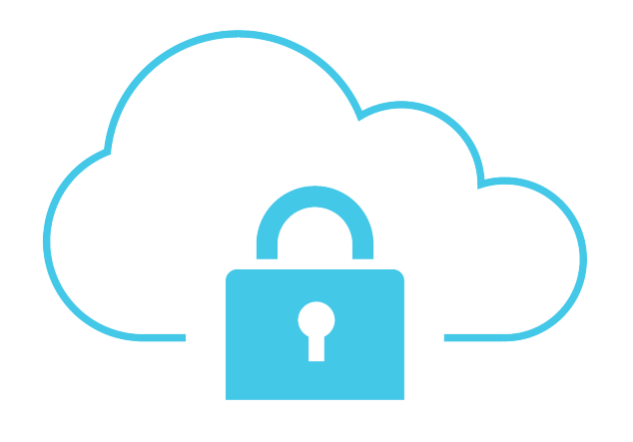
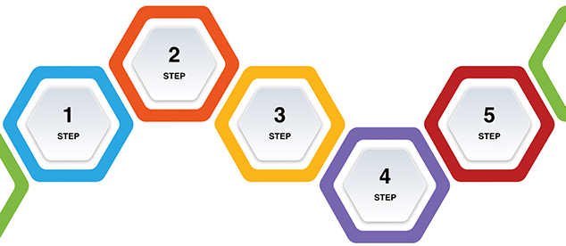
Self-Evident Design
Step by Step Processes
Digestible Analytics
Responsive mobile first design
In the safe, secure and ubiquitous Cloud
Purposeful collaboration by design

Slide 8
Fully integrated with all major ERPs

Slide 9
One portal to rule them all
Vendor messages and communication
Approvals and Routing
Vendor Documents (W9, Licensing, Insurance)
RFI and Bid Requests
Invoices and Check Requests
Purchase Requests

Slide 10
IN THIS DEMO
OnBoard a Vendor and Approve her
Request Payment by the vendor and Approval
Create distributions
Purchase supplies from a store location
Fulfil the order and provide feedback
Communicate with the vendor and see audit trail
See the power of document management
A quick view into our 3-days implementation

Slide 11
Capability balanced with Simplicity
One-Click Vendor OnBoarding
Streamlined Approval Processes
Effortless Invoice and Payment Requests
Flexible and Straightforward Purchase Requests
Seamless Documents Management
Uncomplicated Audit and Data Validation

Slide 12
Pricing Structure
Implementation Costs
On-Going Annual Subscription
3-day Implementation at fixed cost
Includes connectors for your ERP application
Additional technical resources available by request
$-/Vendor Per Month
$--/User Per Month
$0.- Per Premium transaction
No other costs.
* Beta customers are eligible for special pricing.

Slide 13
What sets VendorLaunch apart
Out-of-the-box integration with major ERP applications
Industry leading data verification techniques:
IRS TIN validation
Email, Phone, and Address verification
OIG Exclusion list
UN trade sanctions list
Vendor focused design to enable vendors to do most of the work
Intuitive and simplified design
Cloud based
Pay as you go
Nothing to maintain
Fully managed

Slide 14
Beta Incentives
The opportunity to drive the requirements
Free Beta period with full support
No implementation cost on GA release
50% discount on GA release for life

Slide 15
Request a demo today!
Request A Demo Today

