Slide 1
UpgradeX and CloudSuite
What you need to know

Slide 2
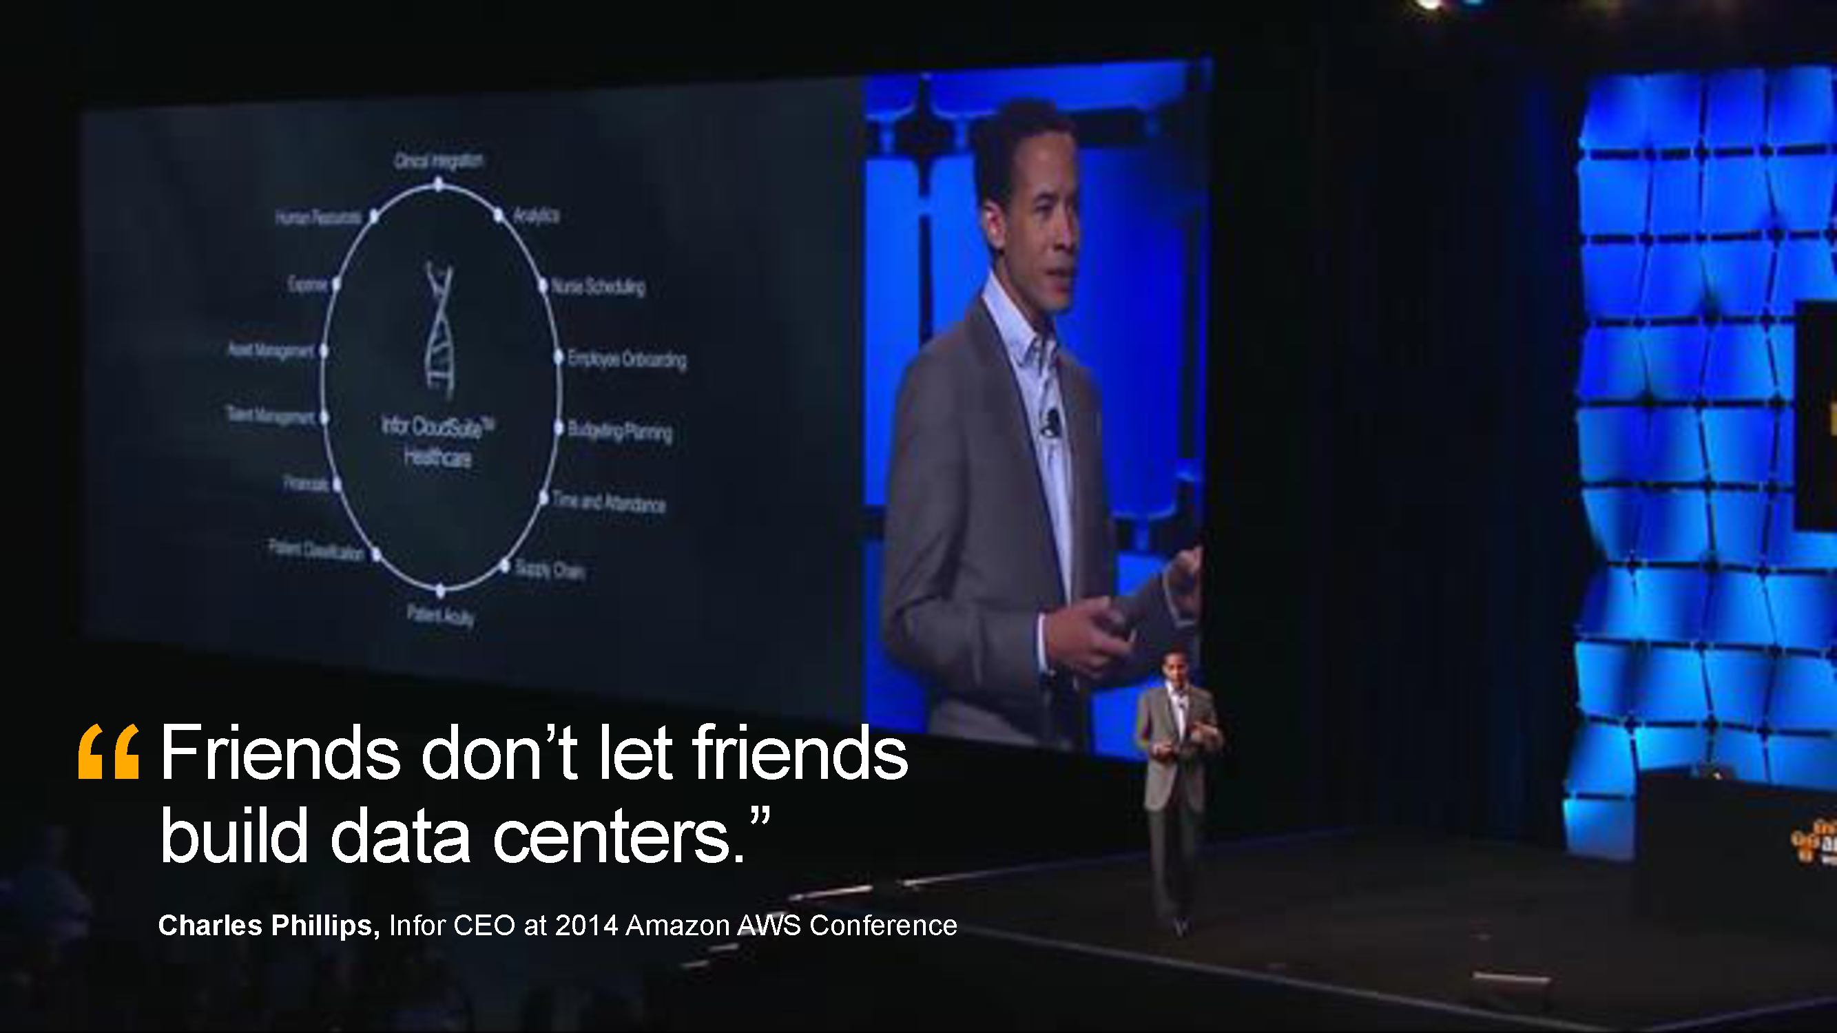

Slide 3
WHY?

Slide 4
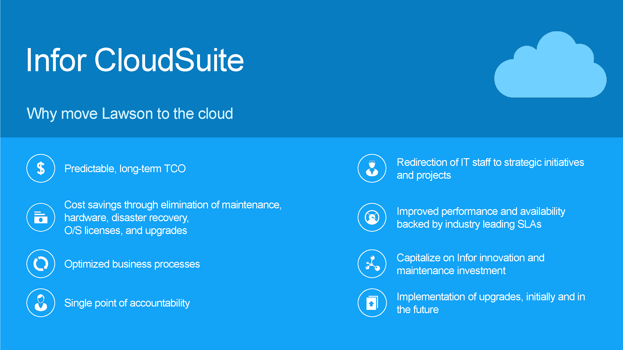

Slide 5
Why move to the cloud?
Eliminate complex upgrades every 3 to 4 years
Eliminate Hardware replacement costs every 4-5 years
Limited technical resources
Time required for budgeting, procurement and contracting for professional services, software and hardware
Long Term Cost Savings
Built in redundancy, replication, and recovery
Timely upgrades and service packs

Slide 6
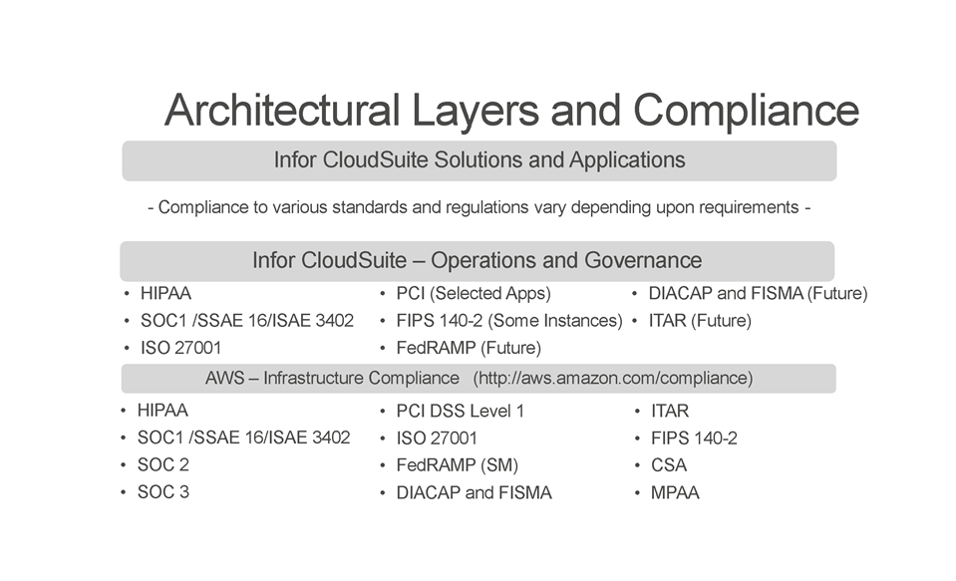

Slide 7
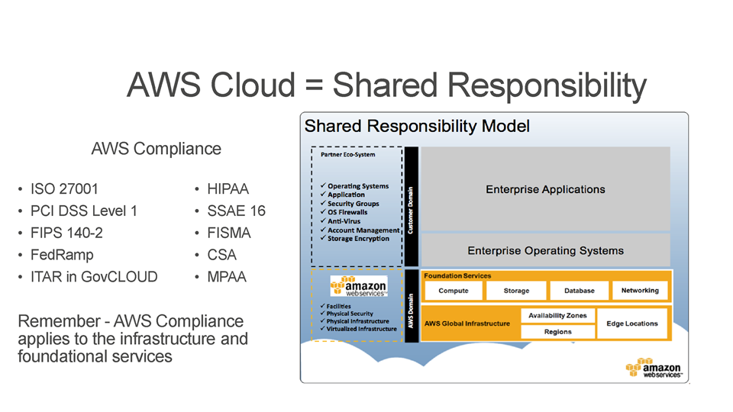
http://aws.amazon.com/compliance/

Slide 8

IT Service Management
  ITIL v3
  Asset Management
  Change and release management
  Incident management
  Problem management
  Task management
  Service catalog

Slide 9
HOW?

Slide 10




Infor CloudSuite Customer Life Cycle
Contract
Provision
Implement
Post Go Live
Complete Contract
System
Create Users and Roles
System, DB, Application Support
Hand Off
to Cloud Operations
System Security
Application and Functional Configuration
Application
End User Training
Tenant
Application and Functional Configuration
Database
Load Codes, Parameters and Data
Setup Backup, Monitoring of System and Database
Go Live and Turn Over to Support
Communicate Provisioning Complete
Perform Backups, System Monitoring/Maintenance, DB Maintenance
Notes:
Lets take a look a simple Customer Life Cycle process for a CloudSuite Industrial customer.
This is a simple view I put together that takes a customer from contract to go live.
Full Customer life cycles can have a more cyclical view where after go live there is the ongoing relationship with the customer that is focused on
Making sure they are getting the value out of the system they invested in
Exposing them to additional features and solutions with the hope of expanding share of wallet
- Securing Subscription Renewals

Slide 11
Infor CloudSuite
Roles and Responsibilities – examples
Infor
Install patches/upgrades
Customers/Partners
User administration
Backups and restores
Manage all SSL certificates
Install OS and DB patches/upgrades
Create, manage and tune
Install patches / upgrades
Batch and job queue management
General knowledge of implemented database
Test installed patches/upgrades
Create and manage process flows, custom triggers, workflows
Create and manage: Security classes, roles, users
System
Security
Database
Application

Slide 12
The Infor CloudSuite Model

Slide 13
Who | Solution Provisioning | Implement |  |  |  |  | Support | Renewals
 |  | Set-up/ Configure | Data Migration | Integration & Reporting | Change Management | Customer Training
Customer/ Partner
Infor

Slide 14
WHAT?

Slide 15
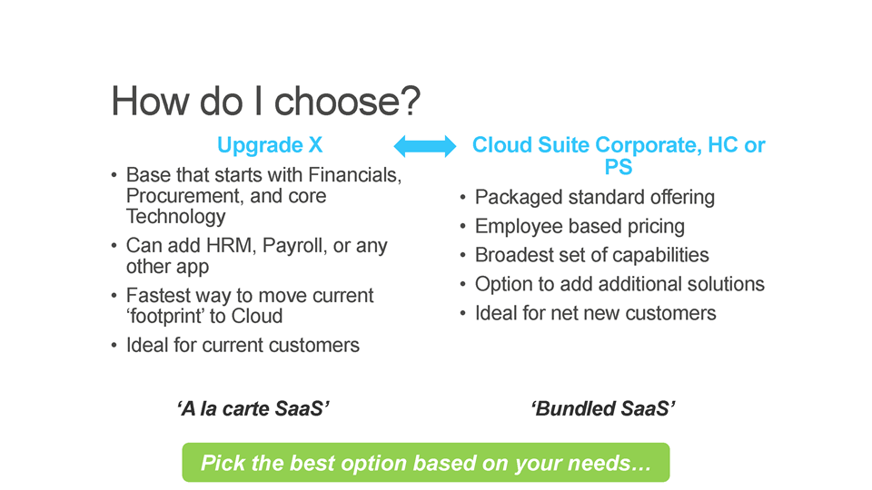

Slide 16
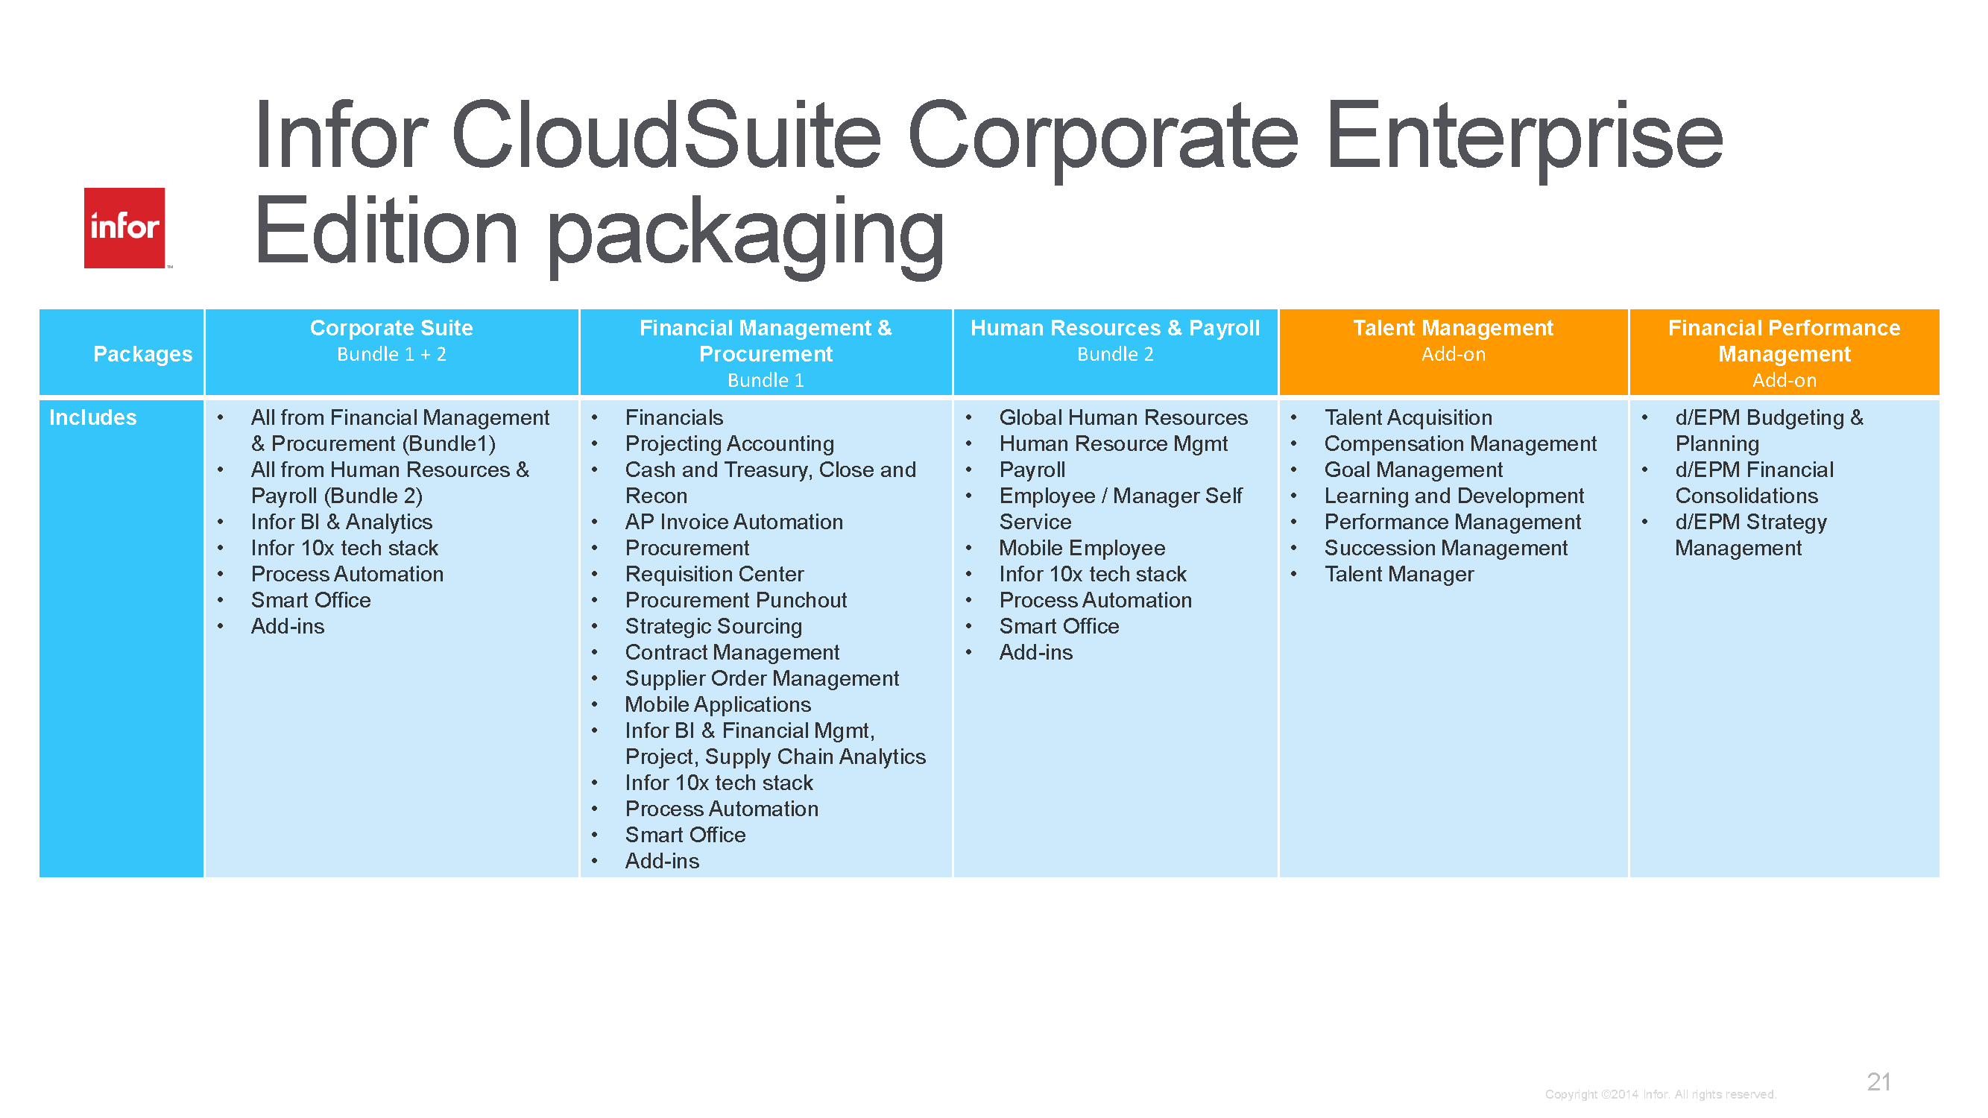

Slide 17
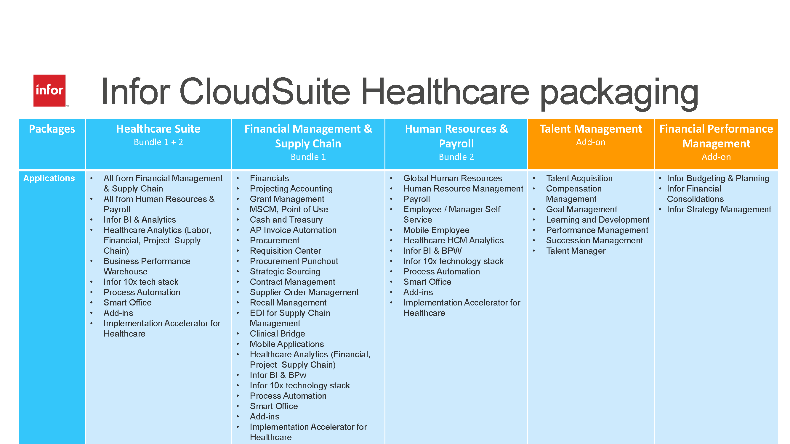

Slide 18
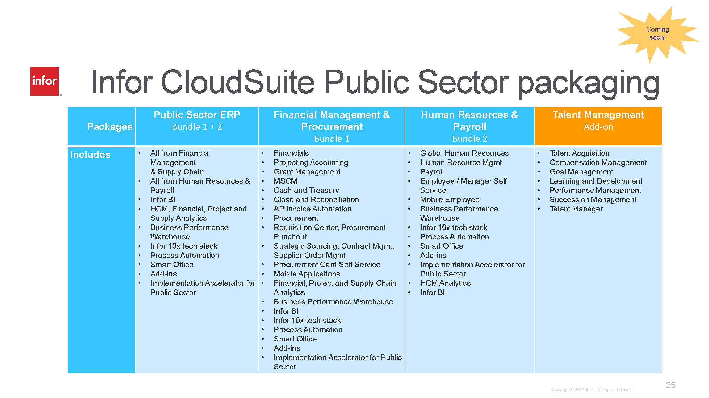

Slide 19
Calculating ROI
Storage Area Network Cost per TB
Physical vs Virtual Servers
Windows Licensing Costs
Utility and data center real estate
IT Audit and compliance costs
IT Staff (Hardware and Operations)
10 year time horizon

Slide 20
Other things to consider
Current OS and Database Flavor vs. Cloud options
Number of existing modifications and customizations
Interfaces to internal applications and systems
Bandwidth
How many environments will you need? TEST? PROD? DEV? TRAIN?

Slide 21
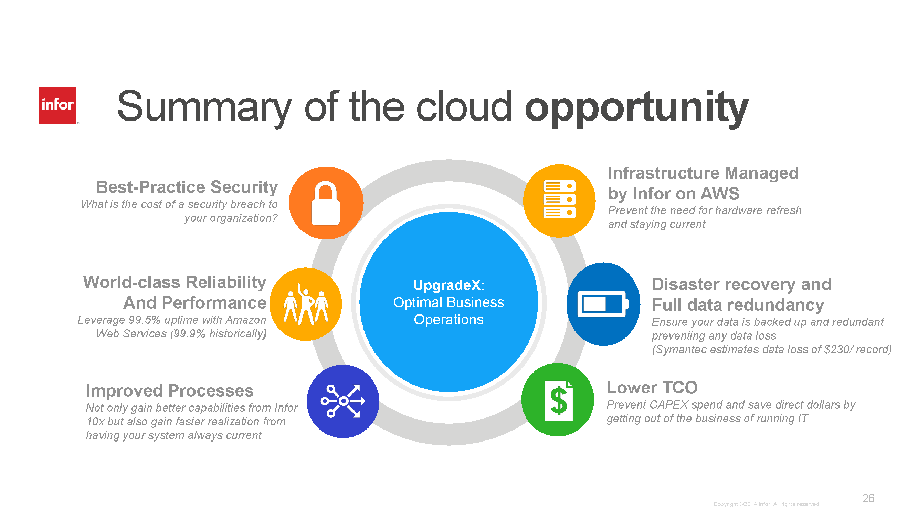

Slide 22
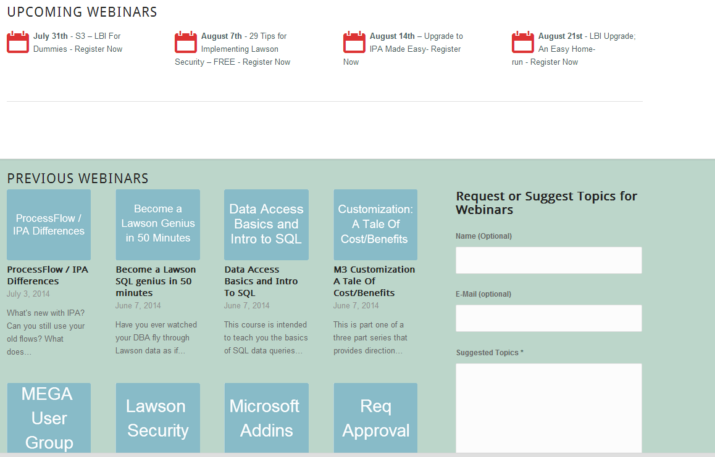
Free Education
www.nogalis.com/education

Slide 23
Upcoming Events
Apr
8-9
West Coast Mega User Conference
5 things you need to know before you move to the cloud
9 Performance enhancers for your Lawson Environment
www.nogalis.com/education

Slide 24
Q/A
For more information please contact us
Tan Rezaei: tan@nogalis.com
@nogalisinc

