Slide 1
Lawson S3 for beginners
The very basics

Slide 2
What is ERP?
Enterprise Resource Planning:
business process management software that allows an organization to use a system of integrated applications to manage the business and automate many back office functions related to technology, services and human resources.

Slide 3
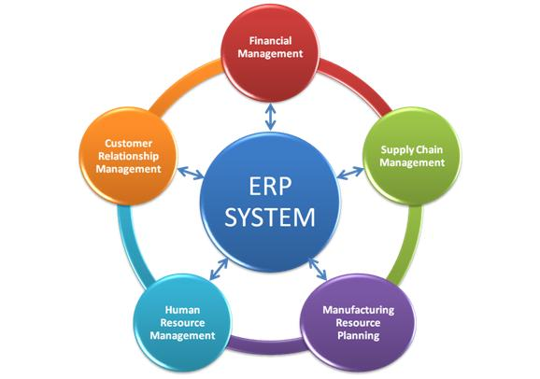
What is ERP?

Slide 5
I like to think of it as…
Quick books for big business
Like, hospital sized companies

Slide 6
Why do we need it?
Managed finances
Control inventory
Managed and Pay employees
Administer benefits
Order products and manage vendors
Fulfill order and manage customers
Pay the bills and taxes
Get paid
Measure performance
Report on the overall health of the company
And much more

Slide 7
How does it work?

Slide 8
How does it work?

Slide 9
Infor Lawson S3
Financial Management
Human Capital Management
Supply Chain (Procurement)

Slide 10
Financial Management
General Ledger
Accounts Payable/Receivable
Billing and Revenue
Asset Management

Slide 11
Human Capital Management
Human Resource
Payroll
Benefits
Recruiting
Talent Management
Learning Management

Slide 12
Supply Chain Management
Procurement
Requisition
Inventory Control
Strategic Sourcing
Mobile Supply Chain (MSCM)
Contract Management
Surgical Instrument Management
Recall Management

Slide 13
Who is involved?

Slide 15
Who is involved?
The Client
Software Vendor
Integration Partner
Hosting Partner
Managed Services Partner

Slide 16
At your company
Business Side
IT Side
Desktop Support
The Super User / SME
Application Analyst
The User
Developer
The Self Service User
DBA

Slide 17
Lawson
Presentation Layer
Screens and Reports that users Interact with each day
Application Technology Layer
Back end code and technologies that help run the application screens
Database Layer
The database that stores the information for the application technology layer

Slide 18
Lawson
Presentation Layer
Application Technology Layer
Database Layer

Slide 19
In Reality
Presentation Layer
Application Technology Layer
Database Layer

Slide 20
Database Layer
Database Layer
The database that stores the information for the application technology layer
PROD
TEST
TRAIN
DEV

Slide 21
Application Technology Layer
Application Technology Layer
Back end code and technologies that help run the application screens
Web Server
Lawson Applications
Security
Lawson System Foundations
Infor Business Intelligence
3rd Party Apps and Tech
Landmark
Infor Process Automation
Operating System

Slide 22
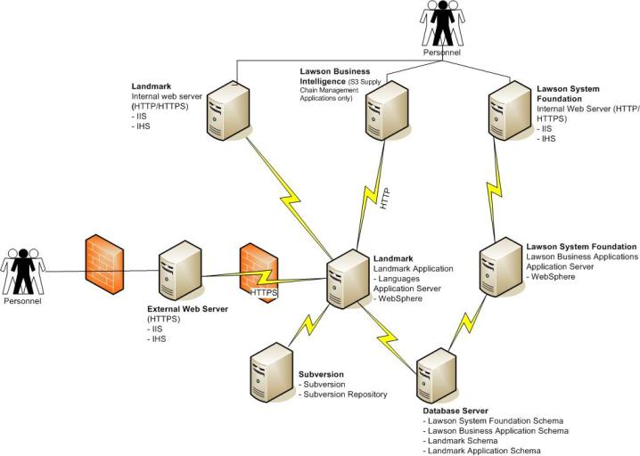

Slide 23
Presentation Layer
Presentation Layer
Screens and Reports that users Interact with each day

Slide 24
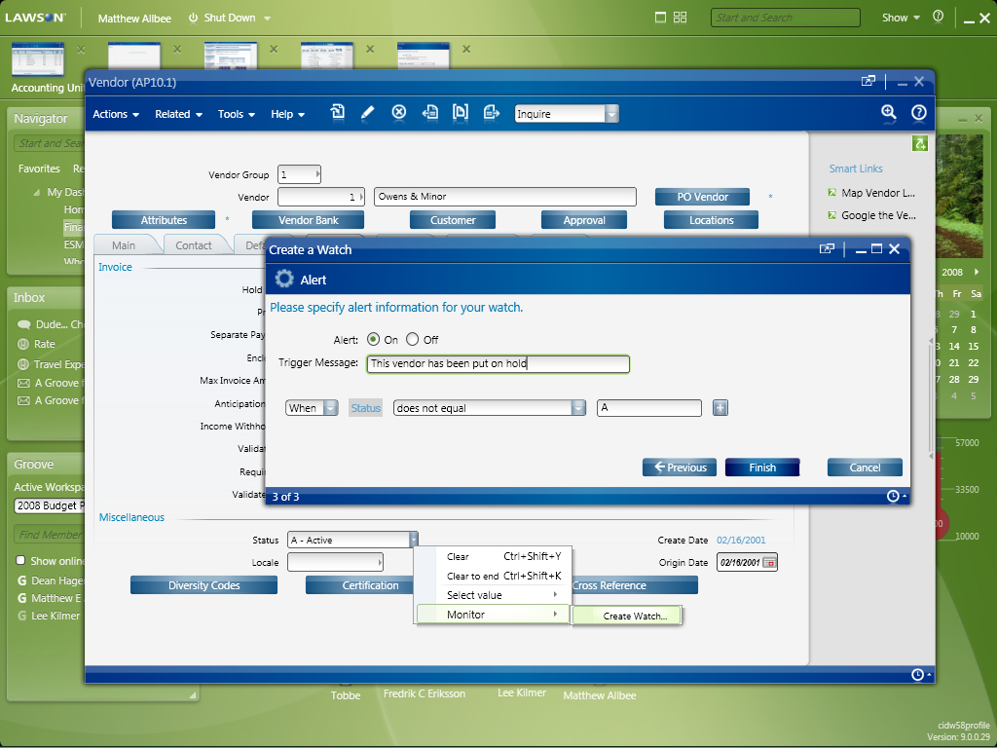
Lawson Smart Office

Slide 25
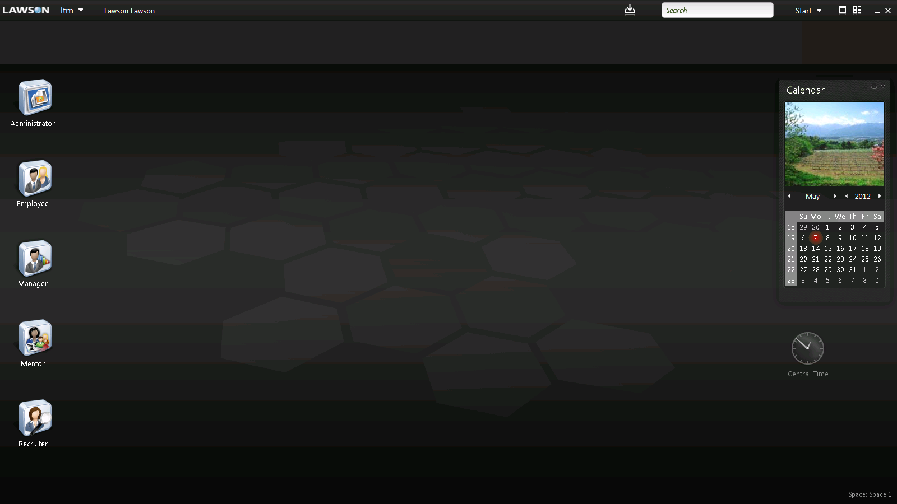
Rich Client

Slide 26
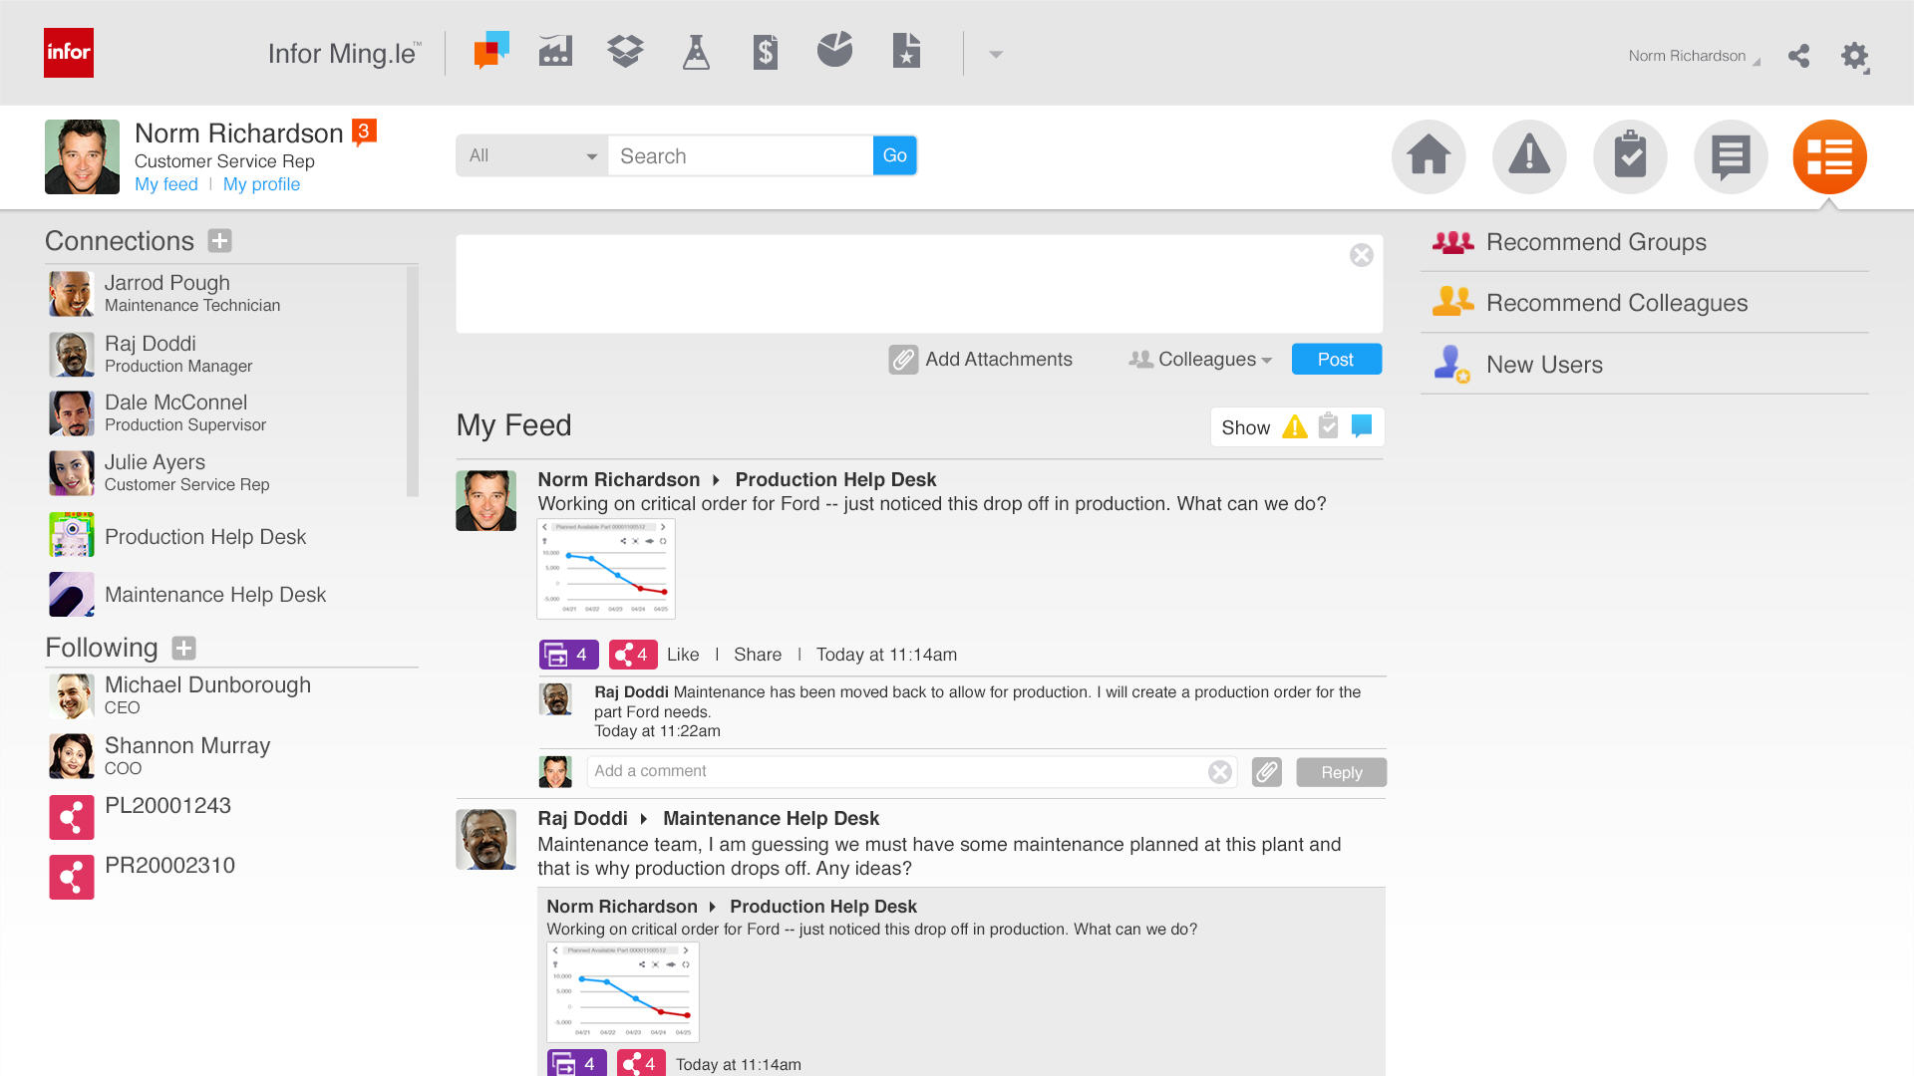
Infor Ming.le

Slide 27
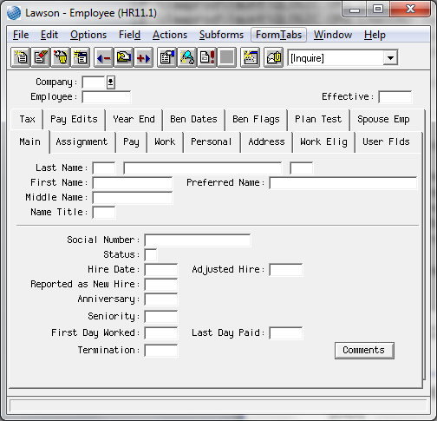
Lawson Insight Desktop (LID)

Slide 28
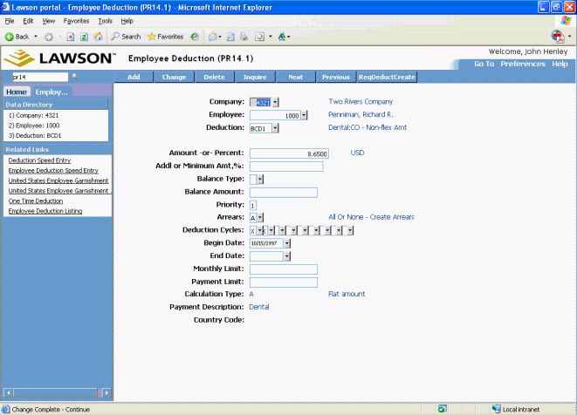
Lawson Portal

Slide 29
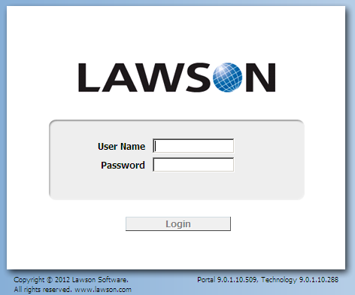
Logging in

Slide 30
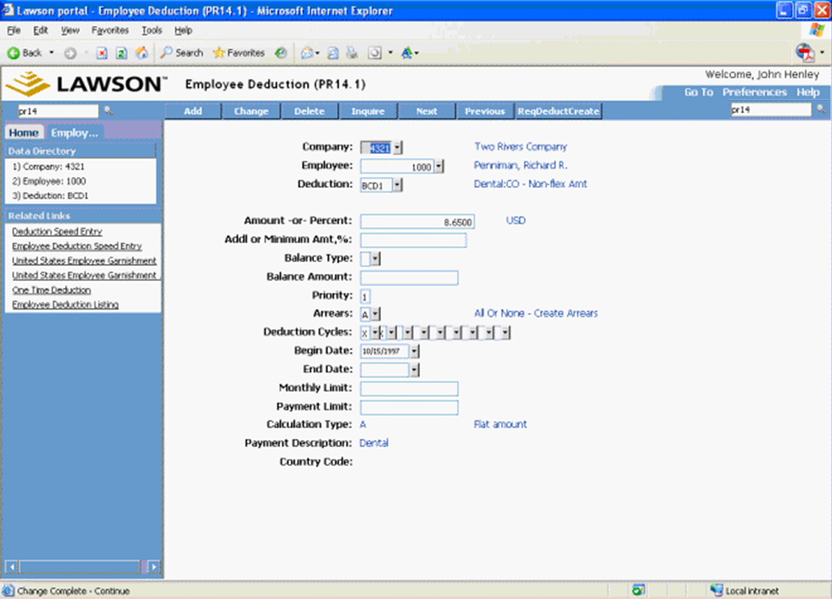
Lawson Portal

Slide 31
The Search Box
Search for a Phrase like:
Employee
Garnishments
Purchase Order
Benefits Enrollment
Request a specific screen
HR11
PO20
AP10
IC12
Request a specific batch program
GL190
HR211

Slide 32
Screen Functions

Slide 33
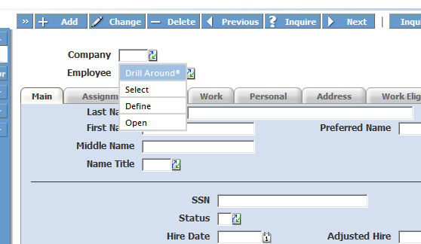
Selects and Drills

Slide 34
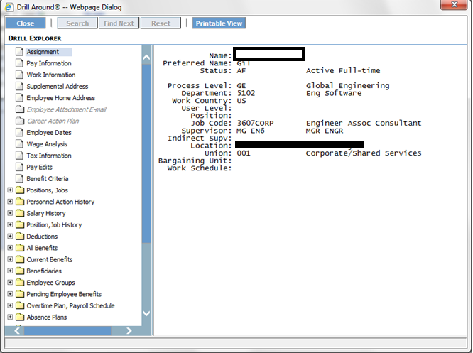
Selects and Drills

Slide 35
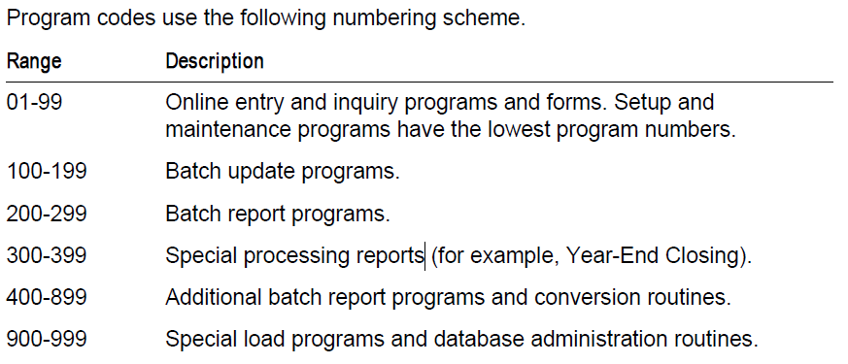
Screen Numbers

Slide 36
Finding Other Screens
User the Search Box:
If your user account has access to the search box you can search by terms.
MENUS (HRMN, PRMN, GLMN…):
Use the MN keyword in conjunction with the system code like HRMN to get the menu system for that System Code
Flowchart (HRFL, PRFL, GLFL…):
Use the FL keyword in conjunction with the system code like HRFL to get the Flowchart for that System Code

Slide 37
Other Components
Infor Process Automation (ProcessFlow):
And automation and integration tool that can integrate Lawson with other applications and automate tasks within Lawson.
Infor/Lawson Business Intelligence (LBI):
A Reporting and Dashboard set of tools that enable the user to access relevant reports within Lawson
Microsoft Excel Addins:
A plugin within MS-Excel that allows the user to query and update Lawson data using Microsoft Excel. This is a very powerful tool for adhoc reporting and mass updates.
BSI TaxFactory:
A 3rd party application that integrates with Lawson for Payroll tax calculations.

Slide 38
Other Components
The Self-Service modules:
A series of web applications built for end-users to use Lawson in a guided, almost wizard-like way to perform pre-defined tasks.
Employee/Manager Self Service (ESS/MSS): Used by employees of an organization for employee and manager related actions like updating personal information, adding emergency contacts, address changes, benefits enrollment, approvals..
Requisition Center (RSS): A Self-Service tool for creating requisitions
Inbaskets:
A term referring to a repository for tasks that have been assigned to a user and are pending his/her actions.

Slide 39
The Community
User Groups:
MWLUG
SCAN
LGUG
Inforum
Web Communities:
LawsonTalk
LawsonGuru
Infor Communities
Support:
www.inforxtreme.com

Slide 41
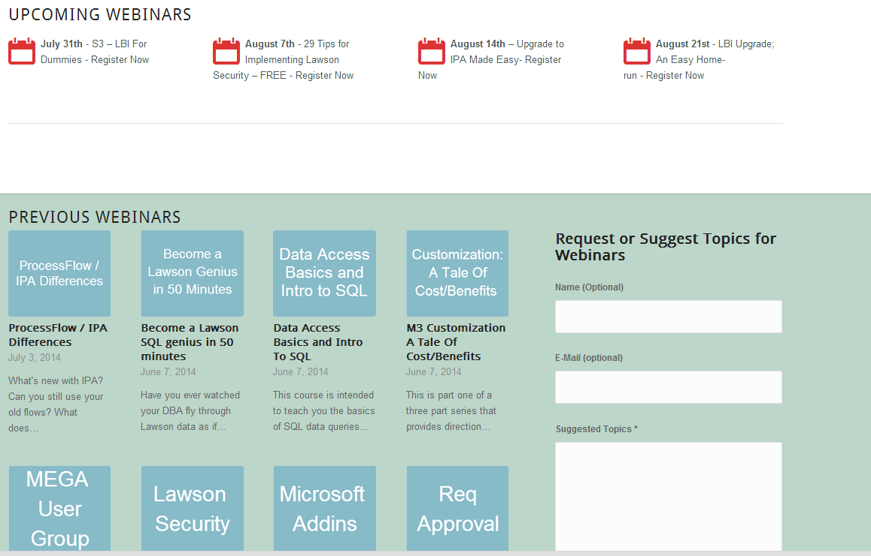
Free Education
www.nogalis.com/education

Slide 42
Upcoming Events
Mar
26
UpgradeX and Infor Lawson in the Cloud
Apr
8-9
West Coast Mega User Conference
5 things you need to know before you move to the cloud
9 Performance enhancers for your Lawson Environment
www.nogalis.com/education

Slide 43
Q/A
For more information please contact us
Tan Rezaei: tan@nogalis.com
@nogalisinc

