Slide 1
Lawson Data Archive Solution

Slide 2
The Scenarios
Lawson Data
40%
?
60%
Upgrading to CloudSuite
Migrating to Workday or Oracle
Merger or Acquisition
Notes:
Many clients have moved from Lawson to another ERP but still have to maintain their servers for audit, archive and historical purposes
In many cases, the Lawson application still houses all historical information and the new system only has a subset of that data

Slide 3
Options
Keep Lawson running
Data Lake
Static Files

Slide 4
The Risks
Compliance
Security
Maintenance
&
Accessibility
Audit

Slide 5
Costs
Hardware maintenance, real estate, and energy costs
Backup, storage, Disaster recovery, monitoring
Internal upkeep costs
3rd party support costs
Software and OS licenses

Slide 6
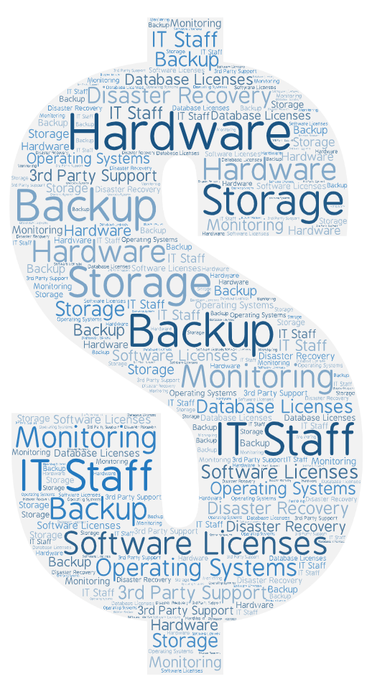

Slide 7
Data Lake
Query complexity and performance
Accessibility and lack of audit
Internal upkeep costs
3rd party support costs
Software and OS licenses

Slide 8
The Opportunity
A clearly defined and complete data migration to the cloud
A simple, easy to query user interface to your data that can be given to each user.
The freedom to decommission the Lawson application and all it’s related servers

Slide 9
Case Study 1
Client implemented Oracle HCM in 2019 but did not convert history
Legacy Lawson version: 9.0.1 (HR/PR)
Archived Data: 1TB
Project duration
Data Migration and validation 2 weeks
Rollout and testing 4 weeks
Customizations: Moderate

Slide 10
Case Study 2
Client implemented Workday in 2020 with 2 years history
Legacy Lawson version: 10.x (HR/PR)
Archived Data: 1.75TB
Project duration
Data Migration and validation 3 weeks
Rollout and testing 3 weeks
Customizations: None

Slide 11
Sample Project Outline
 | wk1 | wk2 | wk3 | wk4 | wk5 | wk6 | wk7 | wk8
Requirements and Planning
Data Move and Validation
Deployment and configuration
Testing and Rollout
Completion and Exit

Slide 12
The Nogalis Solution

Slide 13
STEP 1 - Migrate the database to the client’s cloud (AWS or similar)
Lawson Legacy
(Oracle, MSSQL, DB2)
Cloud DB
Migration Service

Slide 14
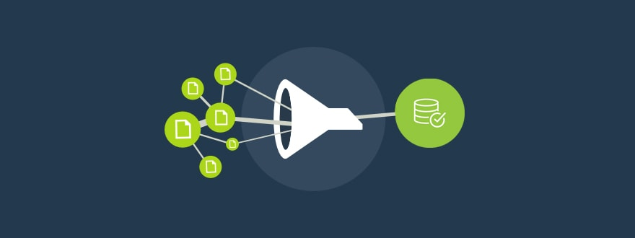
Multi-dimensional Validation
1M+ Dimensions of validation
Complete Audit Report
Report output comparisons

Slide 15
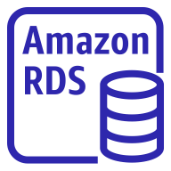
STEP 2 - Implement our serverless solution in the client’s AWS cloud
Cloud DB
AWS Serverless Solution Stack

Slide 16
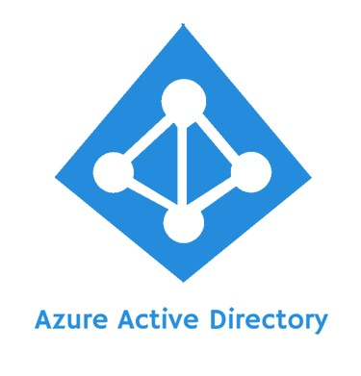
STEP 3 - Integrate the solution with your Active Directory for user access
AWS Serverless Solution Stack
SAML Integration

Slide 17
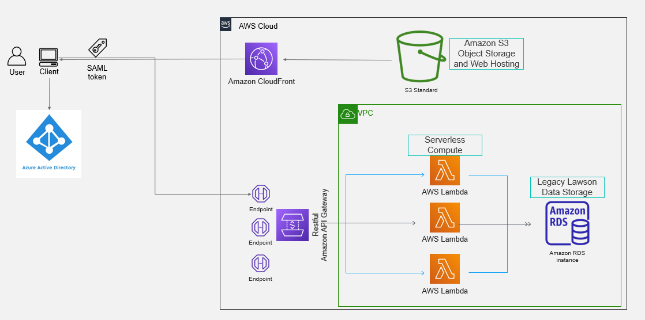
STEP 4 - Provide data access to users as needed by module

Slide 18
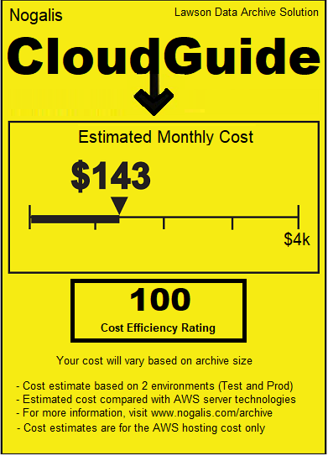
AWS Hosting Costs

Slide 19
By Module
Module | Components
Financials | GL, AP, AC, AM, CB
HCM | HR, BN, AP and PR
Procurement | PO, RQ, IC
Optional features:
Anonymized data in TEST
Static file storage
Audit logging
Data retention policy

Slide 20
Q/A
Tan Rezaei
tan@nogalis.com
949-285-2349
www.Nogalis.com

