Slide 1
29 Tips for Implementing Lawson Security
What you haven’t been told yet

Slide 2
Are you on Lawson Security?

Slide 3
#1
50% Planning
30% Development
20% Testing

Slide 4
Plan Accordingly
#2
1-3 months (2 month average)

Slide 5
Scripts - 1 year later (23 clients)
#3

Slide 6
LAUA Security
#4
User
Security Class
Secured Objects
HR00
PR12
HR01
PR13
HR04
PR51
HRGENCLASS
HR07
PR52
HR09
PR67
HR10
PR68
HR11
HR12
PA52
PA100

Slide 7
LSF Security
User
Security Roles
Security Classes
HRSETUPCLASS
HR00
HR01
HR04
HR07
PRACCESSCLASS
PR12
PR13
PR51
PR52
PR67
PR68
HRGENROLE
HREMPCLASS
HR10
HR09
HR11
HR12
….
PRADROLE
PAACTCLASS
DATAACCESS
PA52
PA100

Slide 8
The Hierarchy (in one profile)
User has many
Roles have many
Security Classes have many
Rules

Slide 9
#5
AUTOMATED CONVERSTION

Slide 11
What can you secure?
#6
Online: Online Screens (e.g. HR11, PR13, GL00, PO20…)
Batch: Batch programs (e.g. PA100, HR211, PR198, GL190…)
Files: Database Tables
Elements … Not in this presentation
Element Groups… Not in this presentation
Data Source: The Productline
Securable Type
Form
Program
Table

Slide 12
Rule?
#7
Grant All Access
Deny Any Access
Unconditional Access to Action
Conditional Rule Access

Slide 13
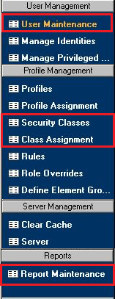
Menus
#8
Add/Edit Users
Add Roles to users
Manage identities
Add users to groups
Add/Edit security Classes
Assign a Class to A Role
Create an run reports

Slide 14
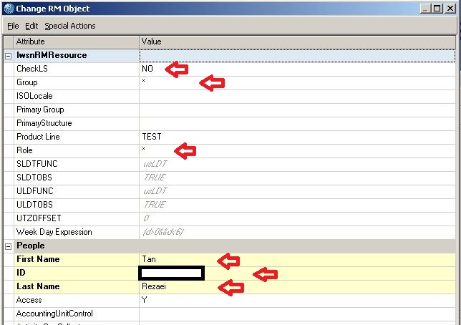
Check LS
#9

Slide 15
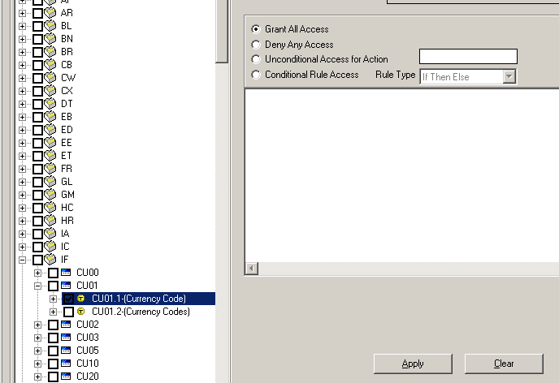
Dealing with Tokens
#10

Slide 16
The Tools
#11
Security Administrator
Manage Security Profiles
Add/Edit Security classes
Add/Edit Security rules
Assign classes to roles
Manage user profiles
Run security reports
Manage security settings
RM Administrator
Add/Edit Groups
Add/Edit Roles

Slide 17
Best Trick
#12
“Skip to End”; “Back”; Check “Description”; Next

Slide 18
Not so obvious
#13
To grant access to a securable object like a screen, a batch job, or a database table, you need to grant access to the productline and the system code it resides in.
In order to grant access to a specific screen token (like HR11.1). You also need to grant access to the screen (HR11). The fields and tabs in the token are automatically granted unless you deny them specifically.

Slide 19
Data Can Hide
#14
Drop Downs
Drills
Report Outputs
LBI
ProcessFlow Inbasket

Slide 20
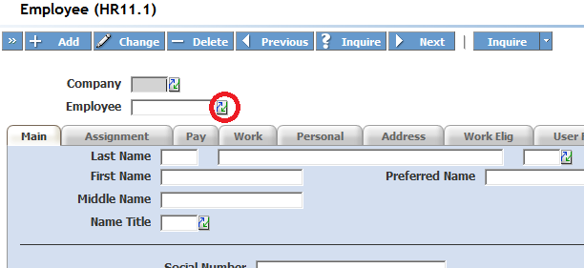
Drop downs and Drills
#15
Must grant access to the tables the select or drill draws data from.
Table information can be found in the <system code>.or and <System Code>.sr files in $LAWDIR/Productline/??src

Slide 21
Contradictions
#16
LSF Security is grant based. If in any of assigned classes access is granted then the user has access. EVEN IF it’s explicitly denied in another one of the user’s classes.
ESS/MSS Can be a but of a chore with crazy rules

Slide 22
Naming Convention
#17
Come up with a good naming convention for roles and classes before you do anything else. These should make sense at a glance and be easy to classify and sorting them should also group them.

Slide 23
Order
#18
Determine Tasks each role needs to perform (These will be your security classes)
Determine what each task is composed of (These will be your rules)
Assign classes to roles
Assign roles to users
Do one user group at a time, not all at once

Slide 24
Test Ad Nauseam
#19

Slide 25
Have users test with scripts
#20

Slide 26
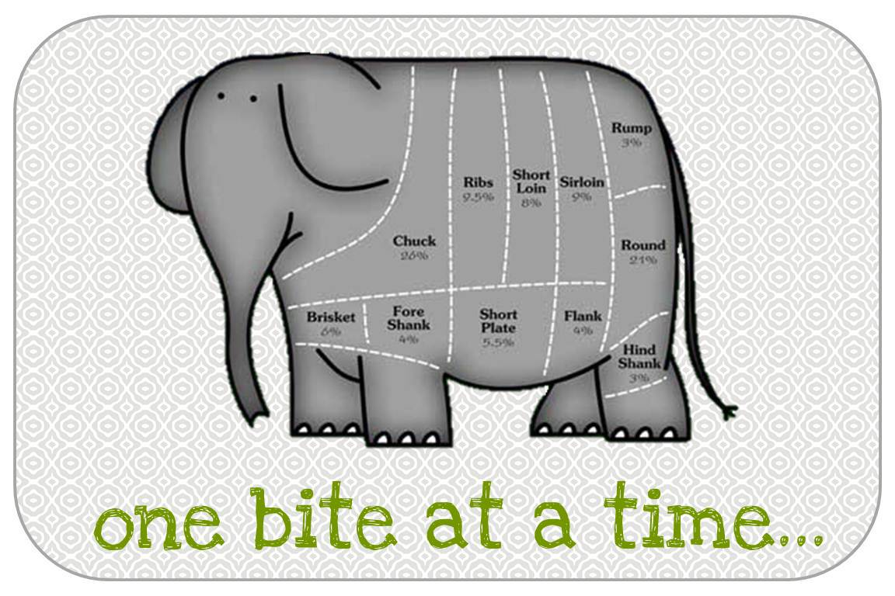
Divide and Conquer
#21

Slide 27
Timing
#22

Slide 28
Caching
#23
Perform an IOSCacheRefresh
Clear all your browsing history and restart the browser
Remove Security Cache
Reduce Caching Interval
Wait up to 15 minutes
Try it in LID

Slide 29
Training
#24
Get at least 2 people trained early on
Infor Class (? Days)
We can help (2 Days)
Online resources

Slide 30
Documentation
#25
Use Excel to plan and document changes often

Slide 31
KISS
#26
Don’t over complicate the rules to begin with
Pick major roles and classes and only add when it’s impossible to reuse
Pick a simple, extensible naming convention

Slide 32
Plan for trained support
#27
Issues with logging in
Issues with screen access
Issues with functionality
Issues with report access

Slide 33
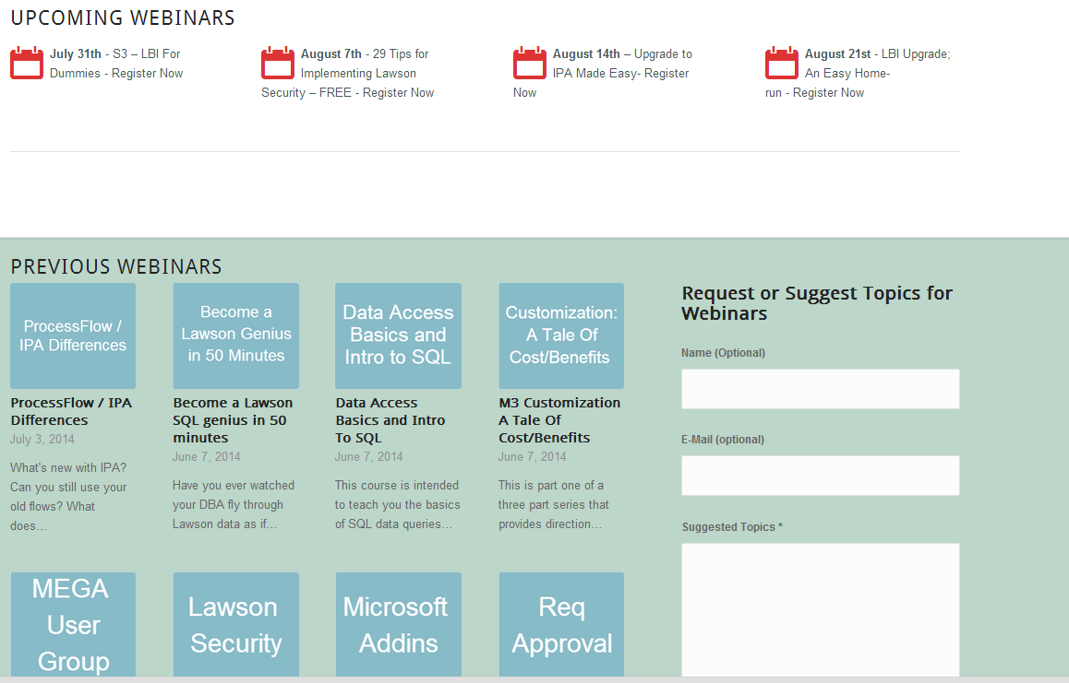
Free Education
#28
www.nogalis.com/education

Slide 34
#29

Slide 35
Upcoming Events
Aug
14
Upgrade to IPA Made Easy
Aug
21
LBI Upgrade; An Easy Home-run
Oct
28
Lawson 10x Upgrade Bootcamp 2.0
www.nogalis.com/education

Slide 36
Bootcamp
www.nogalis.com/bootcamp

Slide 37
“I was thoroughly impressed by the event. It was well-attended by both onsite attendees and webinar attendees. The attention to detail was very impressive. From the tickets, the online video and audio logistics, a dedicated help desk for webinar attendees, the food and beverages, the Infor lanyards, the information binders for onsite attendees, the electronic information for webinar attendees, on and on in every aspect the event was professional, high-quality very polished and infused with enthusiasm and creativity. The onsite attendees were attentive and engaged throughout the day. Considering the event lasted several hours, that attentiveness is a testament to the event's value to the onsite attendees and webinar attendees. If the Nogalis Infor 10x Upgrade Bootcamp event is indicative of the value that Nogalis provides to Infor Lawson customers, then those customers are in good hands and will be well-served when they engage with Nogalis, Inc.”
Regards, Del Dehn
www.nogalis.com/bootcamp

Slide 38
Bootcamp
Tuition:
Early Bird: $295 (Ends Sept 20th, 2014)
Onsite: $495 (100% money back guarantee)
Virtual: $395 (100% money back guarantee)
TODAY ONLY $275 use promo code SECURITY
www.nogalis.com/bootcamp

Slide 39
Q/A
@nogalisinc

