Slide 1
Configuring Lawson for LDAP Signing
Step-by-step Guide for Lawson and Landmark
Desi Houze
Sr. Technical Consultant
Nogalis, Inc

Slide 2
LDAPS Configuration
Prerequisites
Install LDAP Certificate for LSF and Landmark
Update LSF to use LDAPS
Update Landmark to use LDAPS
Update IFS Configuration

Slide 3
Prerequisites
SSL certificate for the AD LDS server with the
Private key (.pfx) included
SAN (Subject Alternate Name)
Can be an existing cert
ssoconfig password
LDAP Bind password
LDAPS Port (typically 636 or 3269)
636 is the standard SSL, 3269 is the Global Catalog Port
Global Catalog is preferred when the LDAP servers support it

Slide 4
LDAP Cert – AD LDS
Only for AD LDS host
Identify which service is your AD LDS service
Import Cert
“Service Account”
Export Base-64 cert
Base-64 encoded X.509 (extension .cer)
Used for OS Java and WebSphere java updates

Slide 5
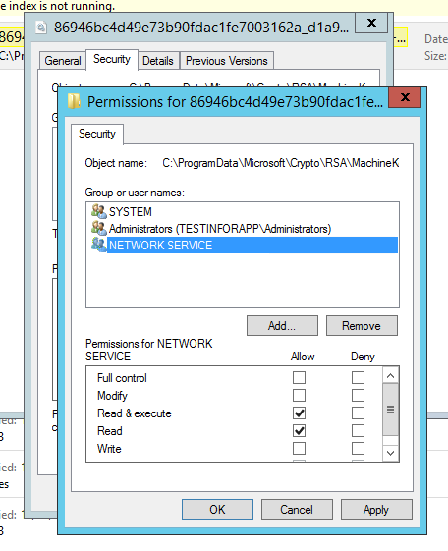
LDAP Cert – AD LDS Permissions
Grant permissions on Cert container
“certutil -store MY’
C:\ProgramData\Microsoft\Crypto\RSA\MachineKeys
Or C:\Documents and Settings\All Users\Application Data\Microsoft\Crypto\RSA\MachineKeys
or C:\Documents and Settings\All Users\Application Data\Microsoft\Crypto\Keys
Read and Read & Execute
Directory
Unique Container file

Slide 6
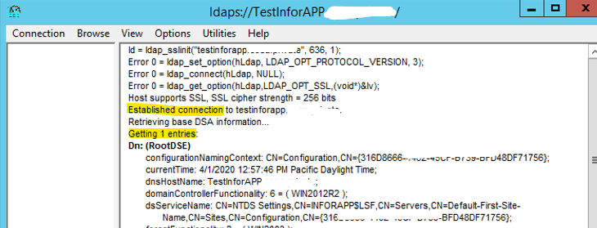
LDAP Cert – AD LDS Smoke Test
ldp.exe
Server FQDN
LDAP SSL port
Check SSL
Verify connection to LDAP

Slide 7
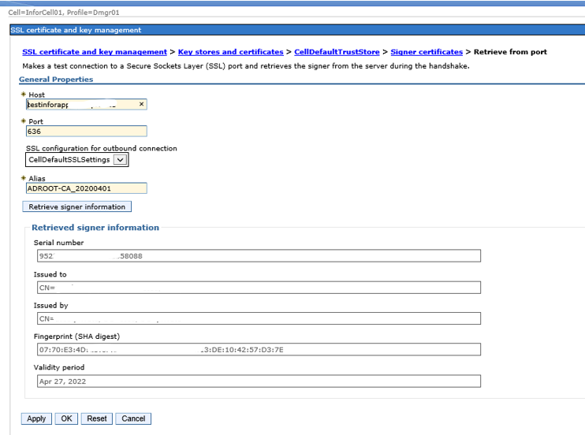
LDAP Cert - WebSphere
Security > SSL certificate and key management > Key stores and certificates > CellDefaultTrustStore > Signer certificates
Click the Retrieve from port button.
Host: adldshost.company.com
Port: your company’s LDAPS port
Alias: choose a meaningful name for the cert
Click Retrieve signer information.
Click OK & save changes
Perform the same steps for the
NodeDefaultTrustStore

Slide 8
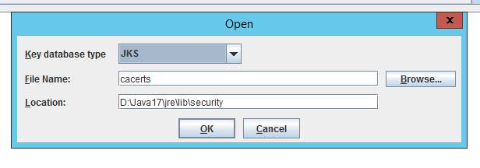
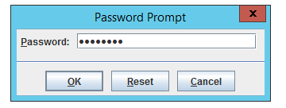
LDAP Cert – OS Java
Lawson and Landmark
Get your JAVA_HOME
Back up the file(s) JAVA_HOME/jre/lib/security/cacerts
Navigate to WAS_HOME/bin and run the ikeyman.bat utility

Slide 9
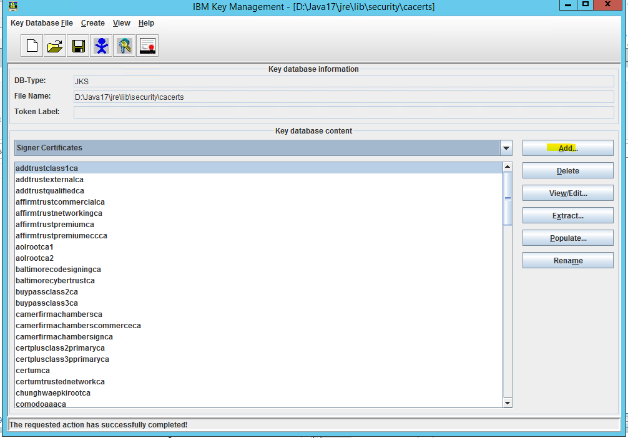
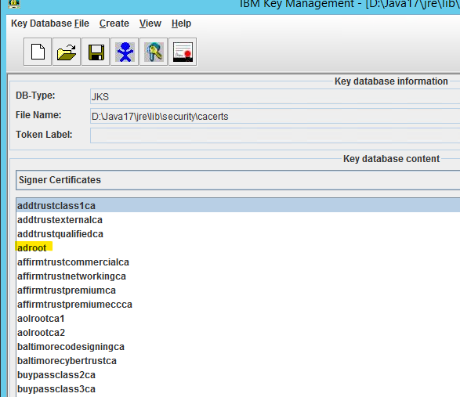
LDAP Cert – OS Java

Slide 10
LDAP Cert – WebSphere Java
Lawson and Landmark
Get WAS_JAVA_HOME
Back up the file(s) WAS_JAVA_HOME/jre/lib/security/cacerts
Add signer certs using keytool command line utility
Get a list of the existing certs and validate using command keytool -list -keystore WAS_JAVA_HOME/lib/security/cacerts -storepass changeit > keytool_list_WS_before.out
Import the new cert using the command keytool -import -file <file path to your .cer file> -alias <meaningful name> -trustcacerts -keystore WAS_JAVA_HOME/jre/lib/security/cacerts -storepass changeit > keytool_import_WS.out
Get the list of the existing certs and validate that the new cert was added using command keytool -list -keystore WAS_JAVA_HOME/jre/lib/security/cacerts -storepass changeit > keytool_list_WS_after.out

Slide 11
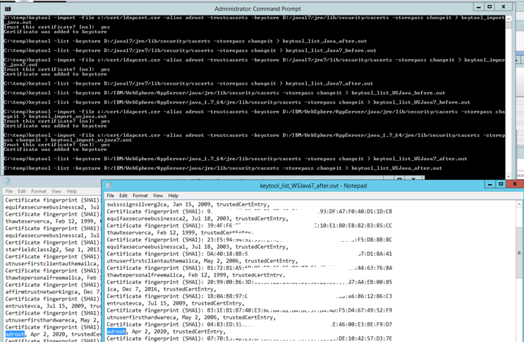
LDAP Cert – WebSphere Java

Slide 12
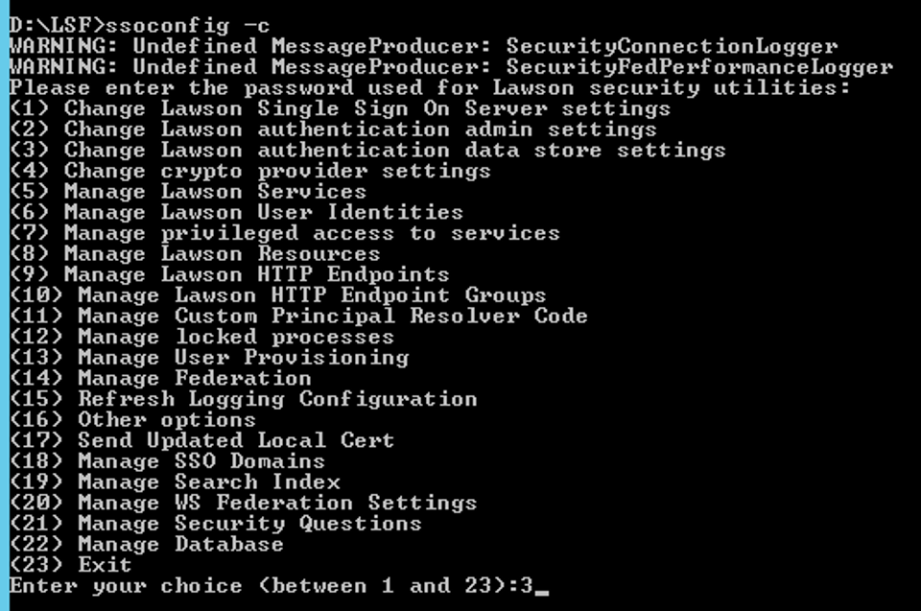
LDAPS Configuration – LSF Only
LSF only
ssoconfig - Update the “Change Lawson authentication data store settings”
Update install.cfg
LDAPPORT
LDAP_PROVIDER_URL
Reboot the LSF server

Slide 13
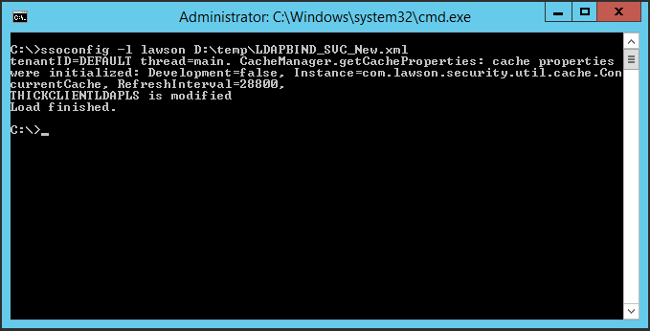
LDAP Bind Service - LSF
ssoconfig
Export your LDAP Bind Service
Update to Override = “true”
Update protocol & port on PROVIDER
ssoconfig –l to update

Slide 14
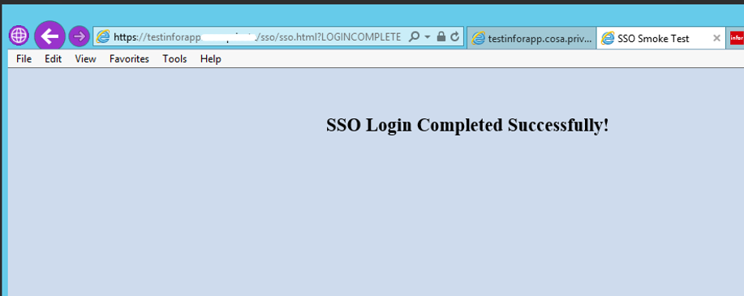
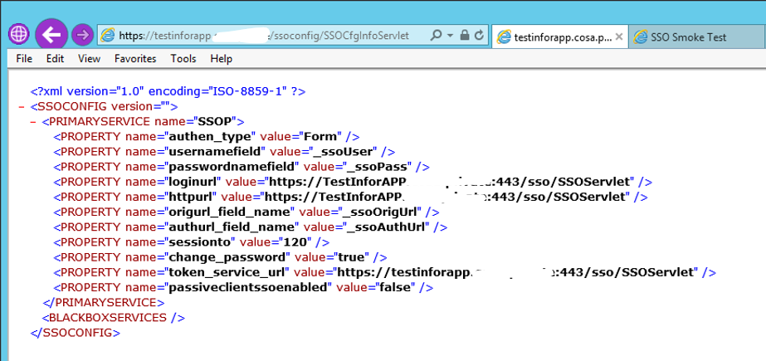
Smoke Test
Smoke Test Lawson Authentication
https://server.company.com/ssoconfig/SSOCfgInfoServlet
https://server.company.com/sso/SSOServlet
Log into Lawson

Slide 15
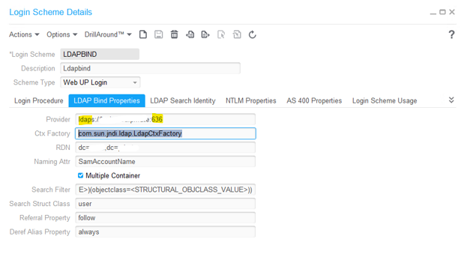
LDAP Bind Service - LMK
Rich Client > Gen
LDAP Bind Login Scheme
Update protocol & port
Restart the Landmark Server
Smoke Test
Log into Rich Client
IPA Smoke Tests
Web Run
System Command
File Access
Lawson Query/Transaction

Slide 16
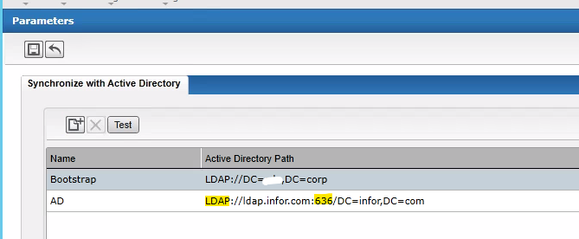
IFS
Need a cert for the AD server in Trusted Root Certificate Store
Update the AD Configuration in IFS > Configure > Parameters

Slide 17
Questions?
desi@nogalis.com
tan@nogalis.com

