Slide 1
API Integration with Infor Process Automation
Tips and tricks for calling APIs from IPA
Desi Houze
Sr. Technical Consultant
Nogalis, Inc

Slide 2
Working with APIs in IPA
Making the calls
Reading Responses
Triggering the flows
Use Cases

Slide 3
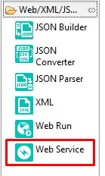
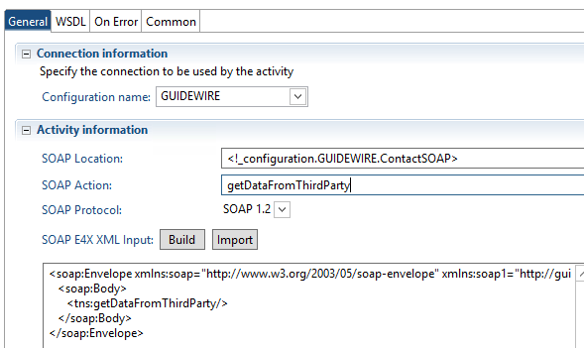
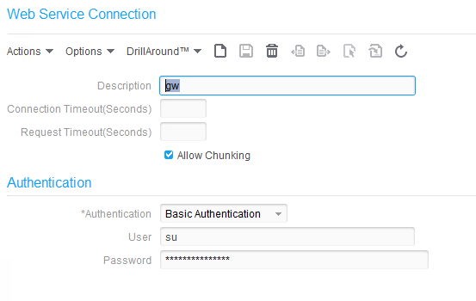
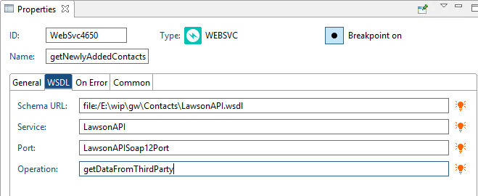
Making the Calls
Web Service Node
Node Properties
Configure

Slide 4
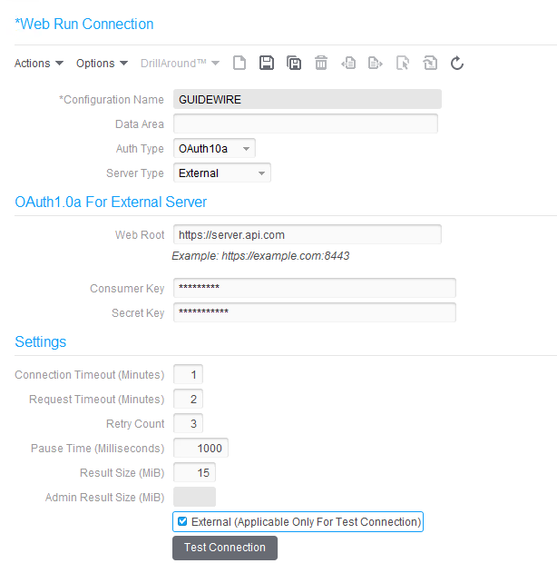
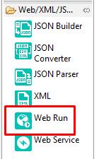
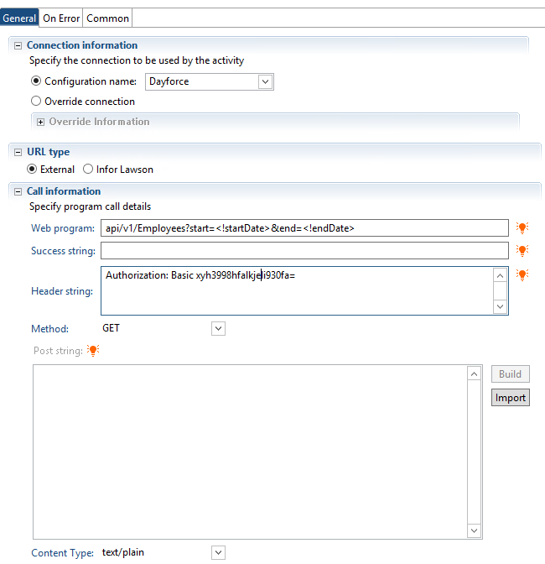
Making the Calls
Web Run Node
Node Properties
Configure

Slide 5
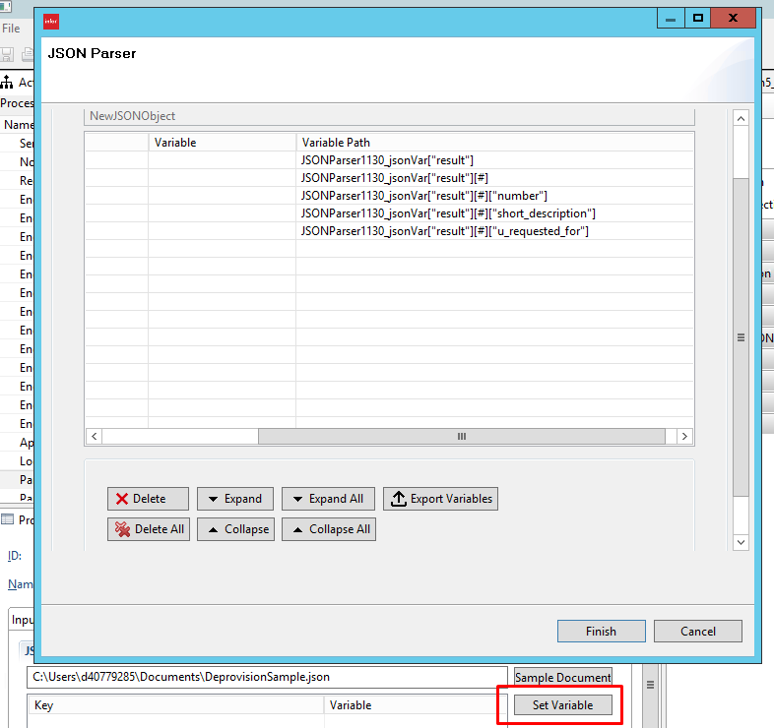
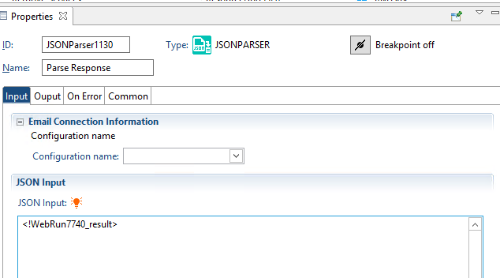
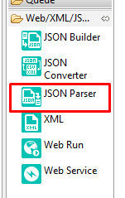
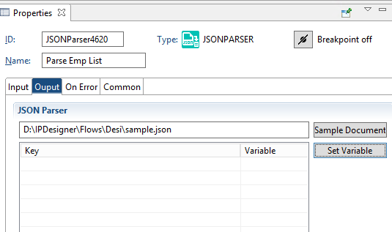
Reading Responses
JSON Parser
Input – Result from Web Run or Web Service
Output <JSONParserID>_jsonVar
“Set Variable” button on Output tab

Slide 6
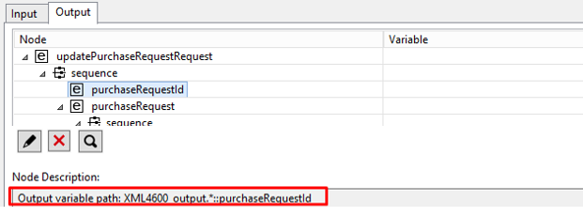
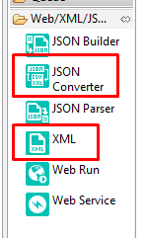
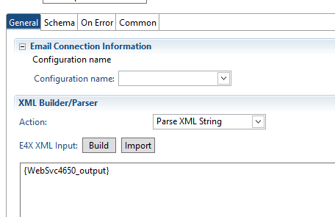
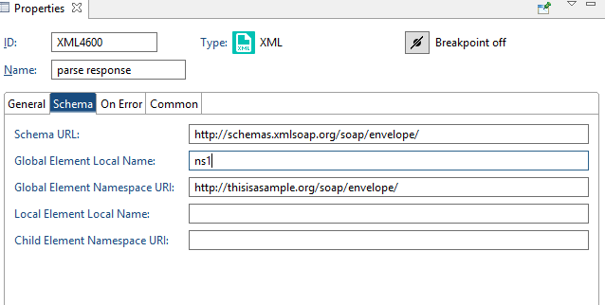
Reading Responses
XML Node
Input – Result from Web Run or Web Service
Output <XMLNodeId>_output
Add Schema
“Build” button on Input tab

Slide 7
Triggering
Real-time for outgoing
Batch processing for incoming
Custom programming on third party system
Trigger File
Create a Work Unit using BPM

Slide 8
Use Case: User Deprovisioning
Service Now API
Reads in Tickets
Updates Tickets
Key Nodes
Web Run GET
JSON Parser
Assignment
Web Run POST

Slide 9
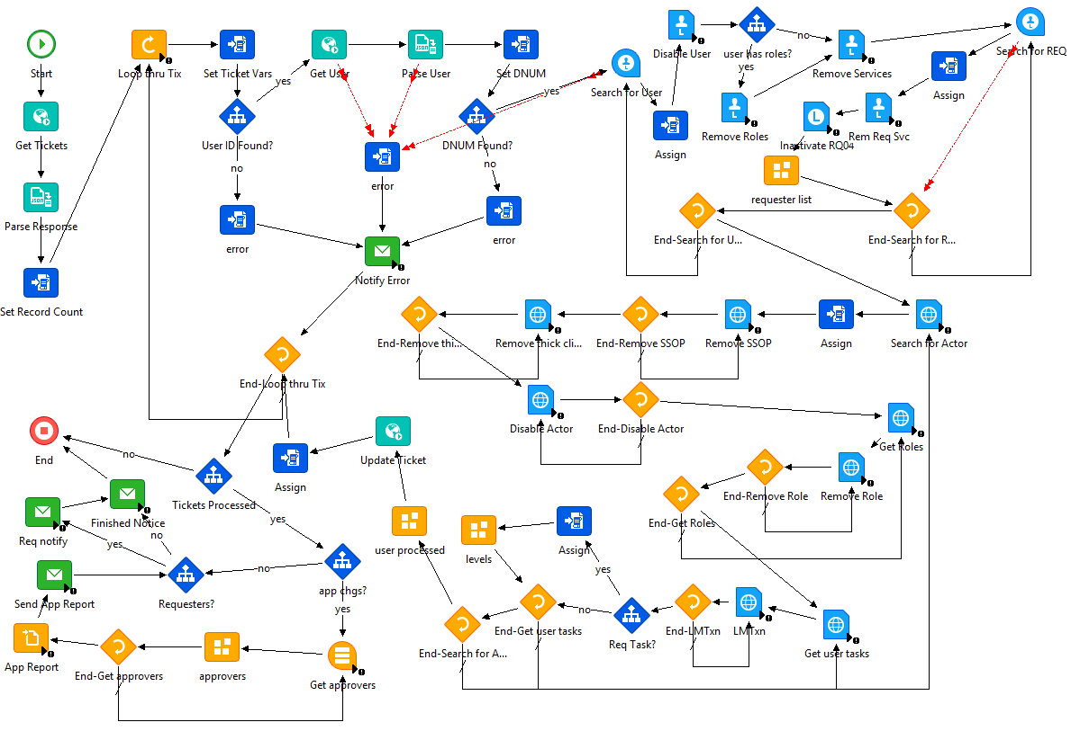

Slide 10
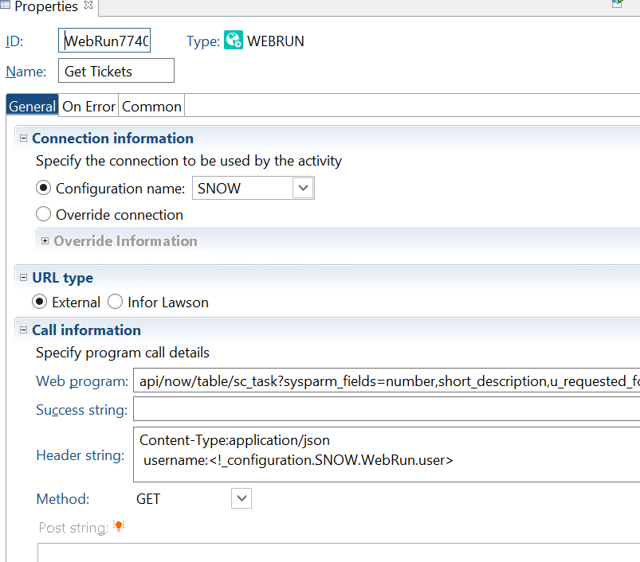

Slide 11
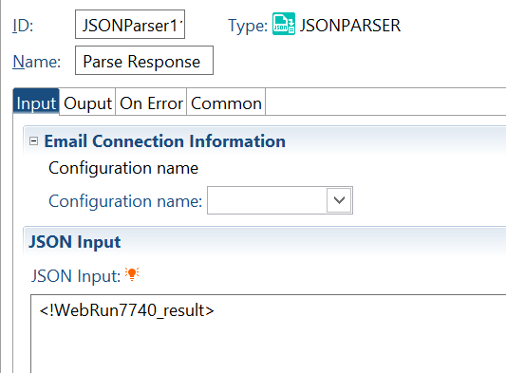

Slide 12
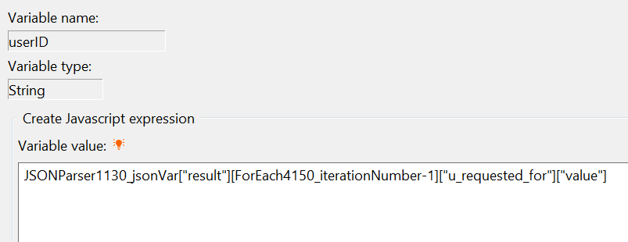

Slide 13
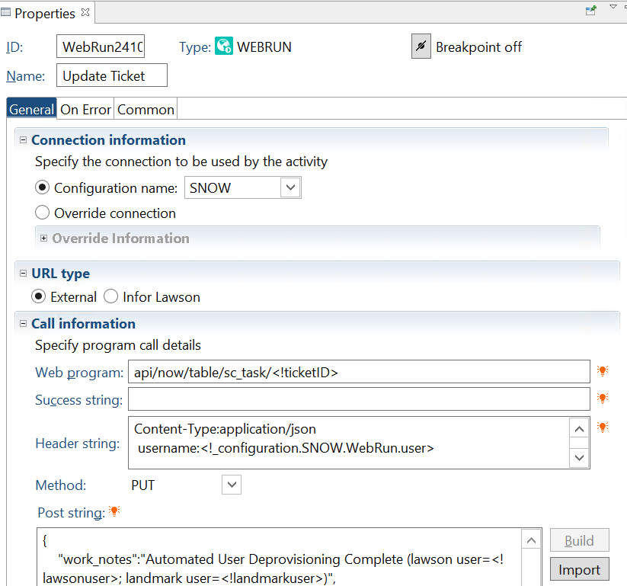

Slide 15
Use Case: Automating AP Tasks
Third-party billing/claims applications
Reads in new vendors
Sends confirmation data
Key Nodes
Web Service SOAP call
XML Node

Slide 16
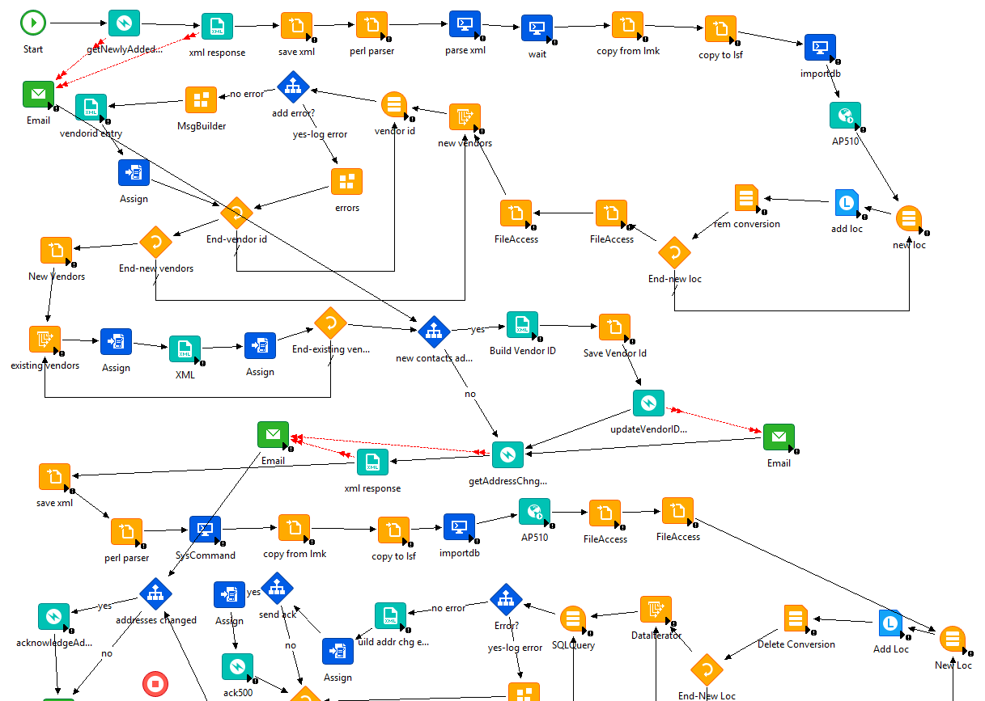

Slide 17
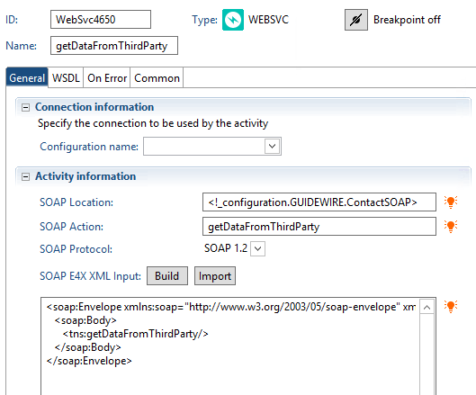

Slide 18
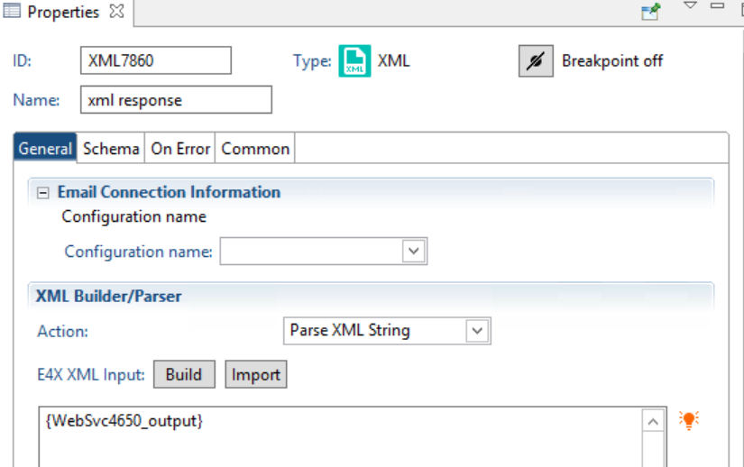

Slide 20
Use Case: HR Automation
Import Employees as vendors
Create flat file for conversion
Key Nodes
Web Run GET
JSON Parser
Assign Node

Slide 21
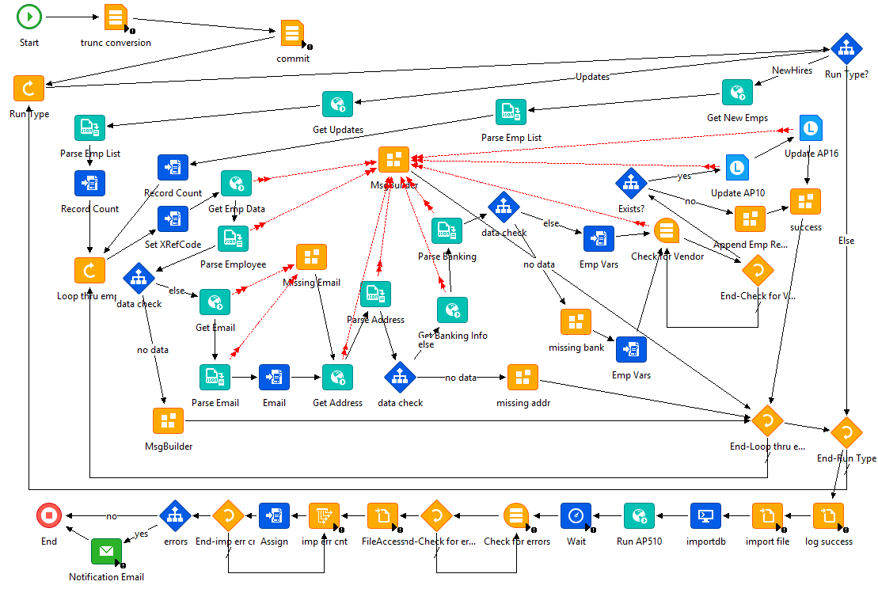

Slide 22
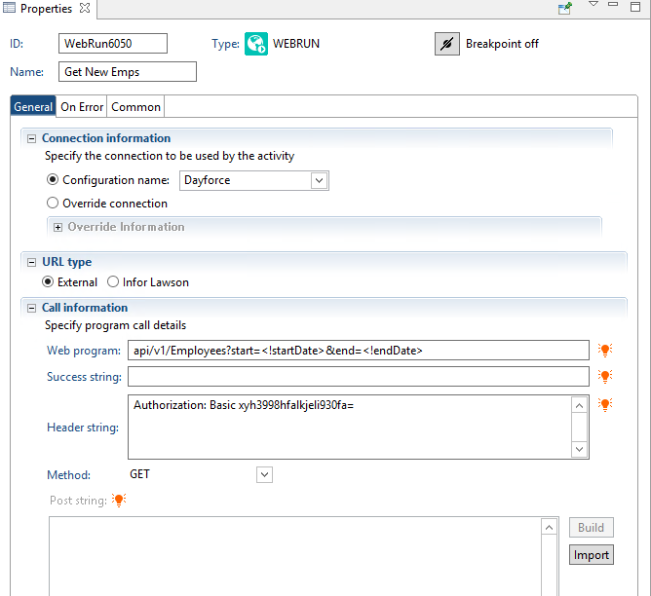

Slide 23
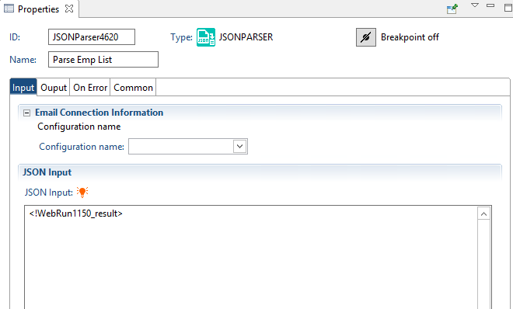

Slide 24
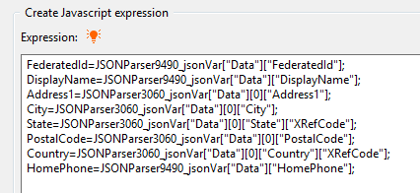

Slide 26
Use Case: Bank Transactions
Bank security more strict
Send purchase requests to bank
Custom program
Key Nodes
XML Node to build the request payload
System Command Node (run the custom program)

Slide 27
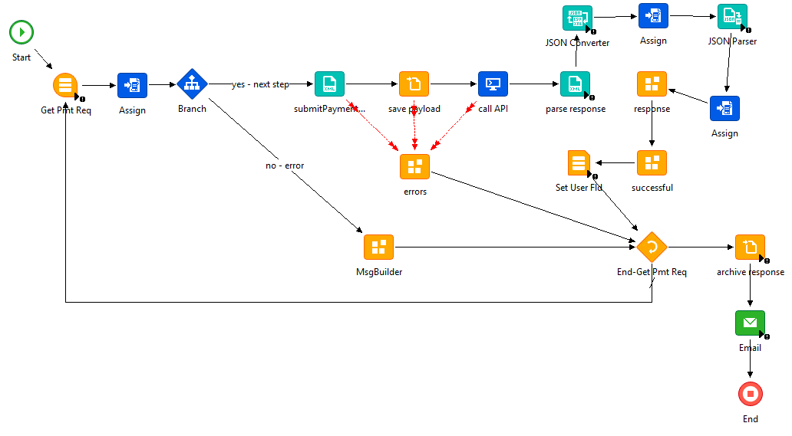

Slide 28
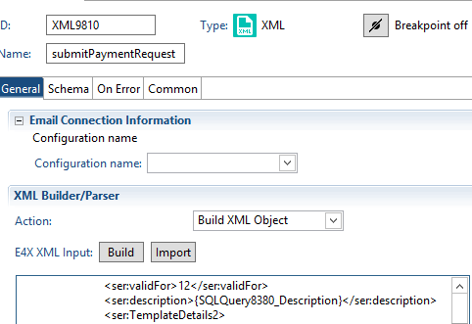

Slide 29
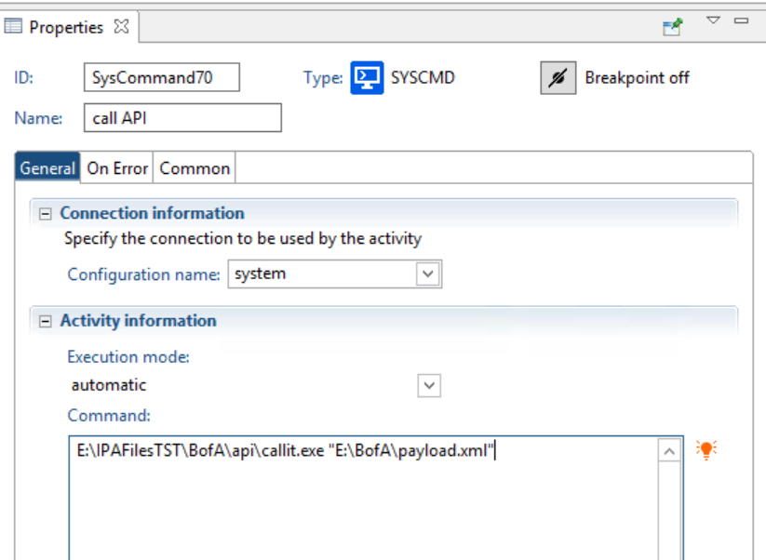

Slide 31
Questions?
desi@nogalis.com
tan@nogalis.com

