Slide 2
Best way to document your interfaces

Slide 3
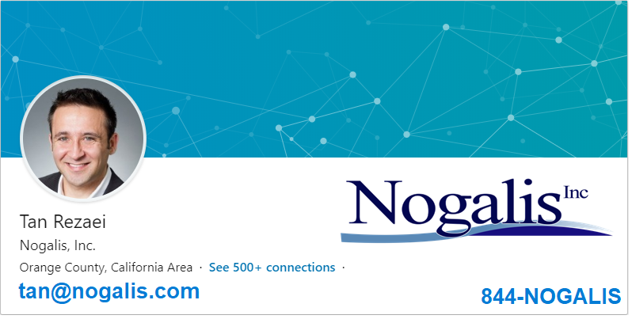

Slide 4
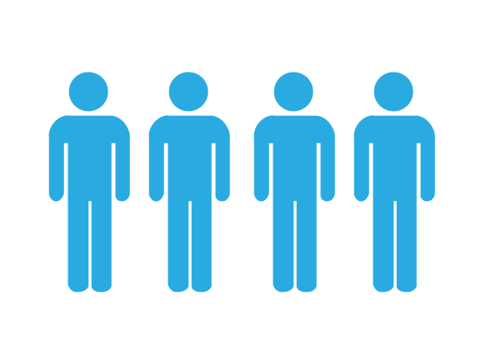
Who is Nogalis
MSP
Products
Infor Focused Products
Managed Service Provider
16
31
6
MSP Clients
Consultants
Leader in cloud migrations

Slide 5
Who we work with
Six of the top ten hospital systems in the US
Three of the largest retail brands in the
Five major restaurant brands
One of the largest staffing firms in the US
One of the largest gaming companies in the US
Several publicly held companies
Over a dozen cities and counties in the US and Canada

Slide 6
What qualifies us to …
Nogalis MSP maintains:
800-900 Custom Interfaces (Mostly IPA)
Over 3000 custom code components (4GL, Java, COBOL…)
Support nearly 1000 core users daily
30 minute SLA on priority 1 tickets
We documented all of it!

Slide 7
What qualifies us to …

Slide 8
What sort of things?
Positive pay interfaces to banks
Invoice import interface
Vendor creation interface
Automated user provisioning
Employee benefits exports and imports
COBRA interface
Batch job automation
Invoice or Purchase Order Approval interfaces
Journal entry imports
And many more

Slide 9
Documentation Goals

Slide 10
What is important
Supporting interfaces to meet SLA
Ease of updates and enhancements
Change Control
Application Upgrades
Training New Hires
One source of truth
Easy to access and maintain
Easily Searchable
Secured access

Slide 11
What is needed
Introduction
General Data Flow
Components
Dependencies
Scheduling And triggers
Recovery
Archiving
Notifications
Troubleshooting
Maintenance
Security
Change Control
Key Contacts
Related Files

Slide 13
Documentation
Service
$70/mo
$150/hr
Per User
Fully hosted
Phone support
Free live training
Average 6-10 hours
Per interface
MSP Clients
FREE UNLIMITED

Slide 14
tan@Nogalis.com
OR
nogalis.com/contact
OR
844-NOGALIS

Slide 15
Q/A?

