Slide 1
Application Maintenance Toolset (AMT) Applying Patches (CTPs)

Slide 2
Established 2003

Slide 3
What’s New 2016
10x
25
142
14
18
Consultants
Clients
Managed Services
10x Upgrades

Slide 4
The leader in Lawson Managed Services

Slide 5
Application Maintenance Toolset (AMT)
A set of utilities that automates installing Lawson application releases:
lawappinstall
Critical Transfer Packages (CTPs)
Maintenance Service Packages (MSPs)
appmetaload
pathcompile
apploadcsv
appmetadiff
metadata dump/load tools
patches_installed_report
source_versions_report

Slide 6
A few obvious points
Apply patches to your Test system first and have users test before considering them for production. Take note of any issues and time required to complete.
Ensure that nightly backup has been successful before patching production
Whenever possible, perform patches outside of business hours
Give yourself ample time to complete the patch in production
Arrange for additional support in case you need it

Slide 7
Getting Ready
Check the job scheduler for any running batch jobs
Ensure no other scheduled jobs are going start during the patching process (rec jobs, IPA jobs, etc..)
Turn security off (optional)
Stop the WebSphere services (optional)
Stop and start the Lawson service (optional)
Check for Java processes on the server

Slide 8
Overview

Slide 9
Download

Slide 10
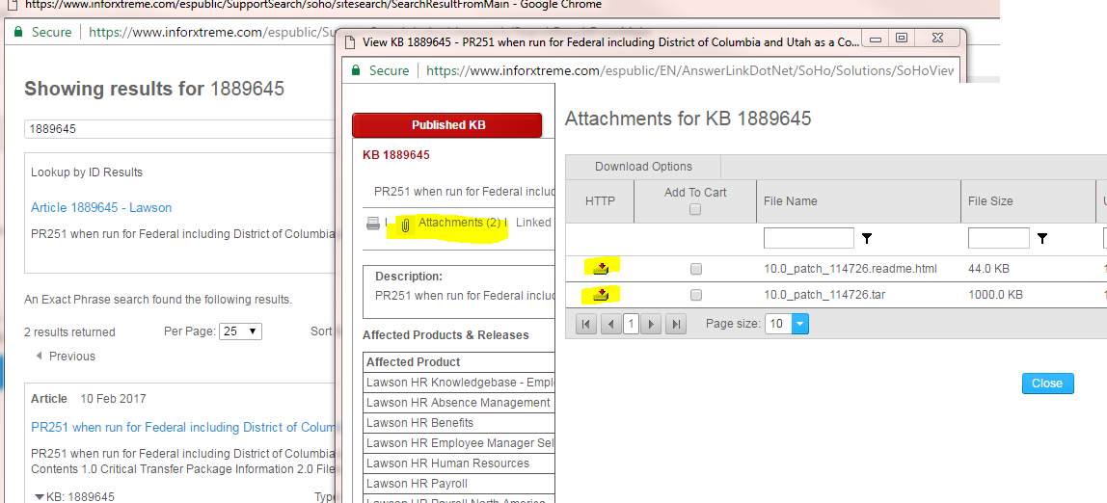
How to find CTPs
Method 1
https://www.inforxtreme.com
Search KB and download

Slide 11
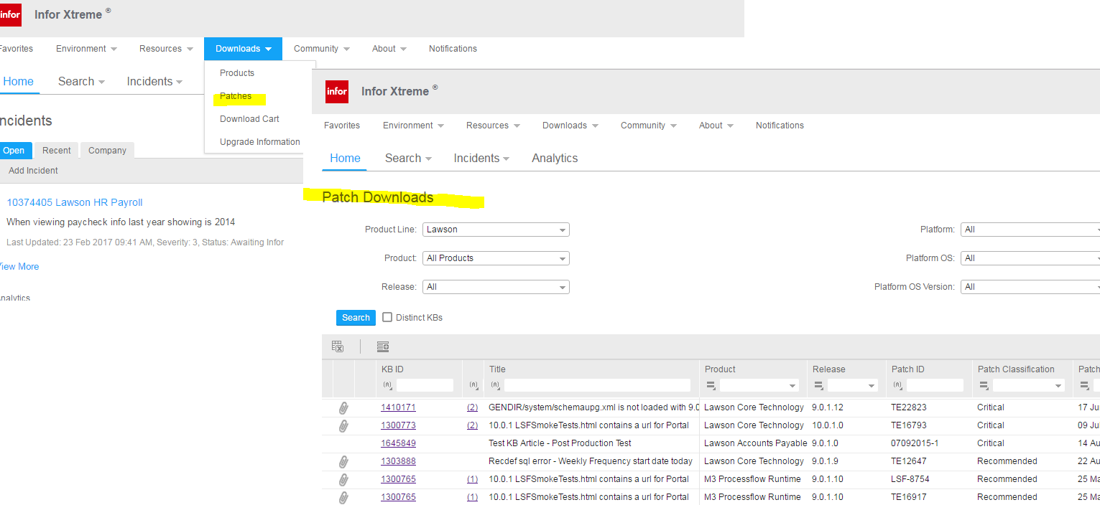
How to find CTPs
Method 2
https://www.inforxtreme.com
Downloads → Patches and search for the patch

Slide 12
Workflow
Note: Directives PREVIEW and VALIDATE, which can be used anytime in the process, were left out of the diagram.

Slide 13
Prep

Slide 14
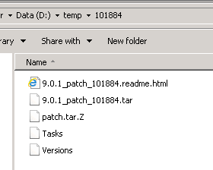
Prep – Extract .tar
Download the CTP to the Lawson Server to be patched:
Place patch in folder and run tar command:
Extracts to:

Slide 15
Applying CTP(s)
Log onto LID as Lawson User (or a user with appropriate security to install patches)
In LID change directories to the patch directory

Slide 16
Preview

Slide 17
PREVIEW
Run the patch install in Preview mode
perl %GENDIR%/bin/lawappinstall preview test
The preview log is located in %LAWDIR%/PRODLINE/Admin
Custom screens in preview.log show up as:
# Patched-Mod: hrsrc/HR11PD
# Patched-Mod: pasrc/PA20WS
Examine/rename preview log for documentation (CTP101884_preview.log)

Slide 18
Update

Slide 19
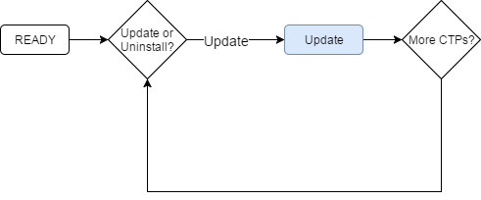
Update Loop
Run the patch install in Update mode perl %gendir%/bin/lawappinstall update test
If applying multiple patches, run Update for each patch before staging
Again, feedback is provided during the patching process. When finished make sure you see completed successfully and review the logs

Slide 20
Activate

Slide 21
Activate
Run the patch install in Activate mode once all updates are completed successfully and you have verified that you are ready to activate the change.
perl %GENDIR%/bin/lawappinstall activate test
Depending on patch(es) you may be asked to
Reorg the database if there are database changes
Recompile affected programs
Recommendations (optional):
Run dbreorg in list mode (with – l flag) in another LID session to verify the changes are what you expect
Double check before activating that the database is not in use
If time is not a factor, it is a good idea to compile the entire productline after major patches rather than just the affected programs (cobcmp)

Slide 22
Compilation Staging
Increases the product line’s availability
Minimize amount of downtime needed to complete the installation and compilation
Provides option to stage compile the affected programs from MSP or CTP
Does not affect your runtime productline objects and can be performed numerous times
Most advantageous with numerous CTPs or an MSP
Runtime objects get created in a staging directory

Slide 23
Stage Workflow
Note: Directives PREVIEW and VALIDATE, which can be used anytime in the process, were left out of the diagram.

Slide 24
Common Issues
If you receive feedback that a program did not compile:
Go to the system code directory of that source file and search for the error file and resolve the error. %LAWDIR%/PRODLINE/xxsrc/*.err (ex: %LAWDIR%/test/PRSCR/*.err)
Check to see if there is custom code that needs to be implemented.
Recompile the program(s)
If the reorg fails due to running processes
Check to make sure WebSphere processes are not running
Check for Java processes
Stop and Start lawson
If reorg fails to copy dictionary
Verify that the reorg is otherwise completed successfully
Copy the + dictionary file to overwrite the active dictionary
Run srgen

Slide 25
Post CTP Application
Preview log is helpful to determine what files were updated during patching in the event that the custom code was overwritten and therefore the source file will need the custom code restored.
If there is custom code, the patching process creates a backup of the source files that will overwritten. Custom Code will be saved there: (%LAWDIR%/PRODLINE/backup/PATCHXXXXX)
Once patching is complete, perform checks in Lawson:
Load a form (i.e. HR11, AP10)
Inquire/Next/Previous
Add and Submit a job (i.e. CU201)
“Drill Around” on a field

Slide 26
Uninstall Patch CTP(s)
In LID, Run command (as lawson):
perl %GENDIR%/bin/lawappinstall uninstall PRODLINE PATCHXXXXXX
(where XXXXX is the patch number. ex: PATCH114726)
Feedback is provided during the uninstall process, when finished make sure you see completed successfully:
Next run the ACTIVATE
Feedback is provided during the patching process, when finished make sure you see completed successfully:
NOTE: If the patch you want to uninstall is not the last patch installed. You will need to uninstall all patches in descending order to get to the patch that needs be uninstalled.
Then reinstall patches following the targeted uninstalled patch.

Slide 27
Available Reports
patches_installed_report
source_versions_report

Slide 28
Available Reports
patches_installed_report
source_versions_report
perl $GENDIR/bin/patches_installed_report <productline>
perl %GENDIR%\bin\patches_installed_report <productline>
perl $GENDIR/bin/source_versions_report <productline>
perl %GENDIR%\bin\source_versions_report <productline>

Slide 29
Upcoming Events
July
10
Inforum 2017 - New York City
www.nogalis.com/education

Slide 30
Q/A
@nogalisinc

