Slide 2
Everything you need to know about implementing AD FS

Slide 3
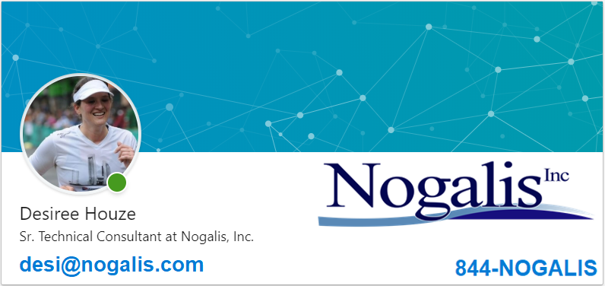

Slide 4
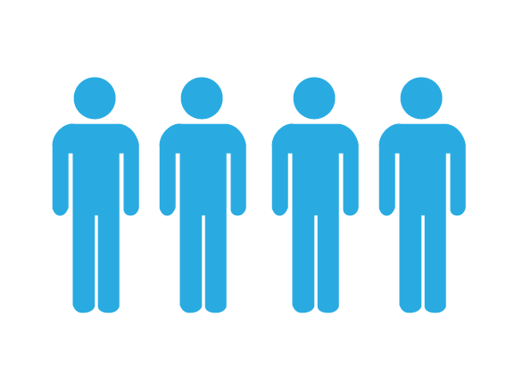
Who is Nogalis
MSP
Products
Infor Focused Products
Managed Service Provider
16
31
6
MSP Clients
Consultants
Leader in cloud migrations

Slide 5
AD FS Implementation
Definitions
Before you begin
Server Specs
SQL Server Databases
Compatibility
SSO Infor applications
IPA to Lawson connections
External Web Server
Update user identities
Tips & Troubleshooting

Slide 6
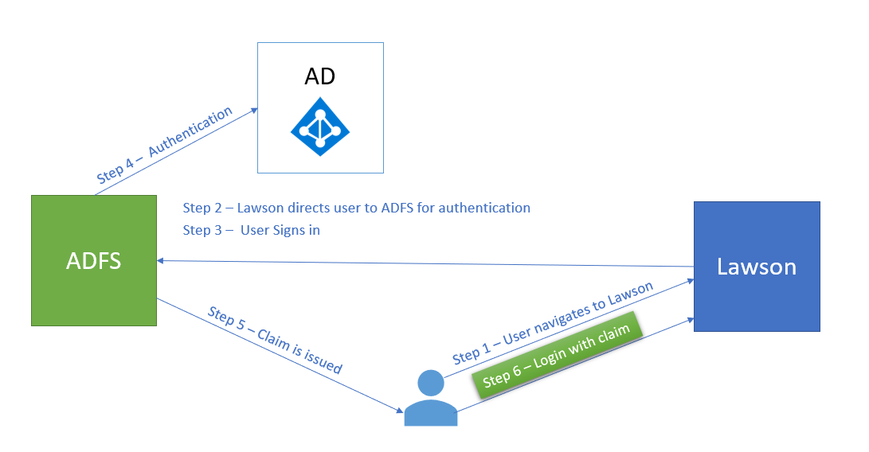
Definitions
Active Directory Federation Services (AD FS)
Infor Federation Services (IFS)
Authentication v Authorization
Relying Party Trust

Slide 7
Before You Begin
Make sure all certs are valid for all applications
PKCS12
Implement SSL for all applications
Get familiar with User Principal Name (UPN)
username@company.com
First.last@company.com
Backout plan
Export ssoconfig services
Back up LDAP
Back up databases
Server Snapshots

Slide 8
Server Specs
Windows Server 2012 (R2)
Domain Controller
AD FS
Lawson applications
12 Gb Memory
2 x 80 Gb drives
Roles & Features
Application Server
.Net 3.5
AD FS

Slide 9
SQL Server Databases
AD FS database
Windows Internal Database
SQL Server Database
Infor Federation Services
Separate named instance

Slide 10
Compatibility
Review Compatibility Matrix
Landmark CU (10.1.1.16+)
Lawson Environment Level (10.0.7+)
SSO Applications
WebSphere 8.5+ (all apps)
Java 7+ (all apps)
DSP
Dependent on LSF security level and SSO application version
Windows

Slide 11
SSO Infor Applications
MSCM, LSO, LBI, etc.
Add user to Lawson Security with UserId = SSOP (UPN)
Login configurations
i.e. Lawson Data Connector for LBI
Port and username

Slide 12
IPA to Lawson Connections
URL – Thick Client Port (usually 1447)
User – UPN
Infor Lawson Connection
File Activity Connection
Web Run Connection
System Command Connection

Slide 13
External Web Server
Lawson authentication redirects to AD FS server
AD FS server externally facing
Create appropriate end points
External certificates
At least a temporary test site

Slide 14
Update User Identities
SSOP identity
Thick Client identity
Add-ins
LSA
Lawson SSO Http client
Landmark
IPA Process
Ssoconfig file upload

Slide 15
Tips & Troubleshooting
Session Timeout
Synchronize AD FS Relying Party Trust timeout with Lawson timeout (ssoconfig option 1)
IFS User Maintenance
Groups, Mass security role assignment
IFS Web Errors
Ports
IFS database port
Thick client port 1447

Slide 16
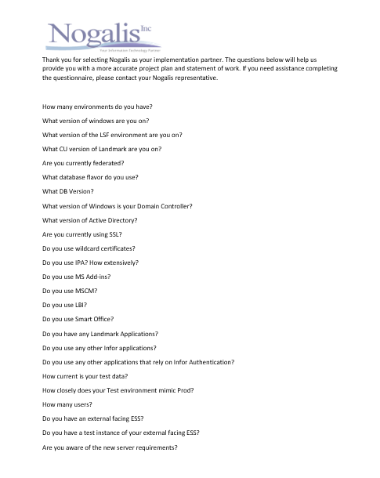
This webinar and all documents will be available for download
Nogalis.com/education
And ..
ADFS Questionnaire

Slide 17
desi@Nogalis.com
OR
nogalis.com/contact
OR
844-NOGALIS

Slide 18
Q/A?

