Slide 1
Automating AP and Fraud Prevention
Jeff Crain
Sr. Technologist
Ascend Software
Larry Robinett
Vice President, Business Development
Ascend Software
This document contains confidential proprietary information that is not to be disclosed to any unauthorized person without prior written consent of Ascend Software, Inc.

Slide 2
Agenda
Introductions
Why Automate AP
How to Automate AP
What does Automated AP Look Like? – Live Demonstration
Why Fraud Prevention
How to Prevent Fraud
What Does Automated Fraud Prevention Look Like – Demonstration
Questions and Answers

Slide 3
Why AP Automation
Path to paperless
Automate manual processes and leverage ERP data
Reduce costs
Visibility and ERP document access
Accommodate growth without adding headcount
Shared services

Slide 4
Why AP Automation cont.
Take advantage of vendor discounts
Ensure internal processes and procedures are followed
Reduce late payments
Leverage ERP data for reduced errors
Auditability

Slide 6
Impact of Invoice Automation cont.

Slide 7
Considerations When Automating Accounts Payable
Examine current processes and identify areas of improvement, goals and metrics
Organization types of invoices
PO, non-PO, employee expense, EDI
Internal Scanning and/or Imaging as a Service (IaaS)
Centralize vs. decentralized

Slide 8
Considerations When Automating Accounts Payable cont.
Invoice Indexing Options
Key from image
Template
Advanced OCR
Types of ERP Integration points
Batch and Real-time
Image Retrieval
Other considerations
Other manual paper-based processes
On premise vs. cloud or SaaS

Slide 9
Cost Savings Analysis
 | Electronic Access & Search Time Saving:
 | Conservative Daily Time Savings: |  |  |  |  | 5 | min per user
 | - Instant on-line availability
 | - Research & Audits
 | - Electronic Smart Folders
 | - Reduces need for new staff |  |  |  |  | = | $40,000.00
 | Real-Time Lawson Integration |  |  |  |  | = | $48,400.00
 | Manual invoice appr routing: |  |  | 3 | minutes | = | $72,000.00
 | Analytical OCR Data entry reduced |  |  |  |  | = | $60,000.00
 | AP reduce copying cost |  |  |  |  | = | $0.00
 | Prevent lost documents |  |  |  |  | = | $15,000.00
 | Reduction in errors & costs |  |  |  |  | = | $8,400.00
 | Reduction in M/E Accruals |  |  |  |  | = | $1,080.00
 | AP reduced filing cost |  |  |  |  | = | $10,000.00
 | Reduced storage cost (based on sq ft) |  |  |  |  | = | $0.00
 | Decrease on-going training |  |  |  |  | = | $3,144.00
 | AP Vendor payment notification |  |  |  |  | = | $19,200.00
 | Reduction lost discounts |  |  |  |  | = | $3,750.00
 | Annual late payment fees |  |  |  |  | = | $0.00
 | Report Distr & reduced printing |  |  |  |  | = | $0.00
 | Off-site storage cost |  |  |  |  | = | $0.00
 | Reduce Mailing cost |  |  |  |  | = | $0.00
 |  |  |  |  | Annual Savings |  | $280,974.00
 | ROI for 100 users and 10,000 invoices per month

Slide 10
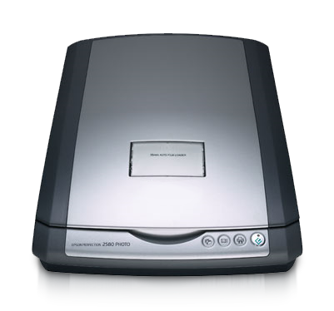
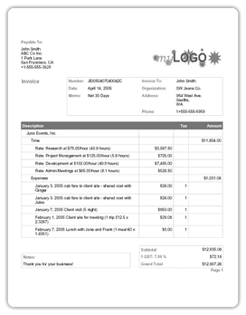
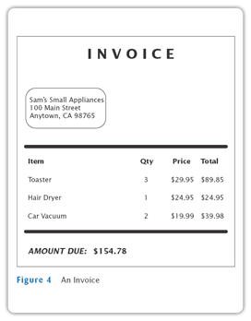

Slide 11
Fraud Prevention
This document contains confidential proprietary information that is not to be disclosed to any unauthorized person without prior written consent of Ascend Software, Inc.

Slide 12
Why Fraud Prevention
“Employee fraud costs the average organization 5% of revenue”
John Warren
VP & General Counsel
ACFE
This can make the difference between many organizations being profitable or not. Average healthcare, retail, and many other organizations have less than a 5% profit margin.

Slide 13
Why Fraud Prevention cont.
ACFE Fraud Facts & Profile of Fraudsters:
Majority are employed longer than 5 years and 25% longer than 10 years
A company is twice as likely to discover fraud by accident than by an external audit
80% of the fraudsters are first time offenders and most have a bachelors degree or higher. The more education they have, the higher the median loss.
55% are between the age of 31 and 45

Slide 14
Why Fraud Prevention cont.
ACFE Fraud Facts & Financial Loss
The median loss from employee fraud is $140,000 per case
36% - 42% there were more than one person involved fraud and in these cases the average financial loss is about $250,000
One case in five represents a loss over $1,000,000
Lack of control was the primary weakness that fraud occurred in 35% of the cases
20% were able to override controls and commit fraud
18 months is the average time it takes to detect fraud
About half the cases are prosecuted and the acquittal rate is only about 1.5%. The number one reason for not pursuing fraudsters is fear of bad publicity
Most companies are unable to recover their losses

Slide 15
How Companies Prevent Fraud
Protecting Your Organization & Fiduciary Responsibility
¨ Educate employees as to the impact on the organization and areas they can identify with
¨ Provide an anonymous employee hotline to report fraudulent activity
¨ Limit ability to add new vendors and require an approval process
¨ Don’t circumvent procedures, such as rushing approvals without going through the proper channels
¨ Verify proper separation of duties are in place and enforced. For example, the AP department should not have the authority to create purchase orders
¨ Secure check stock
¨ Utilize auditors
¨ Ensure passwords expire after a designated period of time

Slide 16
How Companies Prevent Fraud
"Having computer systems in place that flag unusual transactions can reduce losses by 60 percent ….”
John Warren
VP & General Counsel
ACFE

Slide 17
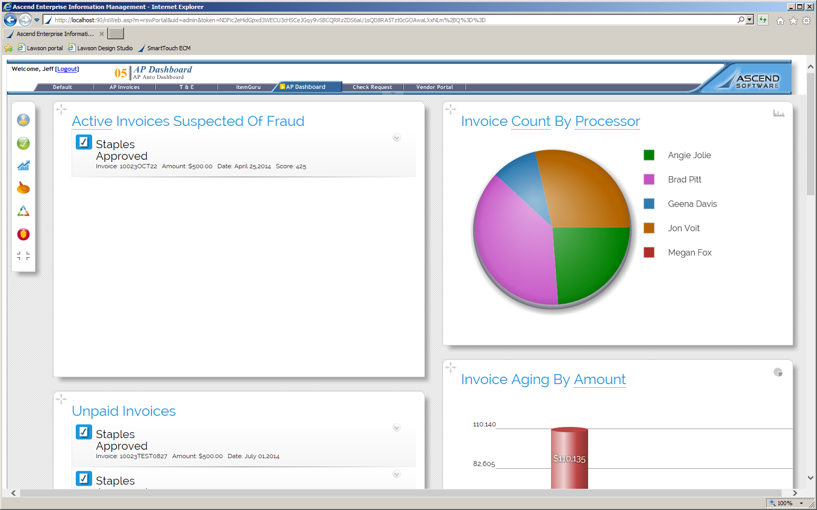
Potential Fraudulent Transactions Management Dashboard

Slide 18
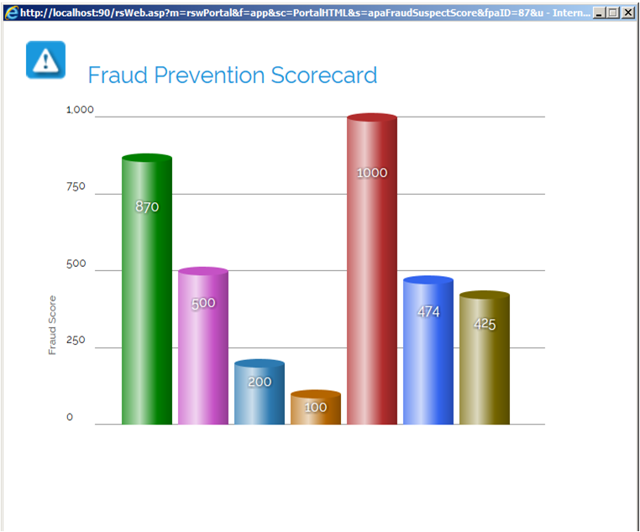
Potential Fraudulent Transactions Management Dashboard

Slide 19
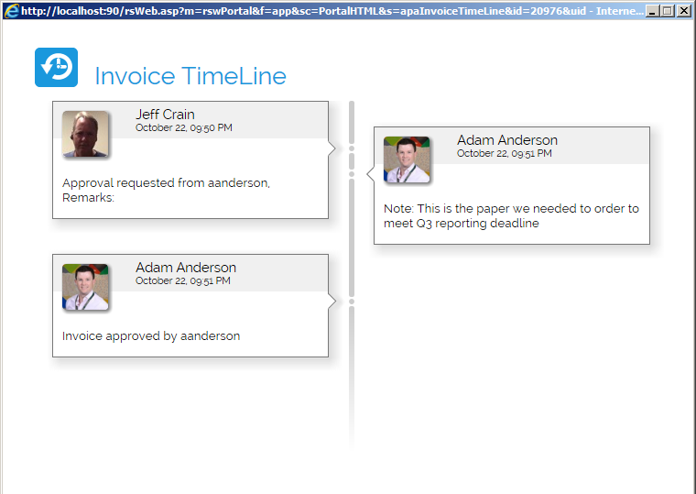
Potential Fraudulent Transactions Management Dashboard

Slide 20
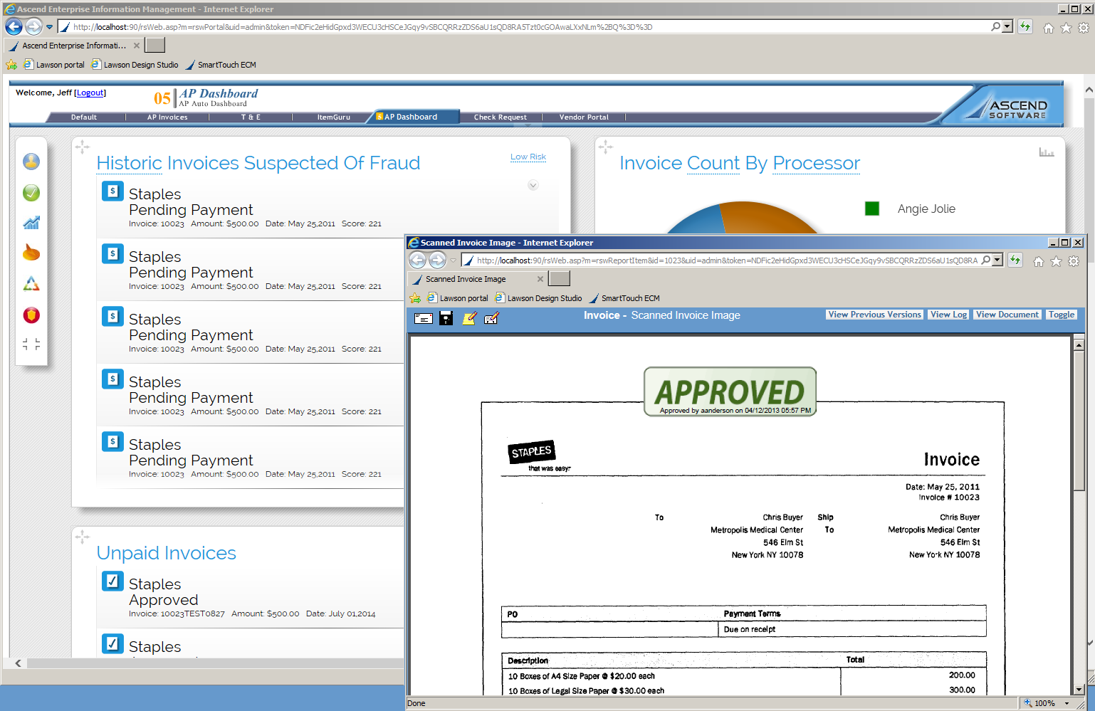
Potential Fraudulent Transactions Management Dashboard
Notes:
In a paperless environment all documentation is available to personnel reviewing flagged transactions prior to payment. This is where having a paperless environment can greatly assist in timely fraud prevention.
Only after a flagged transaction has been reviewed can it be released for payment.

Slide 21
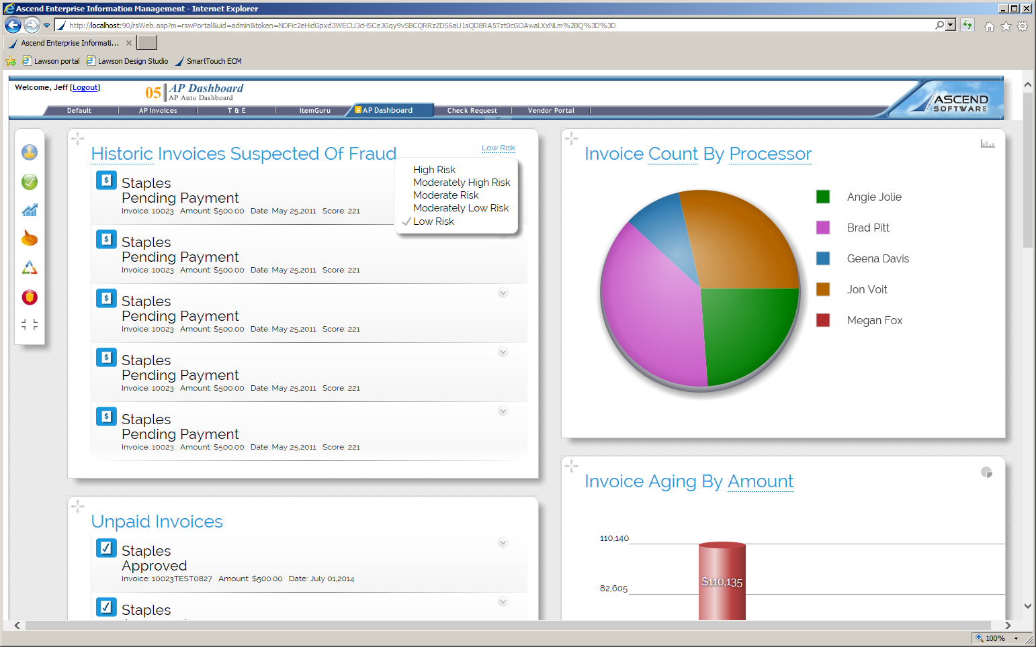
Potential Fraudulent Transactions Management Dashboard
Notes:
In addition to day forward fraud identification, computerized solutions can look at all historical data vs an audit sampling. It’s like having unlimited audit resources without the overhead.

Slide 22
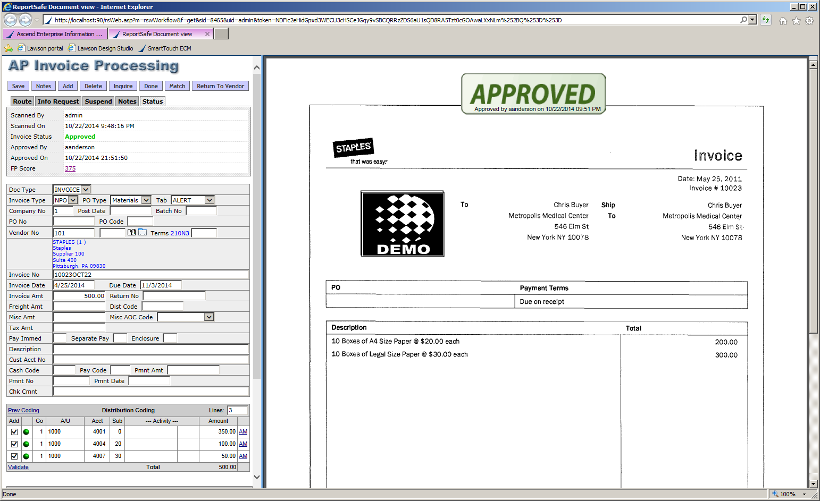
Potential Fraudulent Transactions Management Dashboard
Notes:
In conclusion, fraud prevention is a serious issue that most companies quote frankly do not have the resources to effectively fight, and even if they do identify fraud, is almost always too late.
I hope this brief overview of fraud prevention has been informative
Tan, can we open up for questions and answers?

Slide 23
Upcoming Events
Mar
12
Intro to Lawson for total beginners
Mar
26
UpgradeX and Infor Lawson in the Cloud
Apr
8-9
West Coast Mega User Conference
5 things you need to know before you move to the cloud
9 Performance enhancers for your Lawson Environment
www.nogalis.com/education

Slide 24
Questions?
For more information please contact us
Larry Robinett : lrobinett@ascendsoftware.com
Tan Rezaei: tan@nogalis.com
This document contains confidential proprietary information that is not to be disclosed to any unauthorized person without prior written consent of Ascend Software, Inc.
Notes:
There will be a survey after the webinar, we would really appreciate any feedback.
Thank you for attending.

