Slide 1
Advanced Lawson SQL
The Secrets of SQL Genius

Slide 2
Your Database Flavor
Oracle
Microsoft SQL Server
IBM DB2
Other?

Slide 3
What is covered
Overview of Databases
Introduction to SQL
Introduction to Select statements
Examples (Grouping, Sorting …)
Tools and getting started

Slide 4
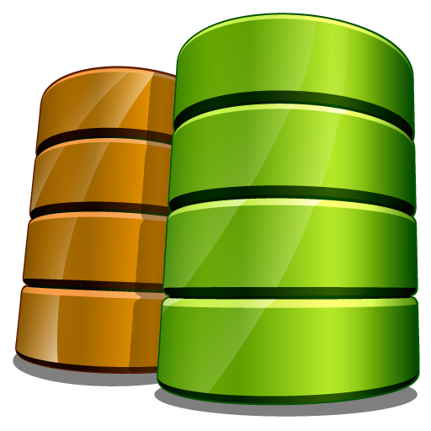
All the Lawson DBs
Application Productline (Prod)
Logan
Gen
FS
RS
SC
SN
MSCM
TF80
Cubes
DataWarehouse …

Slide 5
The Problem
Lawson Has Several Databases
Each database has several hundred tables
The Table names do not necessarily make sense
The constraints (relationships and indexes) are not applied to the database itself which makes it hard to reverse engineer them
There is no easy to reference documentation telling you where to get the data

Slide 6
Making it a bit easier
There are several tools that can make the perocess of retrieving data out of Lawson much easier.
dbdef – The database definition utility
Index definition
Relationship Definition
dbdoc – Database documentation
dburf – Program documentation
Lawson Portal debug mode – Alt+ctrl+A
Portal Field Help – Shift + Ctrl + O
rngdbdump – Range Database Dump
count utility – Database Counts by Productline
Management Studio

Slide 7
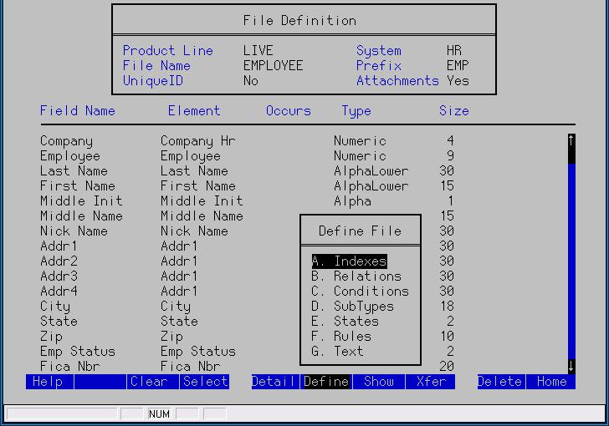
dbdef
Great way to explore the tables and discover their relationships

Slide 8
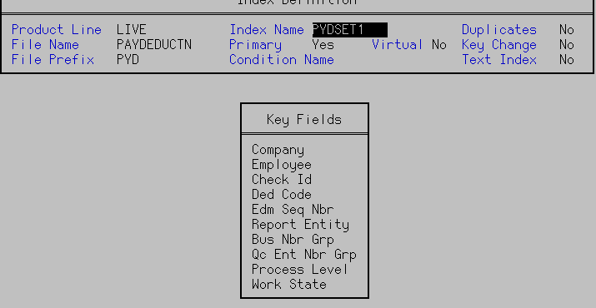
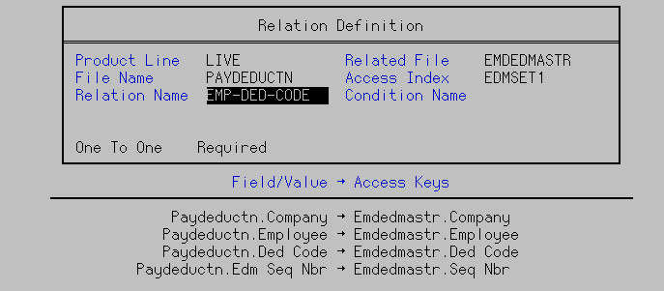
dbdef

Slide 9
dbdef

Slide 10
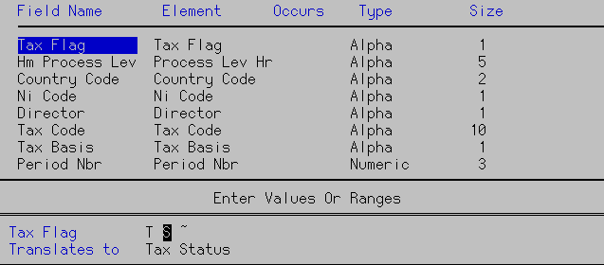
Value list

Slide 11
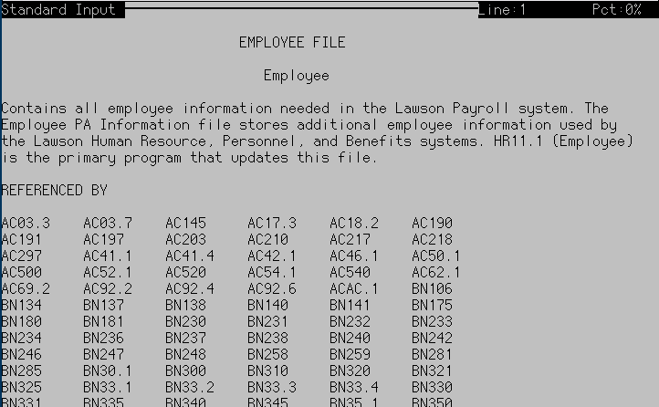
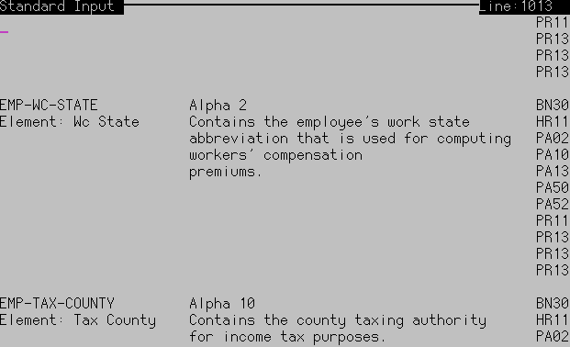
dbdoc

Slide 12
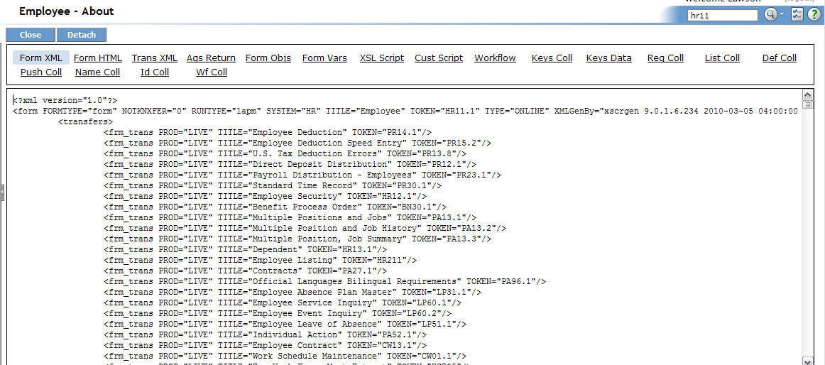
Portal Tricks
Debug Mode: Alt+Ctrl+A

Slide 13
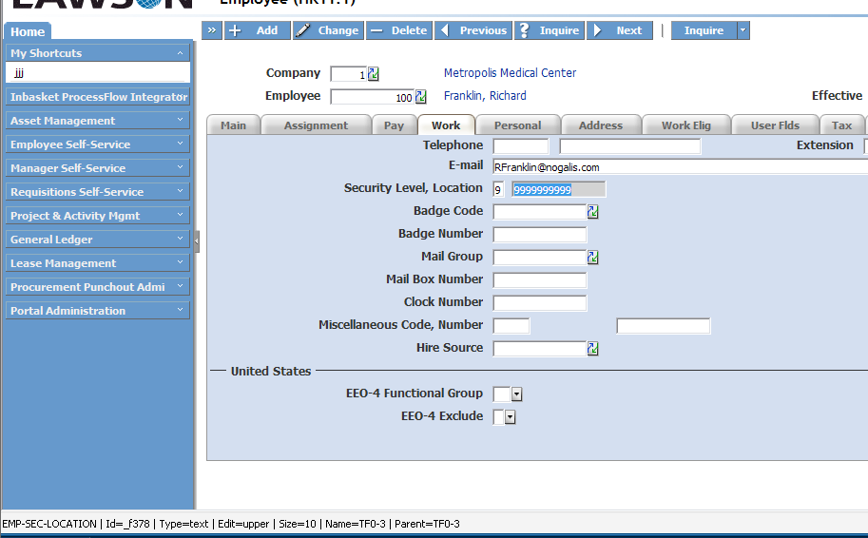
Portal Tricks
Field Help: Shift+Ctrl+O

Slide 14
rngdbdump
rngdbdump -c live employee -f FIRST-NAME LAST-NAME PROCESS-LEVEL -v EMP-STATUS=AG
Output:
"Florance","Edwards","20"
"Julius","Jamison","20"
"Alexia","Vali","20"
3 Records

Slide 15
Count utility
Count prod

Slide 16
What You Need
A SQL Client (SQL Server Management Studio, Toad, WinSQL )
Connection information
Server Address (IP Address or Server Name)
Port Number
Username and Password
User credentials (User needs at least “Select” rights)

Slide 17
So why sql?
Here are some examples of what using SQL can enable you to do:
Adhoc reporting
Database clean up
Finding duplicates in tables
Finding orphaned records
Hacking GEN
Reports and Jobs
Users
Fixing and understanding bookmark issues
Manipulating LBI data
Updating tables with missing information (not recommended unless you know exactly what you’re doing)

Slide 18
Examples

Slide 19
Next Event
10x Upgrade Bootcamp
The one day event that will ensure a successful upgrade
Jun
18
www.nogalis.com/education

Slide 20
Q/A
@nogalisinc

