Slide 1
Lawson Security
The basics to get you started

Slide 2
Are you on Lawson Security?

Slide 3
What is covered
Overview of security past and present
Introduction to components and terminology
Introduction to the tools and menus
A few simple tasks that you’re likely to perform
Implementation methodology
Troubleshooting

Slide 4
LAUA Security
User
Security Class
Secured Objects
HR00
PR12
HR01
PR13
HR04
PR51
HRGENCLASS
HR07
PR52
HR09
PR67
HR10
PR68
HR11
HR12
PA52
PA100

Slide 5
LSF Security
User
Security Roles
Security Classes
HRSETUPCLASS
HR00
HR01
HR04
HR07
PRACCESSCLASS
PR12
PR13
PR51
PR52
PR67
PR68
HRGENROLE
HREMPCLASS
HR10
HR09
HR11
HR12
….
PRADROLE
PAACTCLASS
DATAACCESS
PA52
PA100

Slide 6
The Hierarchy (in one profile)
User has many
Roles have many
Security Classes have many
Rules

Slide 7
What can you secure?
Online: Online Screens (e.g. HR11, PR13, GL00, PO20…)
Batch: Batch programs (e.g. PA100, HR211, PR198, GL190…)
Files: Database Tables
Elements … Not in this presentation
Element Groups… Not in this presentation
Data Source: The Productline
Securable Type
Form
Program
Table

Slide 8
Rule?
Grant All Access
Deny Any Access
Unconditional Access to Action
Conditional Rule Access

Slide 9
The Tools
Security Administrator
Manage Security Profiles
Add/Edit Security classes
Add/Edit Security rules
Assign classes to roles
Manage user profiles
Run security reports
Manage security settings
RM Administrator
Add/Edit Groups
Add/Edit Roles

Slide 10
How to log in
For either the Security Administrator or RM Administrator
Server: Same sever as your Portal URL (you don’t need to type in the “Http://”
User: Has to be a security administrator (there are other user types but for now …)
Password: Same password as used on Portal

Slide 11
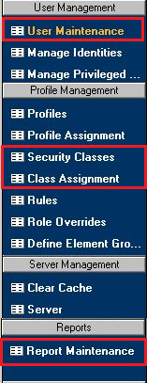
Menus
Add/Edit Users
Add Roles to users
Manage identities
Add users to groups
Add/Edit security Classes
Assign a Class to A Role
Create an run reports

Slide 12
Simple Task 1: Add a role to a user
Log into the Security Administrator
Select “User Management” section on left side bar
Click on “User Maintenance”. Opens new window.
Search for the user name by last name.
HINT: You can use wildcards. e.g. Rez* will bring back Rezaei
Right-click the row and select “Edit RM Information”
With the “Role” row highlighted, click on the button to the right
“Skip to End”; “Back”; Check “Description”; Next
Select Desired role and click the > button
Click Finish
Close the “Change RM Object” window
Acknowledge saving the record
Viola

Slide 13
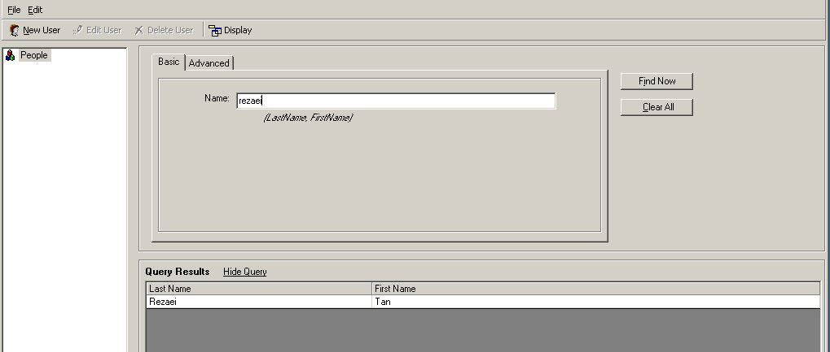
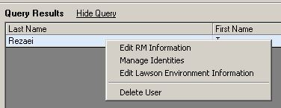
User Search/Edit
Right Click

Slide 14
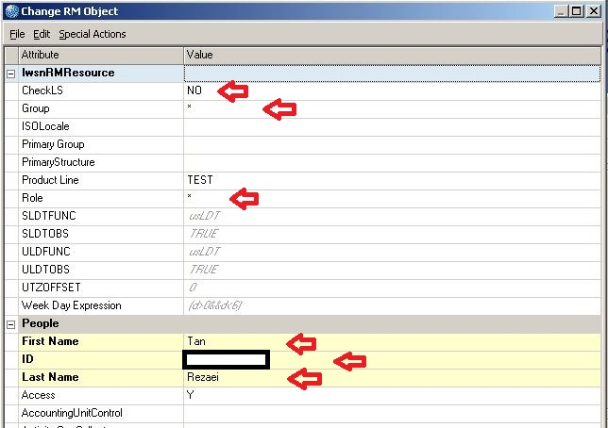
RM Record
Should be set to Yes

Slide 15
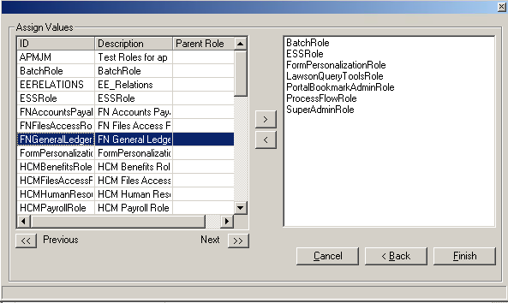
Assigning Roles

Slide 16
Assigning Roles

Slide 17
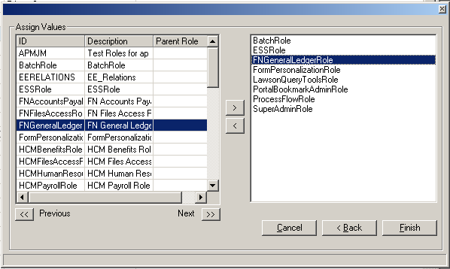
Assigning Roles

Slide 18
Simple Task 2: Grant Access to online Screen
Log into the Security Administrator
Double Click the Profile ID your classes reside in (PRD)
Double Click the Security Class to add access to
Click the “Add Rule” button
Select the securable type. Example: “Online”
Expand the system code your securable object is under. Example “IF”
Check the object you want to grant access to. Example: CU01
Select “Grant All Access” on the right and click Apply
Expand the screen name and select the token you want to grant access to. Example CU01.1
Select “Grant All Access” on the right and click “Apply”
Viola: As long as you have access to the system code (Example “IF”) and the DataSource (Example “PROD”).

Slide 19
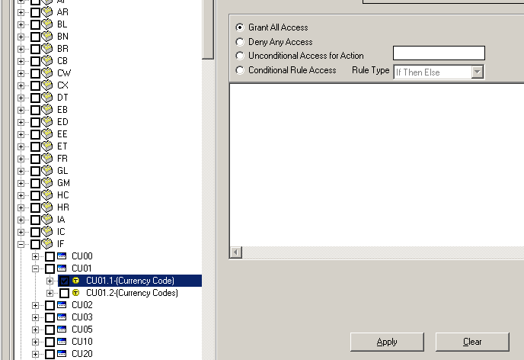
Granting Access to CU01.1

Slide 20
Did you catch that?
To grant access to a securable object like a screen, a batch job, or a database table, you need to grant access to the productline and the system code it resides in.
In order to grant access to a specific screen token (like HR11.1). You also need to grant access to the screen (HR11). The fields and tabs in the token are automatically granted unless you deny them specifically.

Slide 21
Simple Task 3: Grant Access Prod
Log into the Security Administrator
Double Click the Profile ID your classes reside in (PRD)
Click “Add” (to add a new Security Class)
Name your security class (e.g. “ProdAccess”), add a description and click ADD
Click “Refresh” scroll double click your new class.
Add Rule
Select “Data Sources” from securable type
Select “Prod”; on the right select “Grant All Access”
Click Apply
Viola
Notes:
Skip this

Slide 22
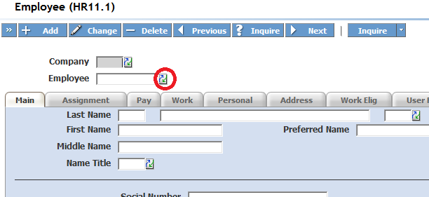
Drop downs and Drills
Must grant access to the tables the select or drill draws data from.
Table information can be found in the <system code>.or and <System Code>.sr files in $LAWDIR/Productline/??src

Slide 23
Couple of other things
LSF Security is grant based. If in any of assigned classes access is granted then the user has access. EVEN IF it’s explicitly denied in another one of the user’s classes.
You can write conditional rules based on lots of things. Here are some examples:
Data Elements: Company, Process_level, Department, Job_Code
Screen Fields
User Profile information
Date/Time
Structures
Elements / Element Groups
Identities

Slide 24
Implementation
50% Planning
30% Development
20% Testing

Slide 25
Methodology
Come up with a good naming convention for roles and classes before you do anything else. These should make sense at a glance and be easy to classify and sorting them should also group them.
Start with Roles in the company
Determine Tasks each role needs to perform (These will be your security classes)
Determine what each task is composed of (These will be your rules)
Assign classes to roles
Assign roles to users
Do one user group at a time, not all at once

Slide 26
Troubleshooting
If all else fails in your troubleshooting make sure to:
Perform an IOSCacheRefresh
Clear all your browsing history and restart the browser
Remove all other roles but the one you’re testing from the user
Run a security report
Check security log files in $LAWDIR/system/
Clear Security Cache under the Server Management section of the security administrator
Reduce the “CACHING_INTERVAL” under the server settings in the Server Management section of the security administrator
Try it in LID
Take a break

Slide 27
Next Webinar
Microsoft Add-ins
Simple queries and data loads.
July
25
www.nogalis.com/education.html

Slide 28
Q/A
@nogalisinc

