Slide 1
Lawson Add-Ins
The basics and troubleshooting tips

Slide 2
What is covered
Introduction to Lawson Add-Ins for Microsoft Office
Architecture
Risks
Navigation and logging in to the Addins
Query wizard
Inquiries
Uploads
Advanced tools
Troubleshooting

Slide 3
Introduction to “Addins”
What are they?
Wizards that integrate Lawson with MS Office
S3 Query Wizard – Database (API used is the DME/Data service call)
Query the Lawson database for “ad hoc” Excel reports
Reports may include drill-around functionality (IDA/Drill service)
Mail Merge in MS Word
S3 Query Wizard – Application (AGS/Transaction service)
Move S3 data from a form into an Excel spreadsheet
Query the S3 application with form function Inquire
S3 Upload Wizard (AGS/Transaction service)
Move data from an Excel spreadsheet into an S3 form
Uses Form logic (eg., HR11, AP20 forms)
Perform form functions Add, Change, Delete
S3 Drill and S3 Map Drill Around (IDA/Drill service)
Landmark Query Wizard
Landmark Upload Wizard
Governed by your Lawson security model (ie., LAUA, LS9. Landmark)

Slide 4
Architecture
(Highly) abbreviated architecture, Upload Wizard
Addins
User runs upload wizard in Addins
Lawson Security
Lawson security authenticates user and determines authorization
Lawson Business Logic (4GL)
- The backoffice form validates, sends the request to the server
- After the update, the form returns message back to user just as in Portal and LID
Lawson Database
Updates are made

Slide 5
Architecture
(Highly) abbreviated architecture, Query Wizard – Database
Addins
User builds query in Addins
Lawson Security
Lawson security authenticates user and determines authorization
Data collected and sent back to spreadsheet
Lawson Database

Slide 6
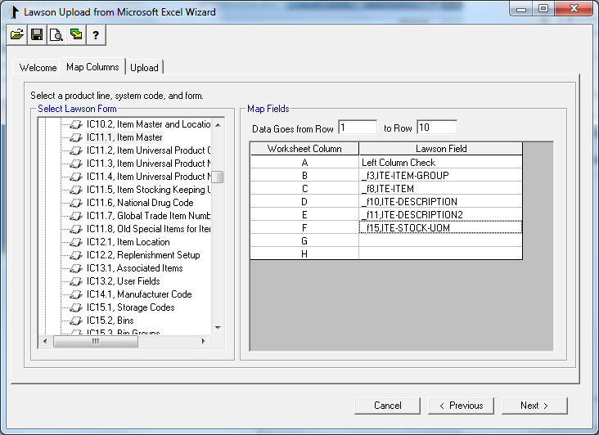
Architecture
Over-simplified Upload Wizard
Lawson Database

Slide 7
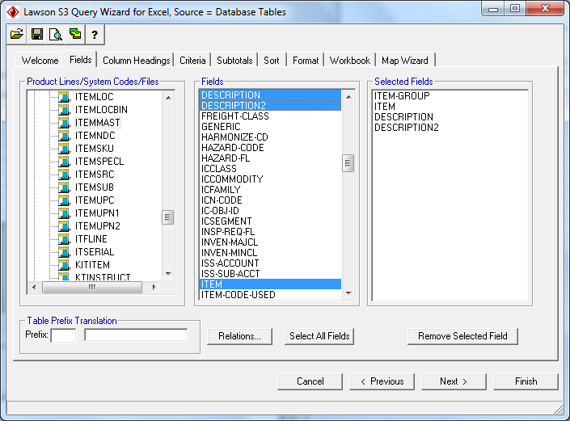
Architecture
Over-simplified Query Wizard – Database
Lawson Database
Queries bypass form logic

Slide 8
Risk
“To use the Lawson Add-ins effectively, you must have the following knowledge and experience:
- Understand these relevant features in Microsoft Excel and Microsoft Word:
- Create, edit, and save Microsoft Excel files.
- Sort, format, and use calculation features in Excel.
- To create mail merge documents, understand how to use the Microsoft Word Mail Merge feature.
- Know how to use Lawson applications.
- Understand how the Lawson system handles data.
- Be familiar with how the Transaction service (AGS), Data service (DME), and Drill service (IDA) work.
- Understand the basic structure of the Lawson database.
IMPORTANT Users of the Upload Wizard need a very strong knowledge and understanding of the form and application to which they are uploading data. Data must be entered correctly in the Upload Wizard to preserve the integrity of data in the database.”
“The Upload Wizard cannot perform some Lawson transactions. For example, you cannot use the Upload feature to do a Release function code or any other function code operation that requires an Inquire first.” - MS Addins User Guide

Slide 9
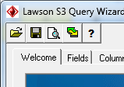
Navigation
Buttons across the top
Open existing Addins.
(Open one that was previously saved)
Save this Addins query/upload
View the ‘raw’ query
Set the timeout period for query
View version, help and clear login information

Slide 10
Navigation
Navigate either with Tabs or Next-Previous
Click Tabs - or -
Click Next/Previous

Slide 11
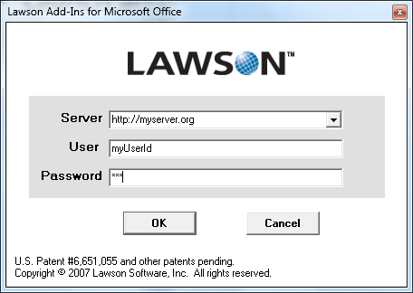
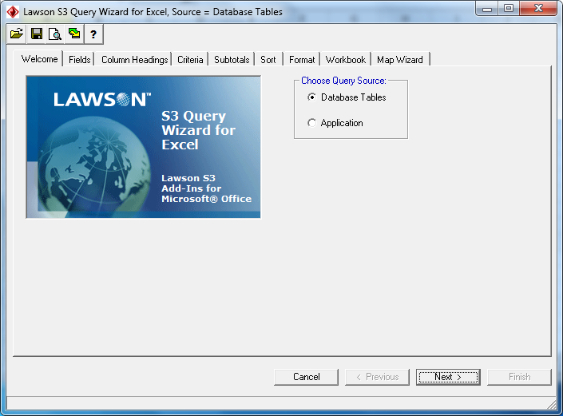
Instructions – Log In
Launch and Log in, choose Query or Upload
Portal path is abbreviated (not /lawson/portal)

Slide 12
Query Wizard – Database
Decide on which fields to inquire (fields in Lawson forms, ie., HR11 the Employee field)
Locate tables for fields
Find main table
Build, save and run query

Slide 13
Query Wizard – Database
Locate the table for a key field: Ctrl+Alt+o

Slide 14
Query Wizard – Database
When logged in, choose “Database Tables”

Slide 15
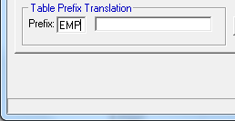
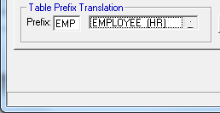
Query Wizard – Database
To find the actual table name, enter the three-character abbreviation and tab off

Slide 16
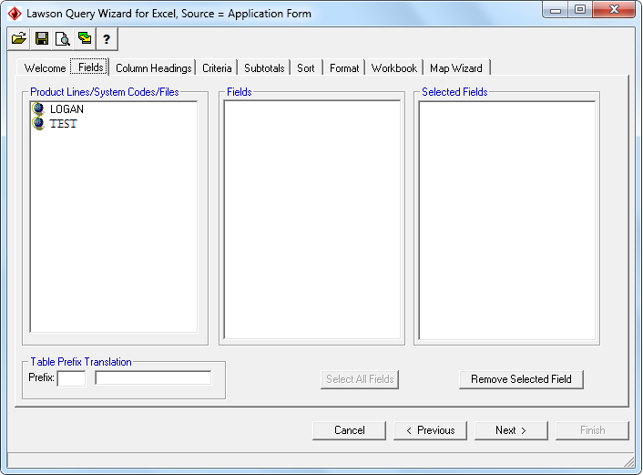
Query Wizard – Database
Choose product line, click to see system codes

Slide 17
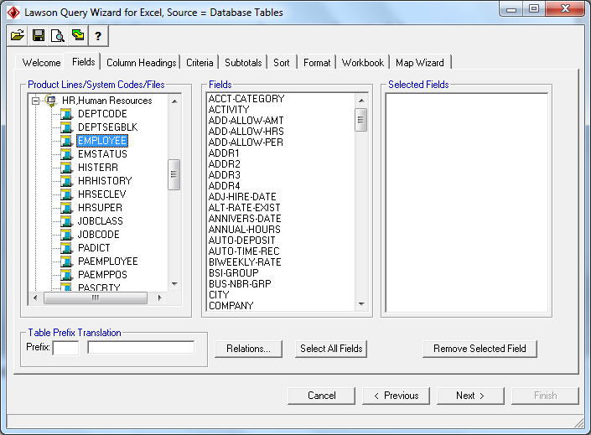
Query Wizard – Database
Choose the system code and table

Slide 18
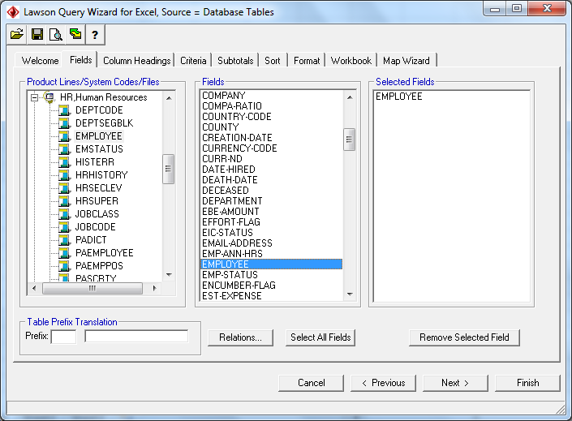
Query Wizard – Database
Choose fields from primary and related tables

Slide 19
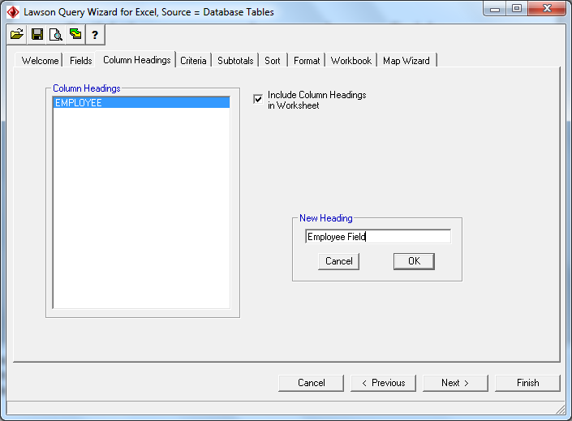
Query Wizard – Database
Change column descriptions

Slide 20
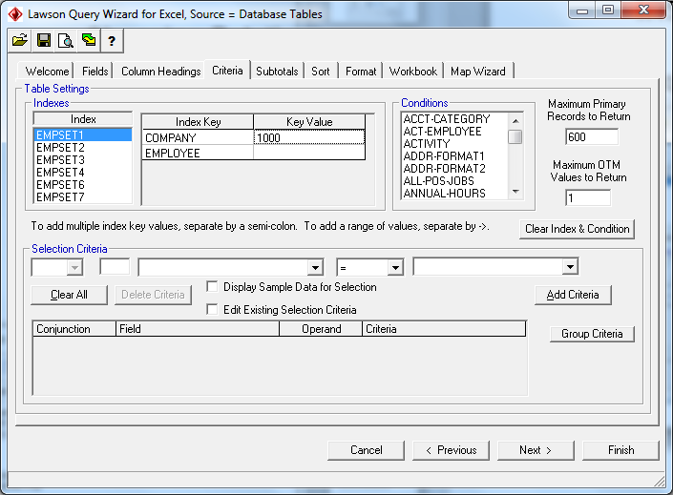
Query Wizard – Database
Select an index and values

Slide 21
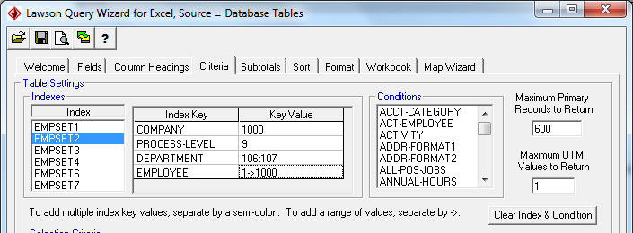
Query Wizard – Database
Do not skip index values
Instead, a useful trick is to use a range (a->z) or several values (a;b;c) for key values

Slide 22
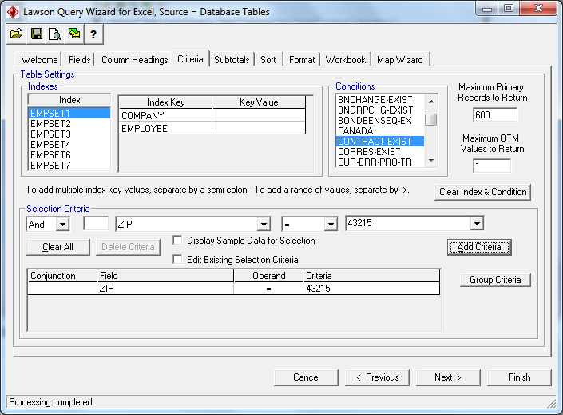
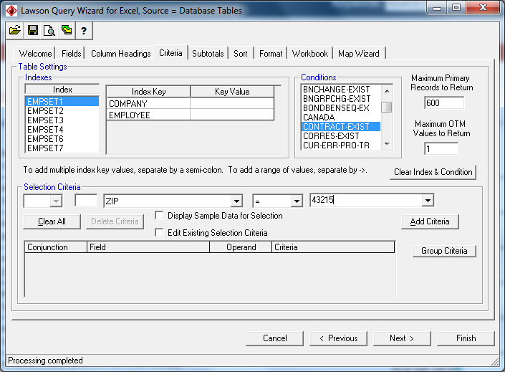
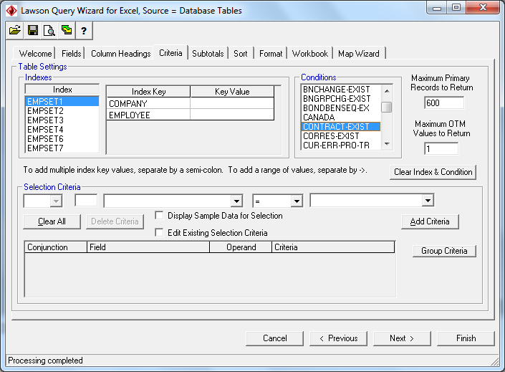
Query Wizard – Database
Choose a Condition, max return, OTM, Select.

Slide 23
Query Wizard – Database
Group criteria: Highlight two, then click Group Criteria

Slide 24
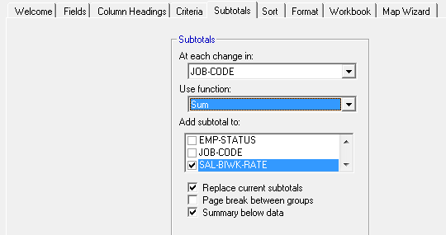
Query Wizard – Database
Calculations and subtotals

Slide 25
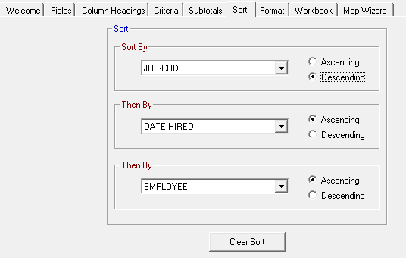
Query Wizard – Database
Sort order
Order defaults from the Index
Override index by settings on Sort tab

Slide 26
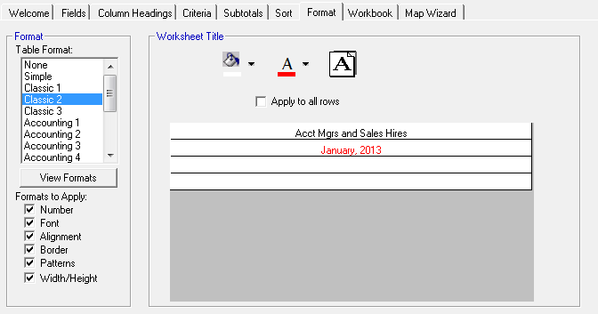
Query Wizard – Database
Format
View formats to see all options
Worksheet Title settings override the Excel format

Slide 27
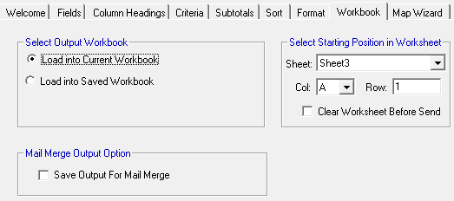
Query Wizard – Database
Workbook options
Choose into which workbook to save output
Output can be used for mail merge in MS Word

Slide 28
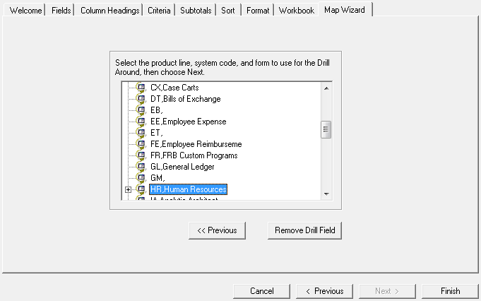
Query Wizard – Database
Map wizard
Set the spreadsheet’s form and drill settings

Slide 29
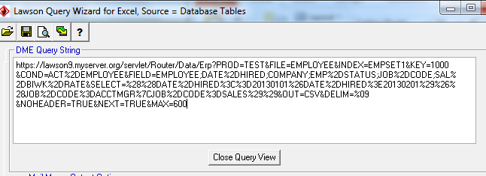
Query Wizard – Database
View the ‘raw’ query that is sent to the server

Slide 30
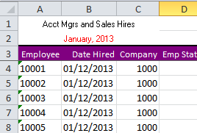
Query Wizard – Database
Sample result

Slide 31
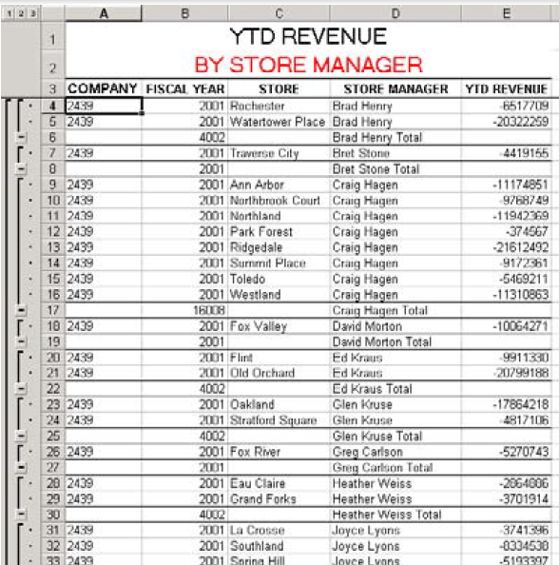
Query Wizard – Database
Result with totals

Slide 32
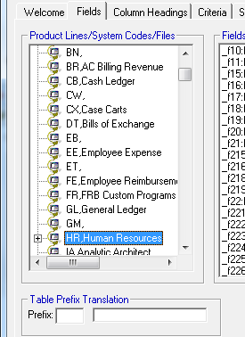
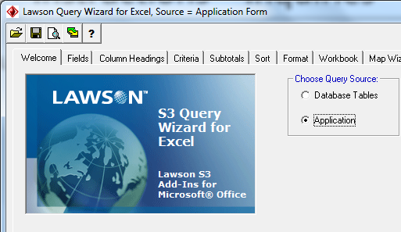
Query Wizard – Inquiries
Log in and choose Application/form to Inquire
Add fields
Used to build upload template

Slide 33
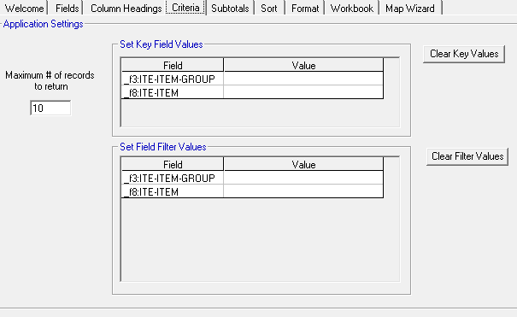
Query Wizard – Inquiries
Enter a value for key fields, such as Company
_f263:EMP-COMPANY
_f265:EMP-EMPLOYEE
1000
_f263:EMP-COMPANY
_f265:EMP-EMPLOYEE

Slide 34
Uploads
Decide on which form to use
Use Inquiry Addin to build (download) a template
S3 Query Wizard, choose Application radio button
Add a column for “Left Column Check” (optional)
Fill in template with new values
Close Query Wizard and open Upload Wizard
Tie Upload Wizard fields to Excel columns
Upload

Slide 35
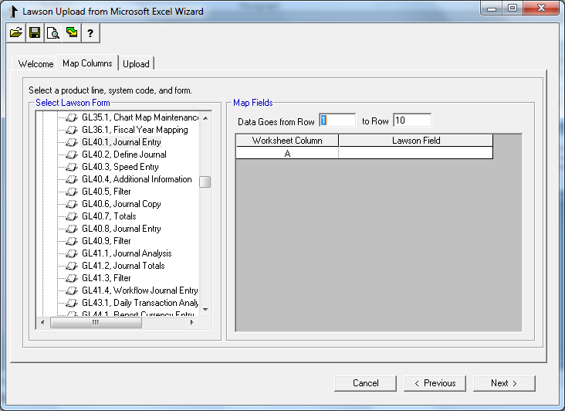
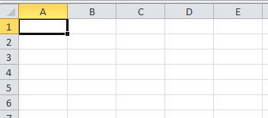
Uploads

Slide 36
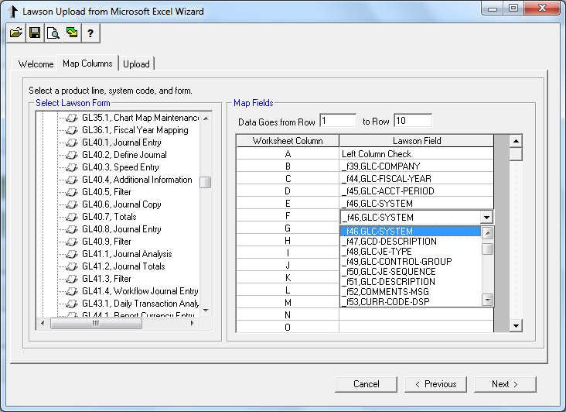
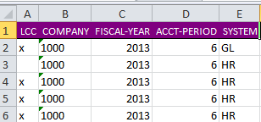
Uploads

Slide 37
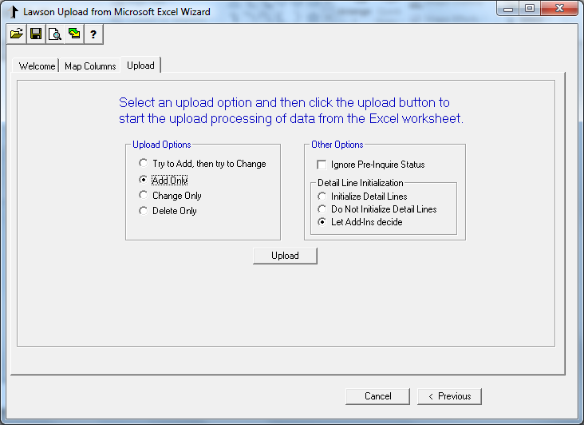
Uploads
When columns are complete, click Upload
Don’t use this!

Slide 38
Advanced/Tricks
There are advanced tools and tricks
XML knowledge helps
Free tutorial on XML at www.w3schools.com
Ctrl+Alt+a
Portal Debug

Slide 39
Advanced/Tricks

Slide 40
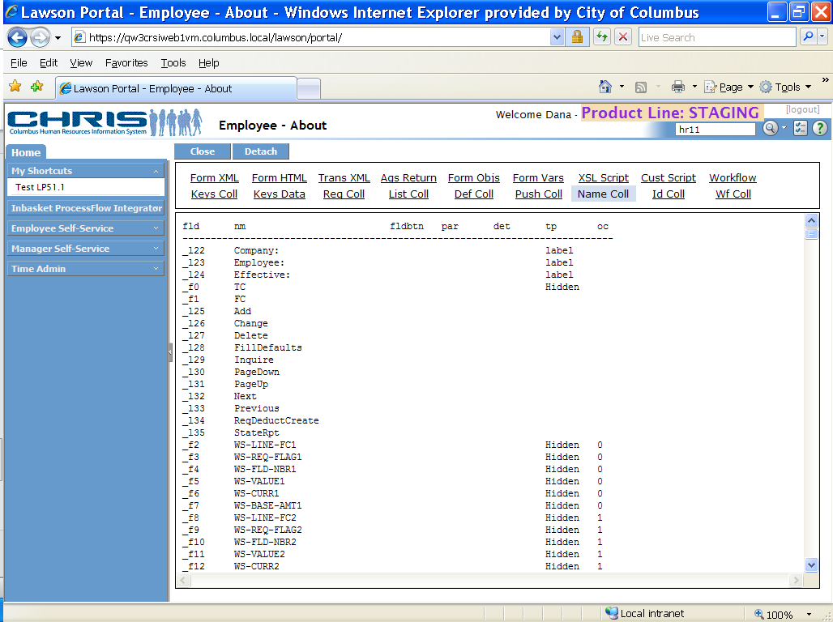
Advanced/Tricks

Slide 41
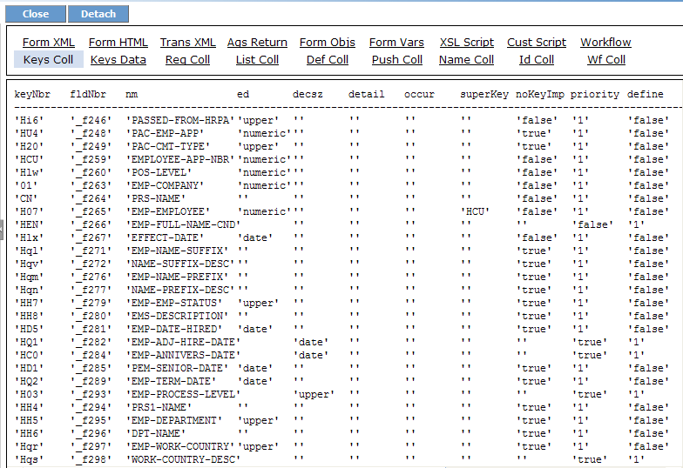
Advanced/Tricks

Slide 42
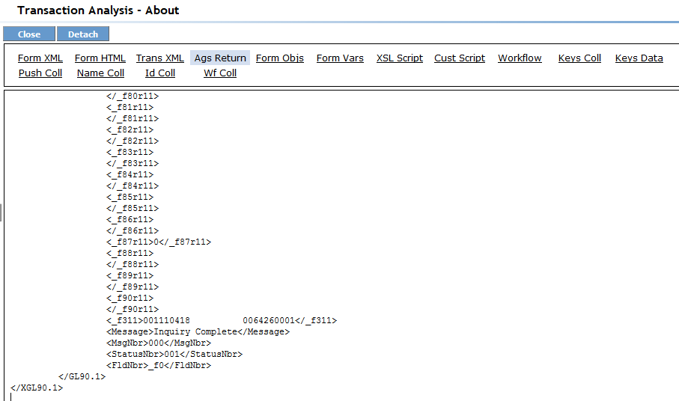
Advanced/Tricks

Slide 43
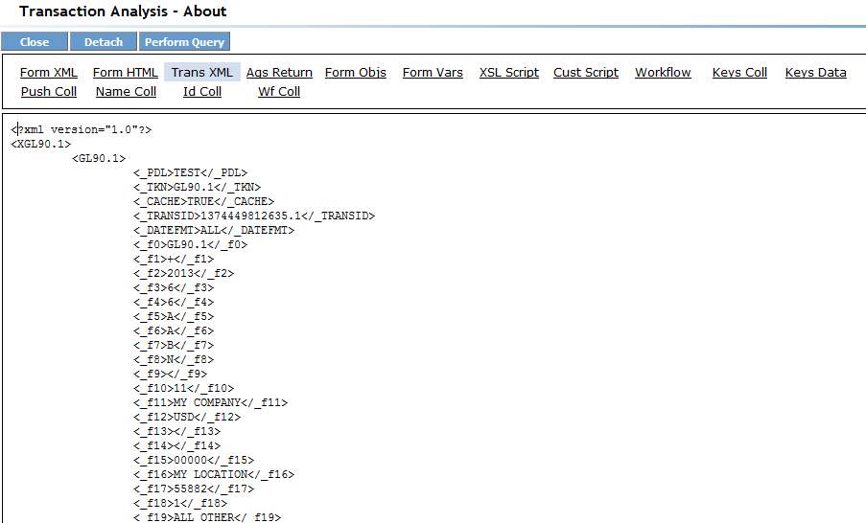
Advanced/Tricks

Slide 44
Troubleshooting
Cannot log in
Make sure the URL is correct, it should be Portal URL without the /lawson/portal portion
Check that Addins are enabled in LS9 (role-based security)
Cannot query a table
Check LS9 to make sure the ID has access
Check for derived fields/related table fields and remove them – retry
Query takes long time to run
Use the proper Index
Use as many Index Key values as possible
Use fewer Filter (Select) fields
Your security settings may restrict records, slowing it down
Server timeout is set to 60 seconds (KB article 5410658)
Choose a smaller data set

Slide 45
Troubleshooting
Unexpected data are returned
Make sure fields from the base tables come before those from related tables in the Select
Make sure dates are format (usually ccyymmdd)
Upload won’t work
Note that some forms are unable to upload to
Make sure all required fields are included
Include the HK value
View the AGS call that was sent in Portal
Use the Portal debug tool
Make sure case is correct (is upper case required?)
View the raw AGS call, include all fields and remove the obvious
Update to most current version of Addins
Still can’t figure it out? See KB article #5266704 for logging

Slide 46
Next Webinar
Requisition Approval
August
29
www.nogalis.com/education.html

Slide 47
Q/A
@nogalisinc

