Slide 7
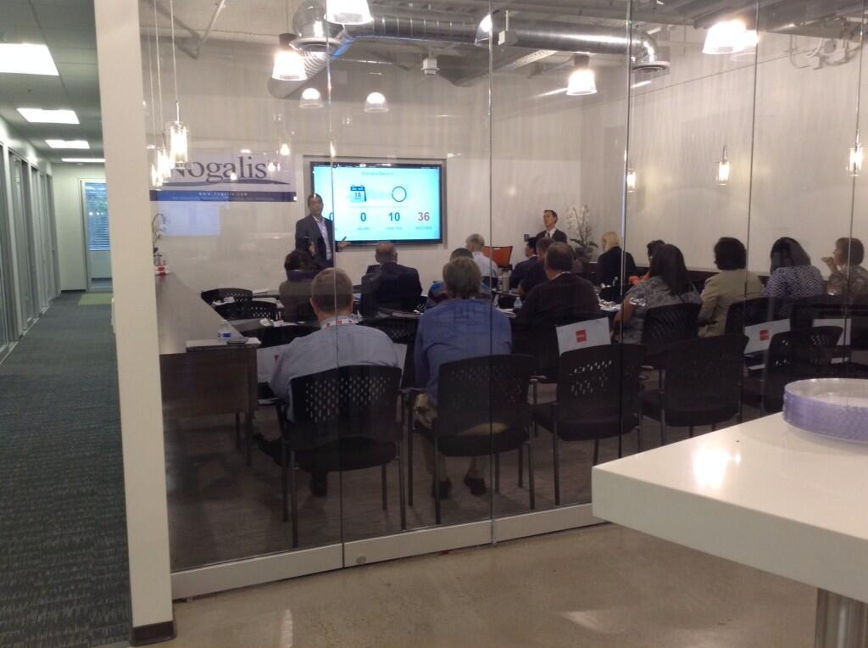

Slide 8
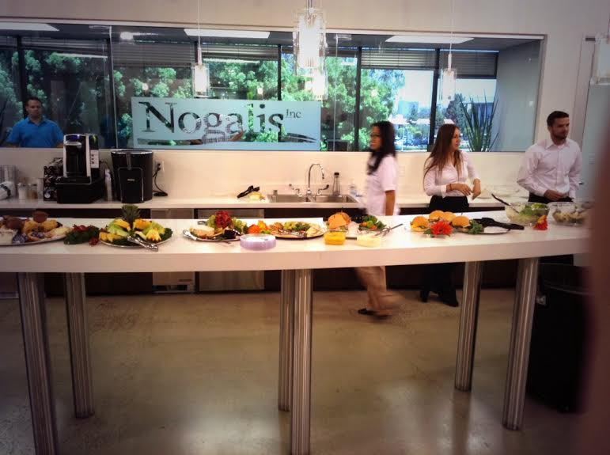

Slide 10
IPA Differences
ProcessFlow / IPA Differences

Slide 11
A little history
ProcessFlow
ProcessFlow Professional
ProcessFlow Integrator
Lawson Process Automation
BCI
Process Integration
Infor Process Automation

Slide 12
What is Process Automation?
Infor Process Automation is a tool for automating business processes. It works with Lawson Landmark applications and is similar conceptually to Lawson ProcessFlow Integrator for S3 applications and M3 applications.
Infor Process Automation is the umbrella term for two software components, Infor Process Designer and Process Server

Slide 13
Pflow vs. IPA
Overview of Tools
• PFI: Traditional Lawson workflow automation tool for S3 and M3 apps
• IPA: Newest workflow automation tool
Use
• PFI: Manage flows initiated out of S3/M3 applications (PRIOR to IPA10)
• IPA: Manage flows initiated out of Landmark (PRIOR TO IPA10)
• Landmark Approval requests
• IPA: Manage ALL processes – IPA10

Slide 14
Technology
Loaded with Landmark Technology and is associated with a Landmark technology release.
Designer must be associated with the specific Landmark technology release.

Slide 15
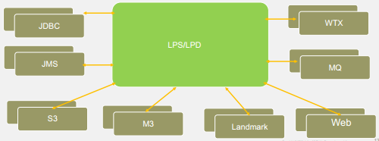
More Connectivity

Slide 16
Major Differences
Built on Landmark technology
Eclipse Designer (new as of LPA)
Admin tool built into rich client
Reduced footprint
Event Manager is merged with LPS
RMI server is removed
Scheduler is part of Landmark
Menu.do is removed
Java client is part of rich client
Designer works with single data area at a time
Flows and Logs are now stored in DB (YAY!!!)
Inbasket is now part of Smart Office / Rich Client

Slide 17
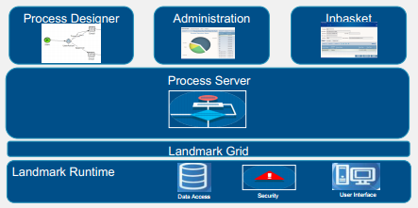
Architecture

Slide 18
Designer Features
All the nodes are still available
Grid displays
Error processing
Break points for debug
You can now save connection parameters

Slide 19
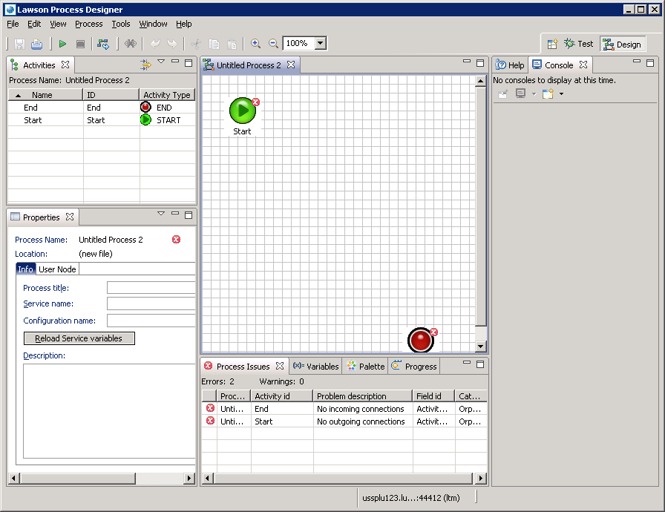

Slide 20
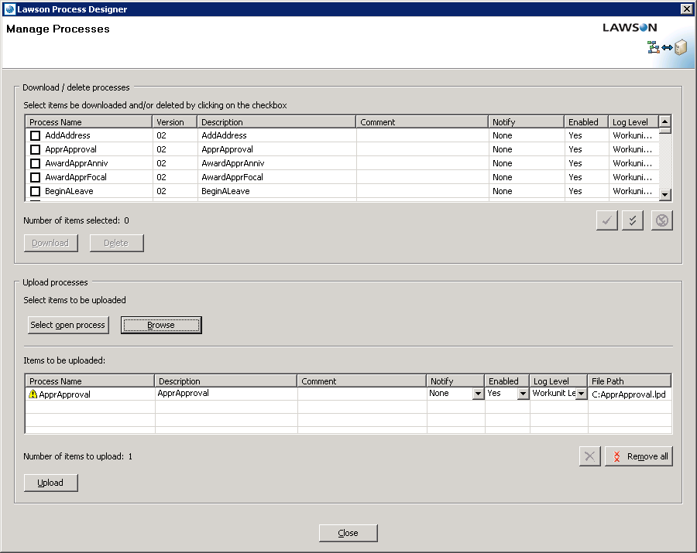

Slide 21
Error Handling
Determine actions to take on error on every node

Slide 22
Error Handling

Slide 23
Error Connector

Slide 24
Rich Client

Slide 25
Rich Client

Slide 26
Landmark Transaction Node
Multiple Landmark Modules (LTM, Contract …)
Object Name = Business Class
Multiple Actions for a business class
Actions are specific to object
Find records
Specific queries
Updates and changes
Action types (CRUD)
Single record query
Multiple record query
Relation query
Creat/Update/Delete

Slide 27
Landmark Scenario
Query a resource in Landmark
Create a resource as an actor within landmark
Assign Roles to actor
Email the results

Slide 28
Administration

Slide 29
Work Units

Slide 30
Workunit Actions
Restart
Cancel
Release
Move Work Unit History
In flight changes
Additional Functions
History
Tracking
Action on pending workunits

Slide 31
Enable Autopurge

Slide 32
Scheduling
By Service
By Process
Similar to pflow scheduler
Options:
Once
Freq in sec
Date of month
By day
By week number
Time zones
Advanced
Notifications

Slide 33
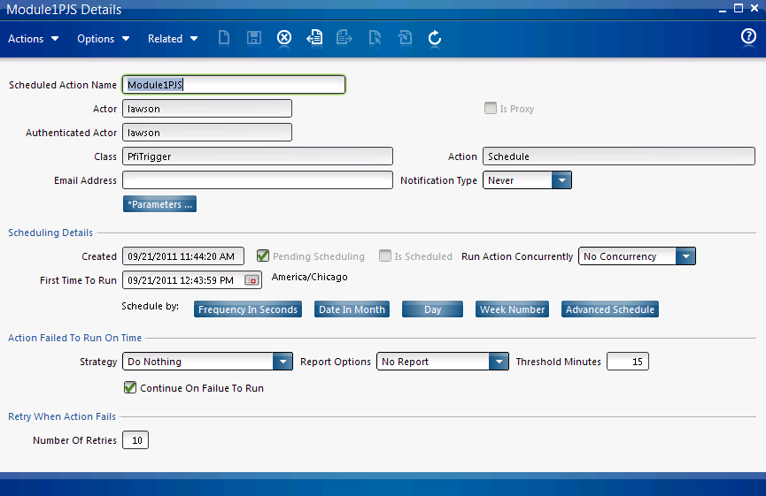

Slide 34
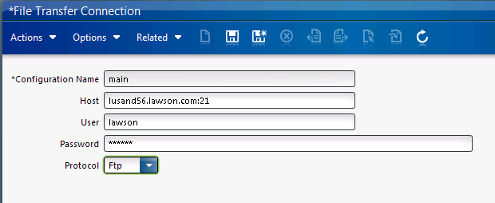
File Transfer Node

Slide 35
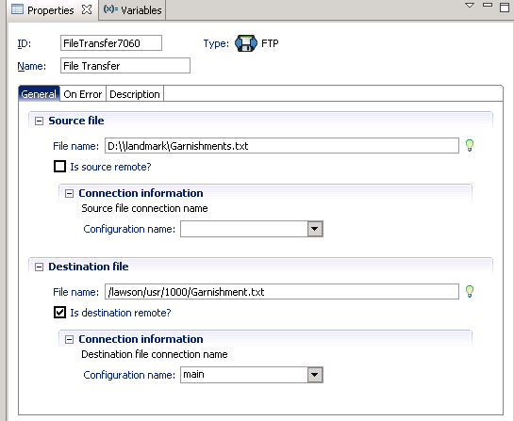

Slide 36
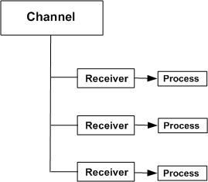
Channels
One way communication between IPA and external sources
JMS (Java Messaging Service)
File Messages (Similar to FileClient)

Slide 37
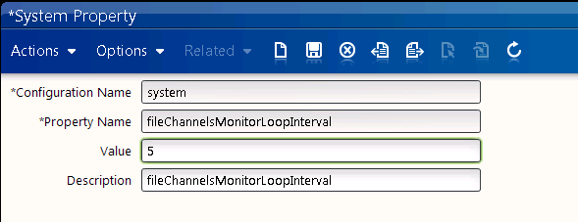
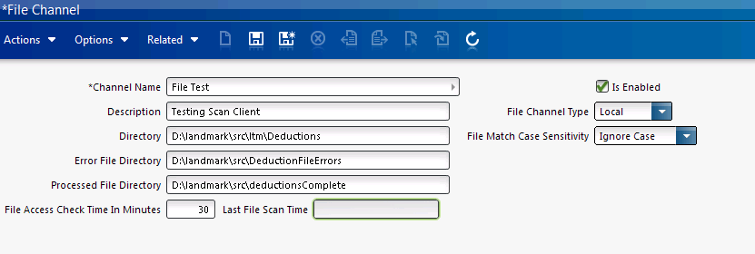
File Channel

Slide 38
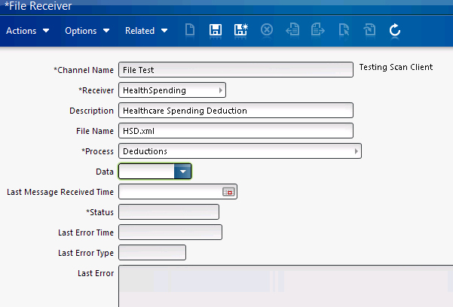
File Receiver

Slide 39
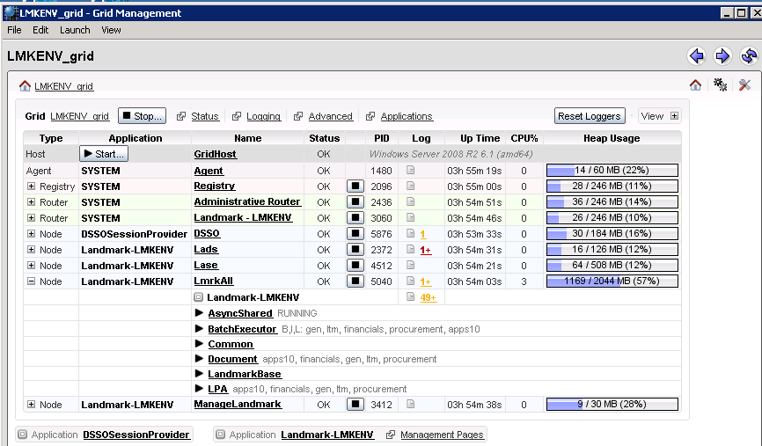

Slide 40
