Slide 1
Automated user administration for Landmark and LSF with IPA
A thorough walkthrough

Slide 2
Inspired by

Slide 3
Why automate
The Manual Process:
Create domain user
Create LSF user
Assign LSF identities
Assign LSF roles
Create Actor
Create Actor Identity
Link Actor to Identity
Create Actor Context
Link Actor to Agent
Provide email notifications / Welcome packet to new users

Slide 4
How to Automate
Infor Process Automation (Formerly known as ProcessFlow Integrator).
Perform all the same actions one by one within IPA
Check for success/error and send notifications accordingly

Slide 5
The challenges
Getting the Context Property for the organization
Linking the Actor to the identity
Adding the actor context
Linking Agent to Actor (Finding the agent)
Handling errors better
KB 1623987, Resource Update not able to add multiple roles

Slide 6
Actors
A user who can act upon a Landmark service.
Agents
An agent is a unique subject within a specified application domain. For example, a Requester
Identities
An identity is a set of credentials that uniquely identifies a subject for a particular Landmark service. An actor must have an identity for the service in order to access that service. (Example Single Sign-on)

Slide 7
The Flow
New hires using Landmark LTM as system of record

Slide 8
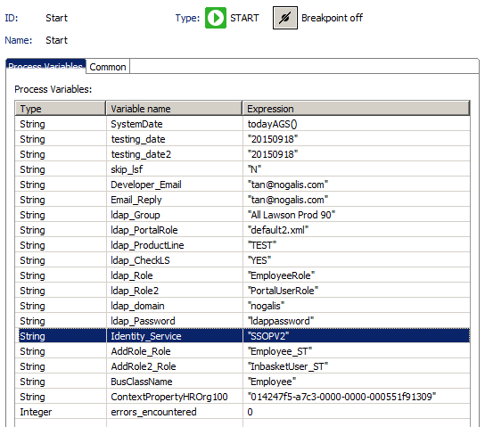
Start Node

Slide 9
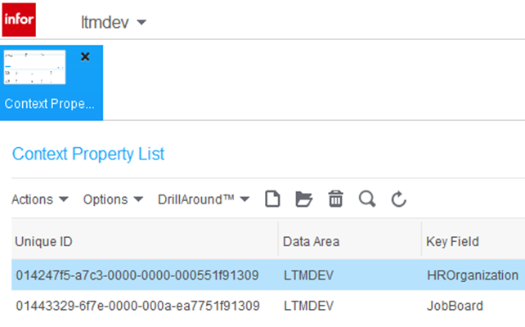
Org Context Property

Slide 10
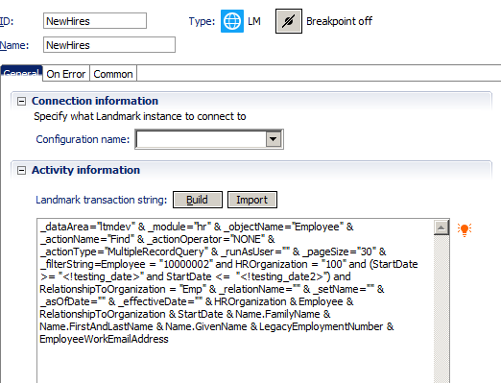
New-hire Query

Slide 11
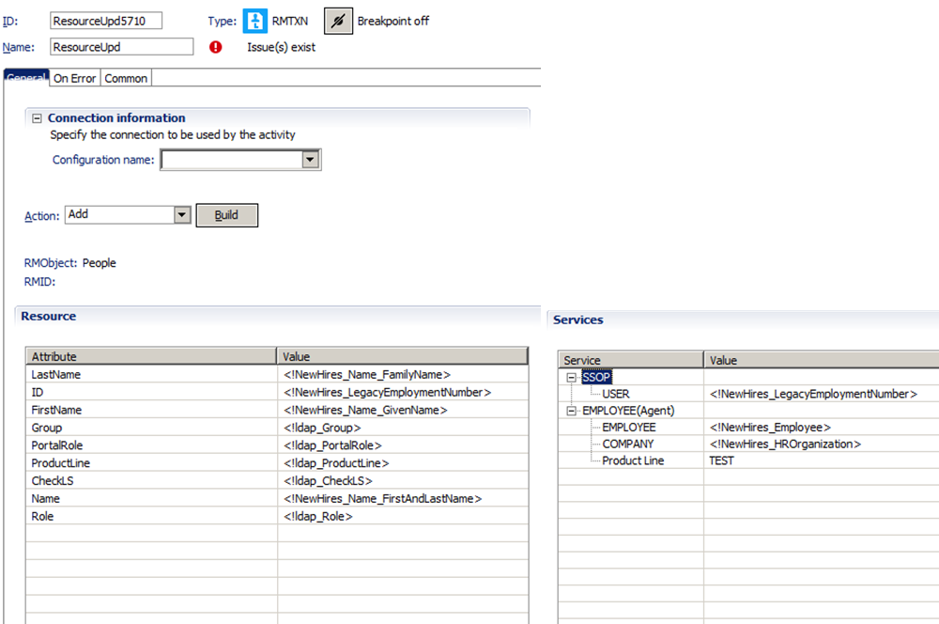
RM Update

Slide 12
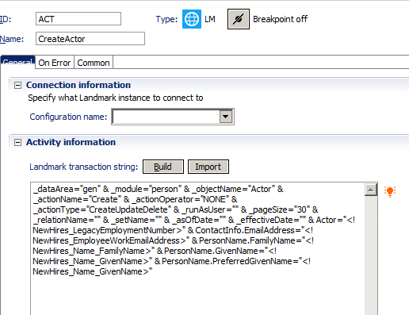
Create Actor

Slide 13
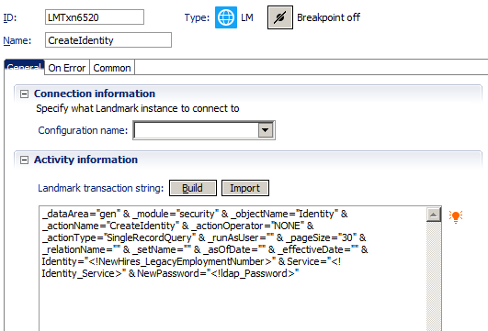
Create Actor Identity

Slide 14
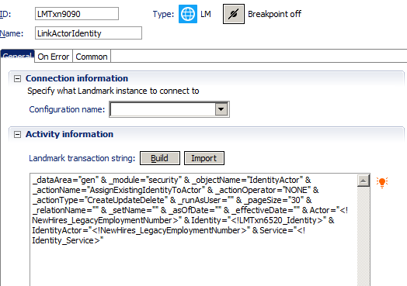
Link Actor to Identity

Slide 15
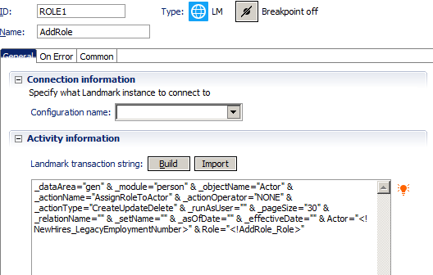
Add a Role to Actor

Slide 16
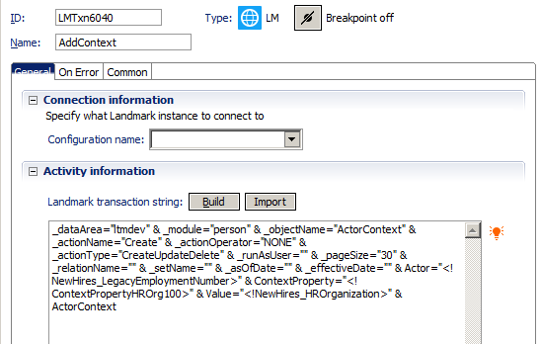
Add Actor Context

Slide 17
Org Context Property

Slide 18
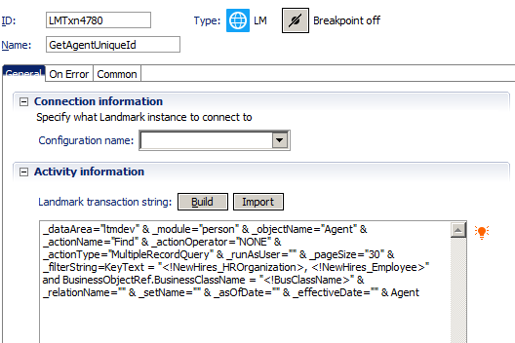
Get the agent ID

Slide 19
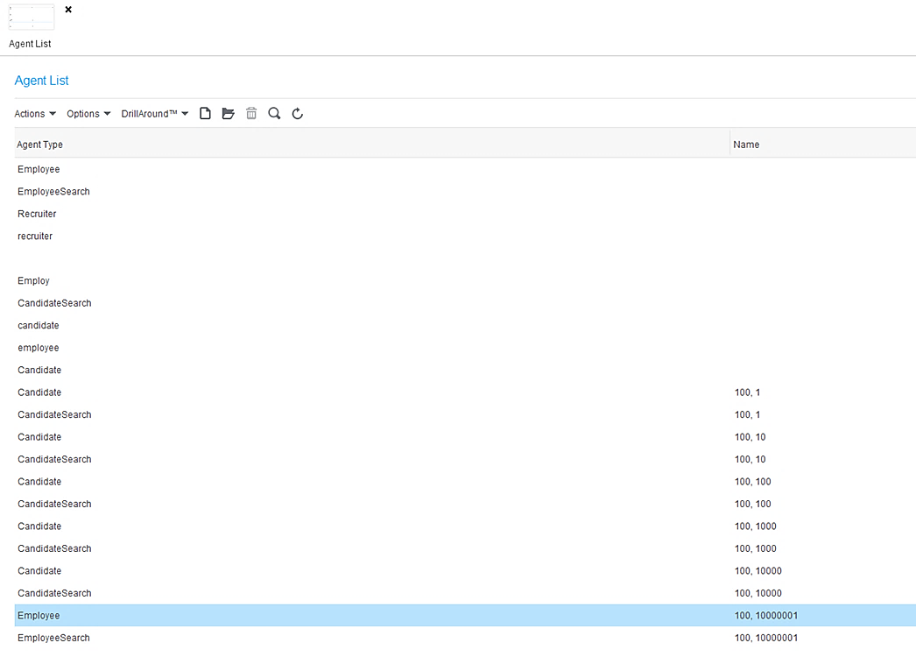
Finding Agent

Slide 20
Creating Agent Filter

Slide 21
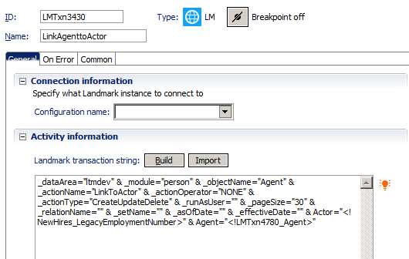
Link Agent to Actor

Slide 22
And if you really want to get fancy…
http://www.nogalis.com/ipa/app/ipa.html

Slide 23
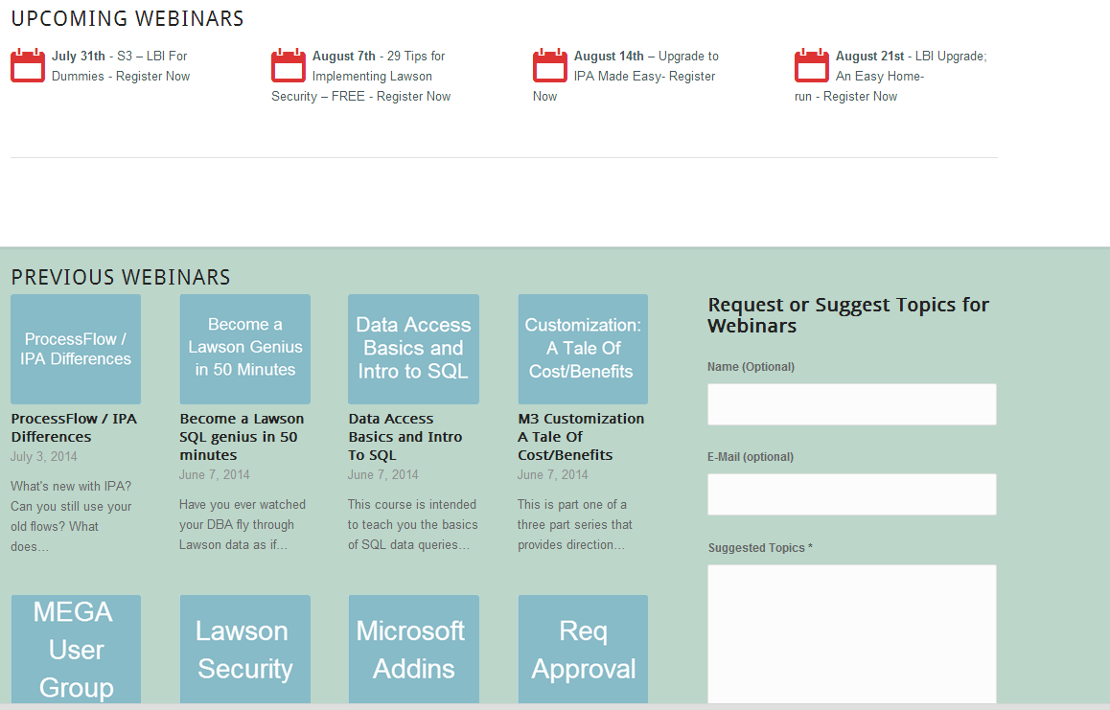
Free Education
www.nogalis.com/education

Slide 24
Q/A
@nogalisinc

