Slide 1
How to Upgrade to Lawson v10 By May 31, 2017

Slide 2
Established 2003

Slide 3
What’s New 2016
10x
25
142
14
18
Consultants
Clients
Managed Services
10x Upgrades

Slide 4
The leader in Lawson Managed Services

Slide 5
Why Upgrade?
Extended 901 support deadline is 5/31/17
Latest technology changes
Infor Process Automation
Infor BI 10
Cleaner look & feel
More supported browsers
IE10+
Chrome
Firefox

Slide 6
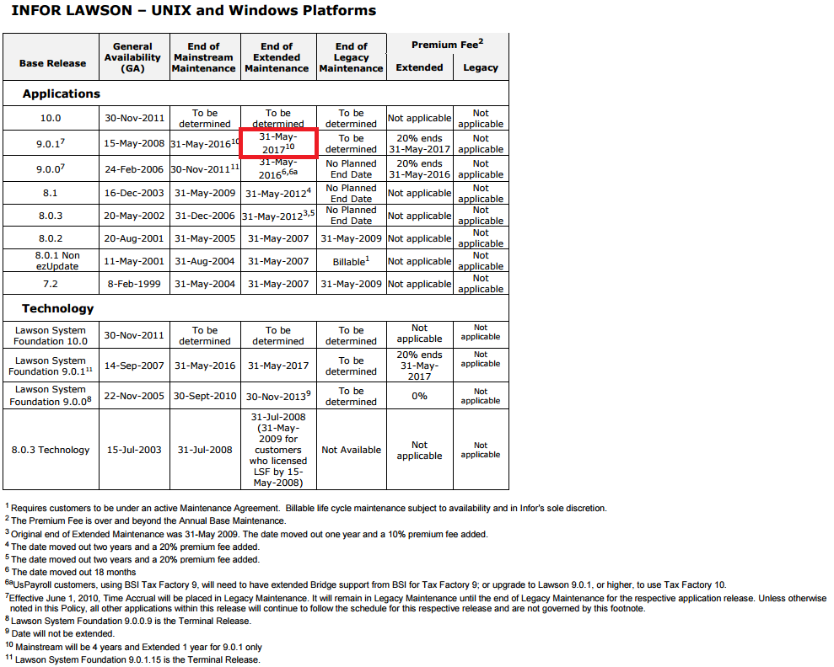
Infor Lawson Product Life Cycle Maintenance Policy
July 22, 2016

Slide 7
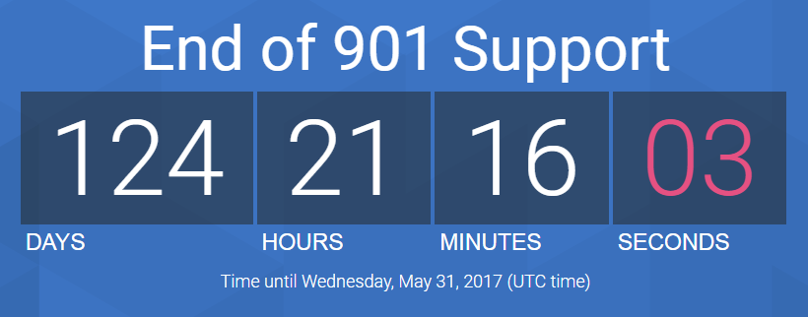

Slide 8
What will happen?
Best Case (No Issues until year-end)
No year-end updates for Payroll
No year-end updates for AP
No support for the environment
Worst Case
Possible BSI Cyclical Update that requires 10x environment as minimum release
Possible OS updated that conflicts with environment
No year-end updates for Payroll
No year-end updates for AP
No support for the environment

Slide 9
Infor Lawson 10.x Information Center
Knowledgebase Article 1444526
Topic # 29307
What’s New
Release Notes
Installation Guides
IPA Guides
Ming.le Guides
ISS Guides
Upgrade Docs
Recommended training
Recent related webinars
Recorded webinars

Slide 10
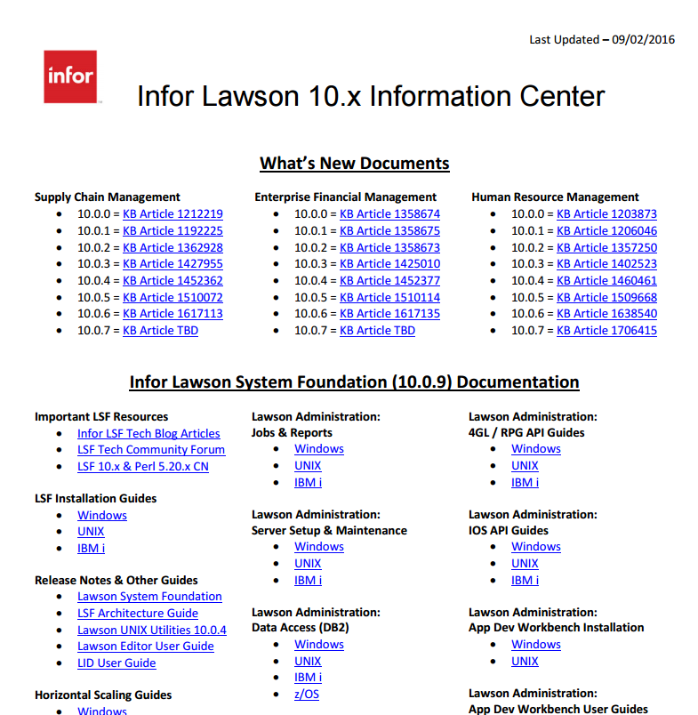

Slide 11
How do we get there?
Before May 31 2017

Slide 12
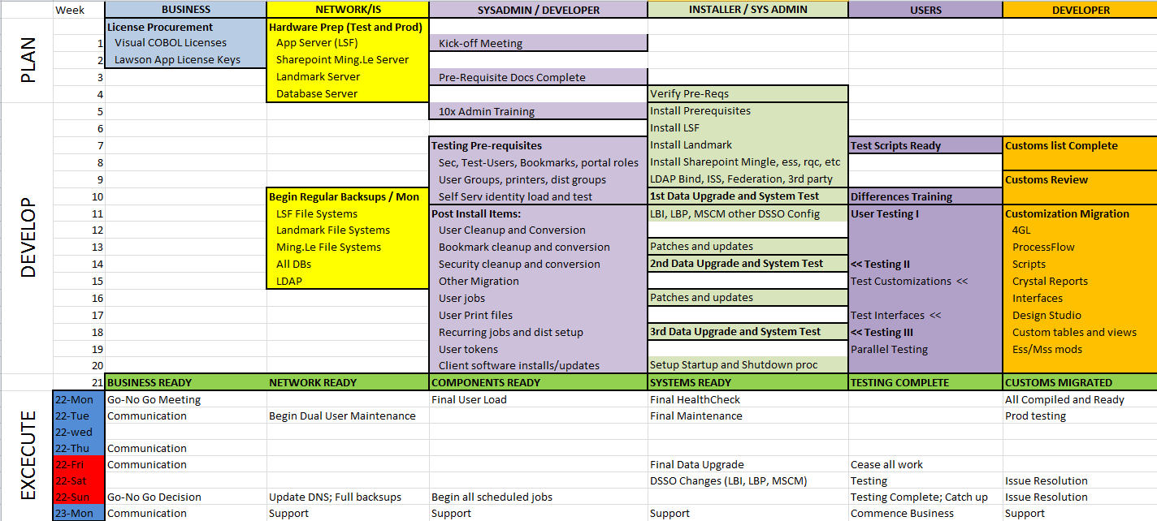
TimeLine

Slide 13
Before we Begin
Complete the pre-install checklist
Applications
Server names & architecture
User names & passwords
Server Pre-requisites
Server configuration/architecture
Pre-requisite installations
Visual COBOL and V10 Apps License Keys
Product downloads
Installer access
Access to the environment
Infor account for issue resolution

Slide 14
Project Management
One dedicated project manager
Decision maker & facilitator
Coordinates schedules
Coordinates meetings
Clearly define roles ahead of time
Project team
Contact information
Limit project meetings
Essential personnel only
Hold to the scheduled time
Issue Tracking
JIRA
NO EMAILS!

Slide 15
Availability
Contact information for project team
Project stakeholders
Multiple contact numbers/emails
Technical staff
After-hours contact information
Clearly defined roles
Help Desk contact information
Priority service tickets
Functional users
Issue resolution
Testing
Functional questions

Slide 16
Tools
JIRA – Project Management and Issue Resolution
Remote Access / VPN – We prefer Cisco Anyconnect
Jump Boxes – Facilitate teams working at the same time
Slack - For quick team communication
On the server
Notepad++
Chrome
LDAP Browser
Classic Shell
LSF_IQ – Review and validate security and loading users
Migration of security
Migration of Users with correct NTIDs

Slide 17
Installation
Two environments only (Pick your version carefully)
Possibly install Landmark after 5/31 if IPA is not critical
Federate Later if possible
Customizations
4GL, reports, Design Studio, Flows/Processes, Custom DB tables, etc.
Essential interfaces/customizations only
Work on the remainder after 5/31
Additional applications
BSI, LBI, MSCM, LBP, LSO, EDI, etc.
Install LSF with Portal only
Install SharePoint & Ming.le after 5/31
Install patches & updates after 5/31
What can we live without for a few weeks?
Examples: LSO, LBI, Specified Interfaces & Customizations

Slide 18
Testing
Limit to two testing passes
Pick your data refresh date wisely
Test case documentation / Test Scripts
Ready before installation begins
Process testing (year-end/month-end/payroll)
Prioritize in case some can be done after 5/31
Testers
Small, dedicated group of functional users
Priority availability
Ability to work after hours and on weekends (especially go-live weekend)
Make sure to test well:
ESS/MSS, RQC, MSCM Handhelds
EDI Maps

Slide 19
Training
Short two hour webinars with each group
HR/Payroll/Benefits
Procurement/Req
Finance
Record webinar for future review
One hour Q/A session

Slide 20
Organizationally
Get buy-in from the organization on necessity of the project
Budget appropriately so you don’t have to spend time on getting additional funds
Get a pass on tight security upfront
Lawson credentials (and other users)
Network security rules and firewall settings
DB SA rights
Set expectations with users, executives, contractors early on
Read this: “How to cut consulting costs by up to 30%”

Slide 21
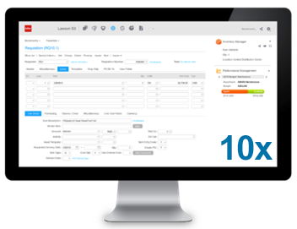
Go-Live
Flexible on the dates & times
Preferably begin on Thursday evening
Availability (including after hours and weekend)
Technical staff
Functional staff
Issue resolution

