Slide 1
Troubleshooting Lawson Security
The hacks you need to know

Slide 2
Are you on Lawson Security? (Feb 2014)

Slide 3
Are you on Lawson Security? (Aug 2015)

Slide 4
Today’s Audience

Slide 5
LSF_IQ Clients

Slide 6
Method 1 – Log Files
ios.log
lase_server_0_0.log
security.log
secadmin.log
All these files reside in $LAWDIR/system

Slide 7
ios.log

Slide 8
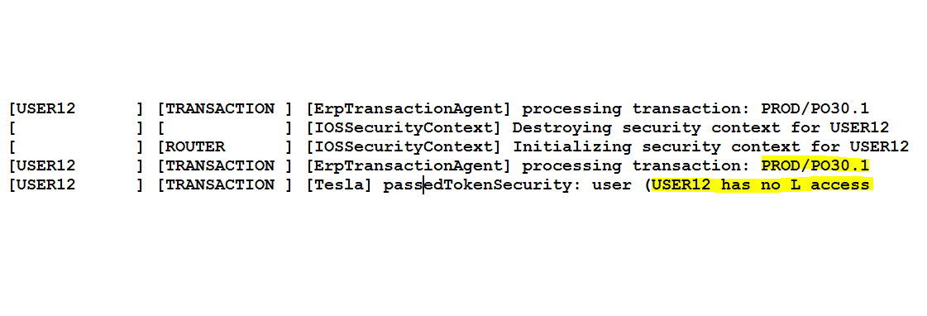
ios.log

Slide 9
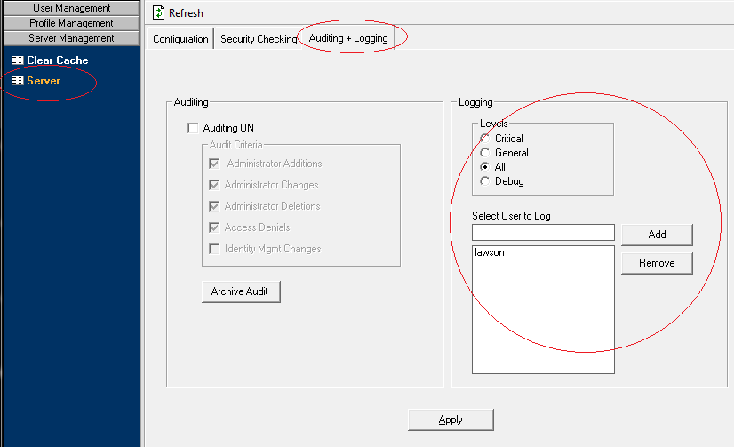

Slide 10
Method 2 - Fiddler
Available from www.telerik.com/fiddler
Web Debugging
Performance testing
Traffic Recording
Session Manipulation
Security Testing

Slide 11
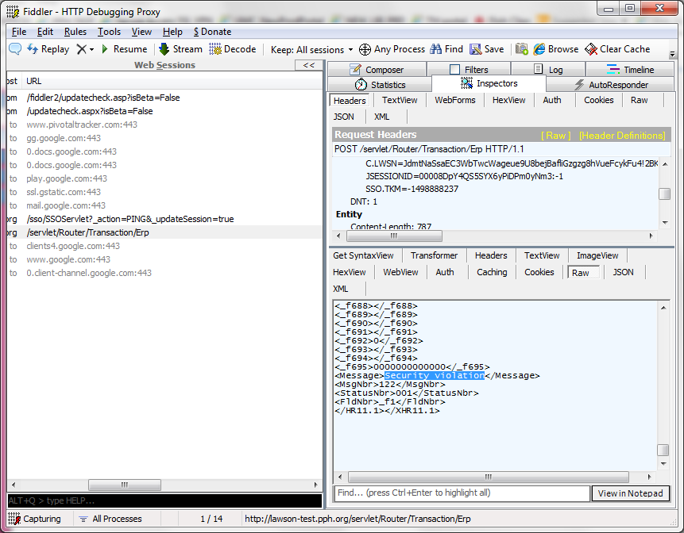
Fiddler

Slide 12
Tips for using Fiddler
Use the Process Picker to select the browser in question
Right Click row and “Mark Red” to highlight a task
QuickExec BPU

Slide 13
Method 3 - JXplorer
Available from www.jxplorer.org
LDAP Browser and Editor
Free and Open Source
Enterprise Version ($10)
Query and Edit LDAP

Slide 14
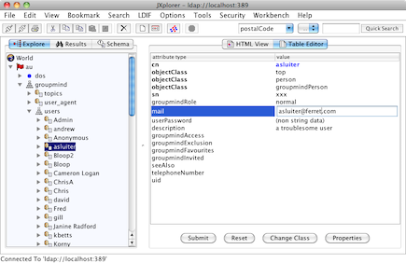
JXplorer

Slide 15
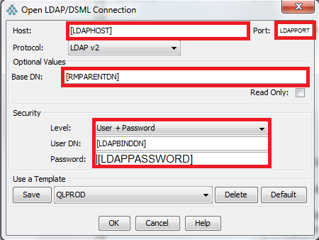
Tips for using JXplorer
Use the $LAWDIR/system/install.cfg file to get your login paramters correct

Slide 16
Tips for using JXplorer
You can expand all the trees and see the attributes of every object down to the roles assigned to a user and their check_ls flag
You can export all this data into text files
It is NOT recommended to modify LDAP data using any external tools. These tools are intended for query purposes only. Very rarely is it necessary to modify anything using Jxplorer.

Slide 17
Jxplorer Connection
LLDAPPORT – The port number
RMPARENTDN – The base root directory
DAPHOST – The host name
LDAPBINDDN – The User Name
LDAPPASSWORD – The password

Slide 18
Method 4 - lsdump
A Lawson delivered uitility for exporting security information into an XML file.
It can be loaded back into another environment.
The xml file can be viewed and edited using a text editor.
Can be used with lsload to migrate security setup to another environment (does not include user information)

Slide 19
lsdump usage
lsdump –f <filename> PROFILE [pofileid]
Example:
lsdump –f prd.xml PROFILE PRD

Slide 20
lsload usage
lsload PROFILE <filename>
Example:
lsload PROFILE prd.xml

Slide 21
Method 5 – ldifde and csvde
A Lawson Microsoft utility for exporting LDAP information into a text file.
The text file can be viewed and edited using a text editor.
This file is useful for searching quickly and spotting issues.

Slide 22
ldifde usage
Usage:
ldifde -f <dumpfile> -s <ldap_server>:<port> -j <Logfile Directory> -d "BaseDN" -v -l <Comma Delimited List> -a <UserDistinguishedName> <password>
Example:
ldifde -f f:\lsftest\rm_20150518.txt -s ldap.nogalis.com:389 -j f:\lsftest -d "OU=resources,O=lwsnrmdata,o=lwsntest,dc=nogalis,dc=com" -v -l name,cn,zzlwsnattrFirstName,zzlwsnattrCheckLS,zzlwsnattrGroup,zzlwsnattrAddins,zzlwsnattrProductLine,zzlwsnattrRole,zzlwsnattrLastName,zzlwsnattrPortalRole,zzlwsnattrWFUser,zzlwsnattrPortalAdmin,zzlwsnattrEmail,zzlwsnattrOLEDBC,zzlwsnattrName,whenCreated,whenChanged,uSNCreated,uSNChanged -a cn=ldapadmin,o=lwsntest,dc=nogalis,dc=com password1234

Slide 23
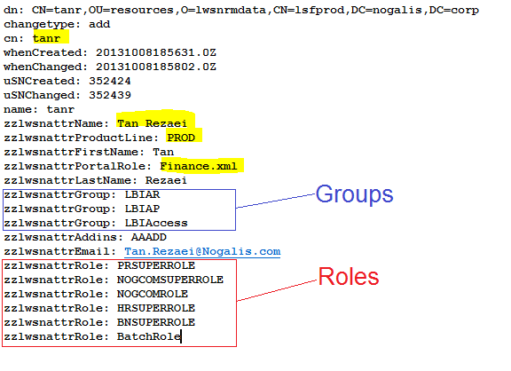
Sample ldifde file

Slide 24
Ldapsearch usage (UNIX)
Usage:
ldapsearch -D <LDAPBINDDN> -w <LDAPPASSWORD> -h <LDAPHOST> -p <LDAPPORT> -b <RESOURCEDATADN> objectclass=zzlwsnobjPeople > $tmpfile
Example:
ldapsearch -D "OU=resources,O=lwsnrmdata,o=lwsntest,dc=nogalis,dc=com" -w password1234 -h ldap.nogalis.com -p 389 -b "OU=resources,O=lwsnrmdata,o=lwsntest,dc=nogalis,dc=com" objectclass=zzlwsnobjPeople > $tmpfile

Slide 25
Method 6 - Reporting
Lawson Security Reports
Third party reporting solutions like LSF_IQ
Home brewed reporting using LBI

Slide 26
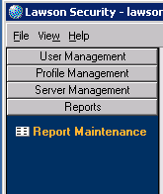
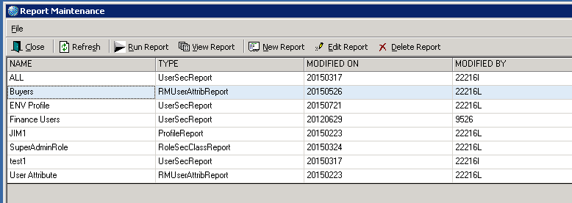
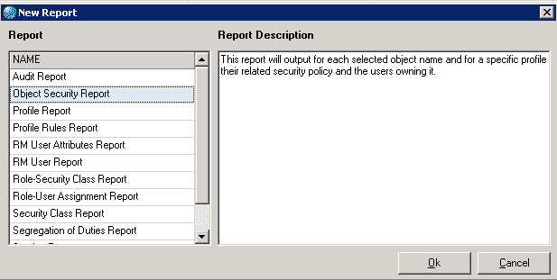
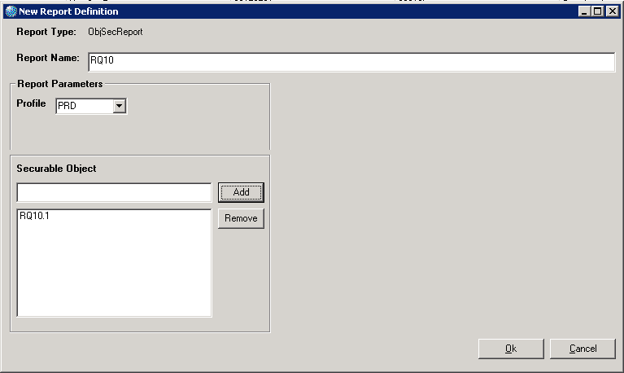
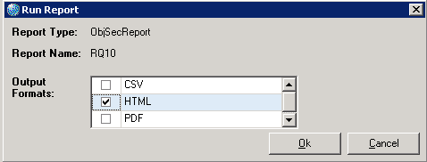
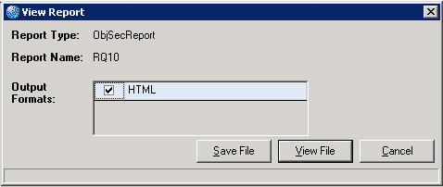
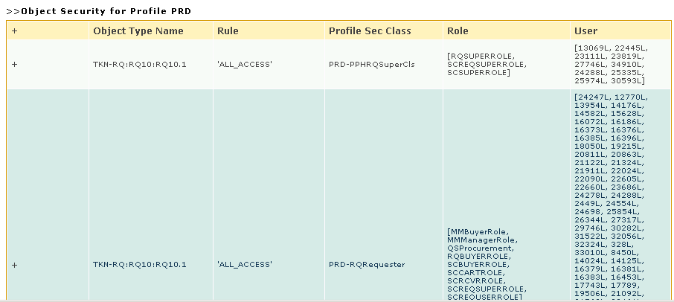
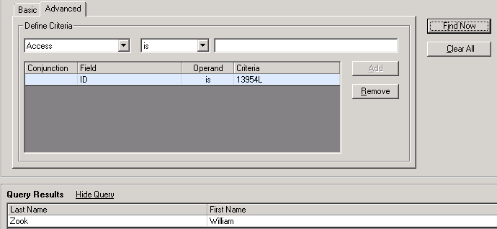
38 Clicks!!

Slide 27
LSF^{IQ}
Security Reporting in the Cloud

Slide 28
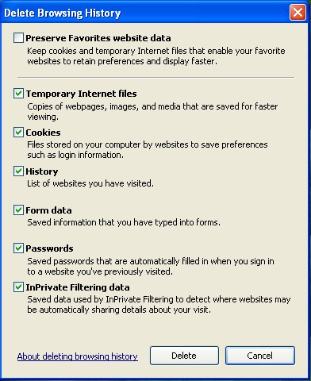
Clearing All the Cache
Perform an IOSCacheRefresh
Clear all your browsing history and restart the browser
Clear Security Cache
Reduce Caching Interval
Wait up to 15 minutes
Try it in LID

Slide 29
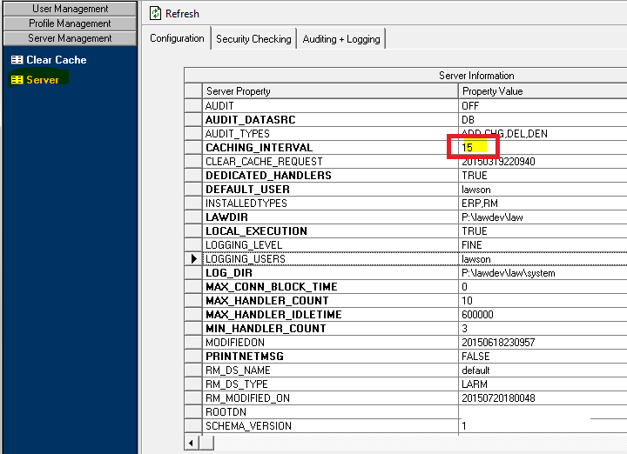

Slide 30
Naming Convention
Come up with a good naming convention for roles and classes before you do anything else. These should make sense at a glance and be easy to classify and sorting them should also group them.

Slide 31
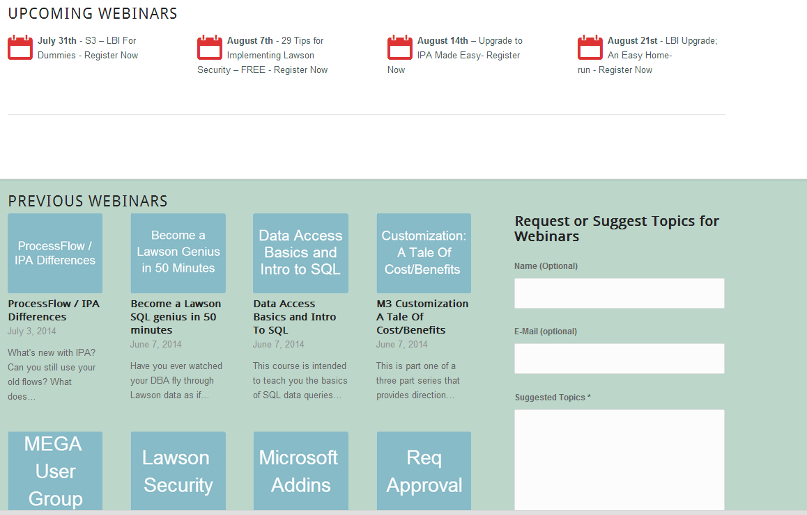
Free Education
www.nogalis.com/education

Slide 32
Upcoming Events
Aug
19
MWLUG – User Group
Aug
27
11 Performance Enhancers for your Lawson Environment
www.nogalis.com/education

Slide 33
Q/A
@nogalisinc

