Slide 1
Landmark Data Copy

Slide 2
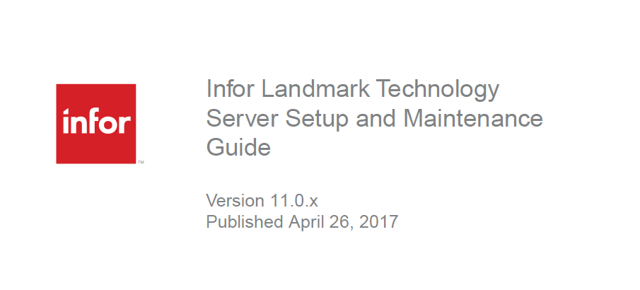

Slide 3
What is a Landmark Data Copy?
Copies application data from one environment to another
Application data
Security
User data
Refresh test from production
Upgrade to newer version

Slide 4
Can’t I just copy like LSF?
LSF Productline Copy
Source files
Metadata
Configuration files
Database

Slide 5
Landmark Prerequisites
Source & Target Require Same Versions
Operating system
Landmark environments
Landmark applications
HTTP Protocol
LSF environments
Applications

Slide 6
Scenarios
Standalone Scenario – Where there is no connection to LSF (An LTM productline for example that is not connected to LSF)
Connected Scenario – Connection to an LSF exists but not federated (Example: Supply chain)
Federated Scenario – Connection to an LSF exists as a result of ISS federation

Slide 7
Standalone Copy
Landmark Data Copy (standalone)
Verify database, actors, identities
Sync encryption keys
Export data & identities
Import data
Load identities, assignments
Verify system

Slide 8
Connected Copy
Landmark Data Copy (CONNECTED)
Verify database, actors, identities
LSF productline copy (apps not gen)
Sync encryption keys
Export data & identities
Import data
Load identities, assignments
Manually setup LSF users (or use LSFIQ)
Verify system
NOTE: Destination envs remain connected because Services and Endpoints are NOT overwritten
Landmark has primary authentication

Slide 9
Federated Copy
Landmark Data Copy (Federated)
Verify database, actors, identities
LSF productline copy (apps not gen)
Sync encryption keys
Export data & identities
Import data
Load identities, assignments
Manually setup LSF users (or use LSFIQ)
Verify system
NOTE: Destination envs remain federated because ISS configuration is not overwritten
LSF has primary authentication

Slide 10
Landmark Considerations
Trim your data down before starting
Backups
Federation
Testing
Run time
Memory
Copy tool

Slide 11
Landmark Considerations

Slide 12
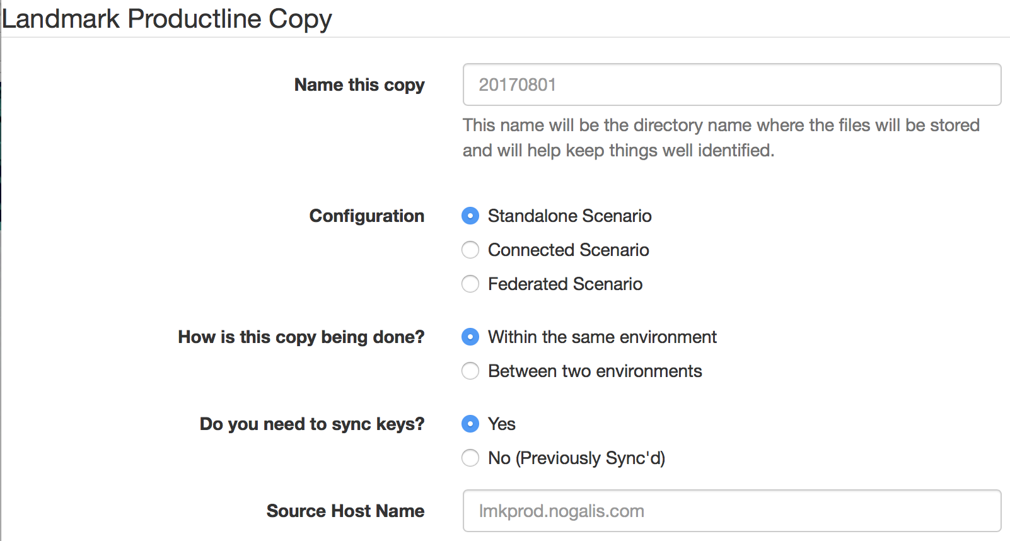
Copy Tool
http://www.nogalis.com/lmkcp/copier.html

Slide 13
Questions?
Visit our YouTube channel and comment on this video and we’ll respond within the comments.
YouTube.com/c/Nogalis

