Slide 1
Getting more enterprise value out of your Lawson data

Slide 2



What’s New 2018
10x
25
142
13
11
Consultants
Clients
Managed Services
10x Upgrades

Slide 3
Getting More Enterprise Value out of Lawson Data
Introduction
What is Big Data?
How Is Big Data Different from Traditional BI?
Case Studies Using Lawson Data
How to Get Started

Slide 4
What is Big Data?
Notes:
So what is Big Data?
The Original Source
“Data sets are generally quite large, taxing the capacities of main memory, local disk, and even remote disk. We call this the problem of big data. When data sets do not fit in main memory (in core), or when they do not fit even on local disk, the most common solution is to acquire more resources.” - NASA Scientists in 1997
Big Data Gets Bigger
“An all-encompassing term for any collection of data sets so large and complex that it becomes difficult to process using on-hand data management tools or traditional data processing applications.” - Wikipedia 2014
Big Data Now Assumes a Purpose
“The ability of society to harness information in novel ways to produce useful insights or goods and services of significant value” and “…things one can do at a large scale that cannot be done at a smaller one, to extract new insights or create new forms of value.” - Mayer-Schönberger and Cukier

Slide 5




By 2025, The Data Explosion will equate to
163 Zettabytes
OF DATA PER YEAR
75 Billion
CONNECTED DEVICES
Up to 20%
of the data will
be critical to
our lives
8 Billion
CONNECTED PEOPLE
Every 18 seconds
AN INTERACTION
Source: Forbes, 2017
Notes:
So How Big is Big Data?
Luckily we are in the middle of a data explosion that will greatly disrupt the Healthcare industry.
Over the next 8 years, we will be become a planet with 163 Zettabytes of data produced per year
connecting 8 Billion people to 75 Billion devices every 18 seconds.
According to Forbes, Up to 20% of the data will be critical to our lives

Slide 6
Healthcare & Life Sciences Digital Transformation
Cyber
Security
Mobility &
Cloud
Telemedicine
Wearables
Artificial Intelligence
Blockchain
Internet
of
Things
Machine Learning
Notes:
What is happening with Big Data in Healthcare?
In Healthcare & Life Sciences we are seeing Digital Transformation opportunities become prioritized across a handful of areas including:
Cyber Security
Mobilty & Cloud
Telemedicine
Wearables
While other oppurtunities are quickly emerging around:
Artificial Intelligence
Blockchain
Internet of Things
Machine Learning
90% of CEOs believe the digital economy will effect their industry, but less than 15% are executing on a Digital Strategy

Slide 7
How Is Big Data Different from Traditional BI?

Slide 8
Defining How We Analyze Data
Business Intelligence v. Data Science
Predictive and Prescriptive Analytics
Typical Techniques & Data Types | Ad hoc, optimization, predictive modeling, forecasting, statistical analysis Semi-structured/unstructured data, many types of sources, very large data sets Unpredictable size and velocity of ingestion into a data lake
Common Questions | Is there a correlation between gender and LOS? What factors contribute to HAIs? What will happen next month? Why is this happening?
High
Data
Science
BUSINESS VALUE
Business Intelligence
Typical Techniques & Data Types | Standard reporting, dashboards, alerts, queries, details on demand Structured data, traditional sources, manageable data sets Predictable batch schedule into a data warehouse
Common Questions | How many patients did we have last month? What was their average length of stay? What percentage of patients were covered by Medicare? What were the DRG codes?
Business
Intelligence
Low
Past
TIME
Future
Notes:
Given Most Organizations still co-mingle the terms Business Intelligence and Data Science I would like to spend a moment to differentiate these two types of analytics.
Business Intelligence typically deals with structured and transformed data sets to produce standardized reports to known questions. Essentially you are Reporting on what happened in the business.
Data Science typically deals with all types of data to do ad hoc analysis, and creaates models to assess what is happening and to predict and forecast what is likely to happen.

Slide 9





Business Intelligence Process
Step 1: Pre-build data schema
(schema-on-load)
Step 2: Define question to be answered
(queries)
Step 3: Use Business Intelligence (BI) tool’s graphical user interface (GUI) to construct query)
Step 4: BI tool creates SQL
Step 5: SQL is run against data warehouse
to create report
DW
Notes:
This is a quick Step Through of the process for BI

Slide 10



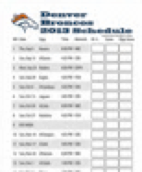








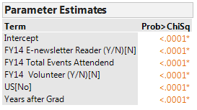
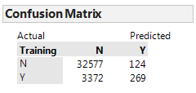
Data Science (Predictive / Prescriptive) Process
Historical
Weather Forecast
CDC
Google Trends
Physician
Notes
Local Events
Step 1: Define Hypothesis to test or Prediction to be made
Kronos
Epic
Lawson
Step 2: Gather data…and more data
(Data Lake: SQL + Hadoop)
Step 3: Prepare data; Build schema
(schema-on-query)
Step 4: Visualize the data
(Tableau, Spotfire, ggplot2,…)
REPEAT
Step 5: Build analytic models
(SAS, R, MADlib, Mahout,…)
Step 6: Evaluate model “goodness of fit” (coefficients, confidence levels)

Slide 11
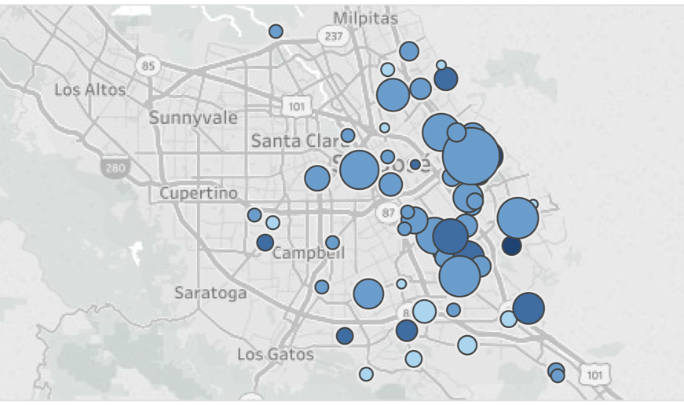
Number and Severity of Fatal Traffic Accidents Over Past 6 Months
Legend
Color = Severity (dark most severe)
Size = Number of fatalities
Notes:
Consider this scenario This report shows the Number and Severity of Fatal Traffic Accidents Over Past 6 Months near South Bay in Northern California.

Slide 12
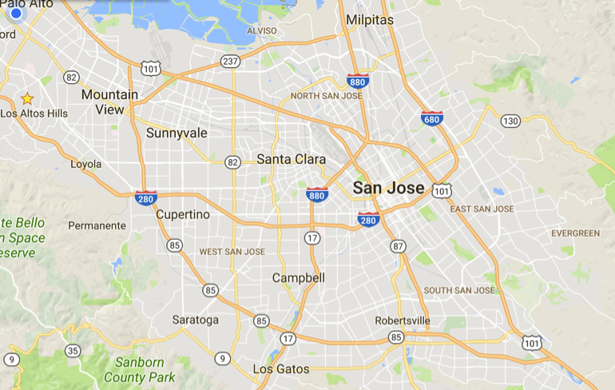
Predicted Number and Severity of Fatal Traffic Accidents Over Next 2 Weeks
Legend
Color = Crash severity (dark most severe)
Size = Number of fatalities
45%
71%
82%
Prediction Confidence Level
71%
30%
38%
62%
35%
65%

Slide 13



Recommended Location of Emergency Equipment On Tuesday September 5 from 6:00am to 9:00am
Legend:
Police Car
Ambulance
45%
Tow Truck
71%
82%
30%
38%
62%
35%
65%
Notes:
Compare the value of the previous report with this report which anticipates where accident responders should locate themselves based on a prediction of where accidents will likely occur at a given time.

Slide 14
Continuously Learning to Reduce Fatal Traffic Accidents
Most Predictive Variables
Variable | Variable Predictability | Change in Predictability
Precipitation | 32%
Sunrise Time | 28%
Average travel speed | 17%
Holiday Day Before | 13%
45%
71%
82%
30%
38%
62%
35%
65%
Notes:
Finally, by understanding where and when accidents are likely to occur you can make changes to how you manage traffic flow to help reduce accidents in the first place.

Slide 15
Case Studies using Lawson Data

Slide 16
How Do We Leverage
Big Data ?

Slide 17


BIG DATA BUSINESS MODEL MATURITY INDEX
Measures effectiveness of leveraging data and analytics to power business models
Learnings
(Best Practices)
BUSINESS
METAMORPHOSIS
INSIGHTS
MONETIZATION
BUSINESS OPTIMIZATION
BUSINESS
INSIGHTS
BUSINESS MONITORING
Real-time Optimized
Decisions
Capture Data Sources
Create Analytic Models
Data & Analytics as Corporate Assets
Data as Currency
Data Analytic
Platform
Notes:
Show this and talk through it – then pop the survey questions

Slide 18





Enabling Lawson Big Data Transformation
INGEST
STORE
SURFACE
ANALYZE
ACT
Capture data e.g.
EMR, Lawson, Kronos, Claims, Scheduling, 3rd party, public
Store everything in standardized environment: Data Profile, Describe & Enhance with metadata
Share across the Enterprise Clinicians, Executives, Analysts & Patients
Use Big Data analytics
to discover predictive patterns – clinical / business ops
Project future opportunities: ACO, Patient Engagements, Population Health, Precision Medicine
Enable Self Service Reporting
Notes:
Talk through this as a high-level methodology, and end by leading into the more specific framework of the vision workshop

Slide 19
Vision Workshop Timeline
Prep
1 Day
2 Weeks
1 Day
Post
Pre-project
Prep
Day of Interviews
Data Exploration
Ideation Workshop
Recommend-ations
Confirm targeted business initiative
Identify business and IT workshop participants
Identify appropriate data source(s)
Schedule interview and workshop dates
  Output – Targeted business initiative
Conduct business interviews
Conduct IT interviews
Secure sample data set (5GB)
Collect supporting materials (file structures, sample reports)
  Output – Key decisions and business questions
  Collaborate with data owners to capture subset of relevant data
  Acquire, prepare and explore data
Explore external data sources
  Build Analytic model
  Develop mockups
  Output – “Art of the possible” data
Review targeted business initiative
Review analytics and mockups
Brainstorm use cases
Output – Prioritized feasible Big Data business opportunities
Present business opportunities and prioritization
Output – Score data sources
Output – Recommend next steps

Slide 20
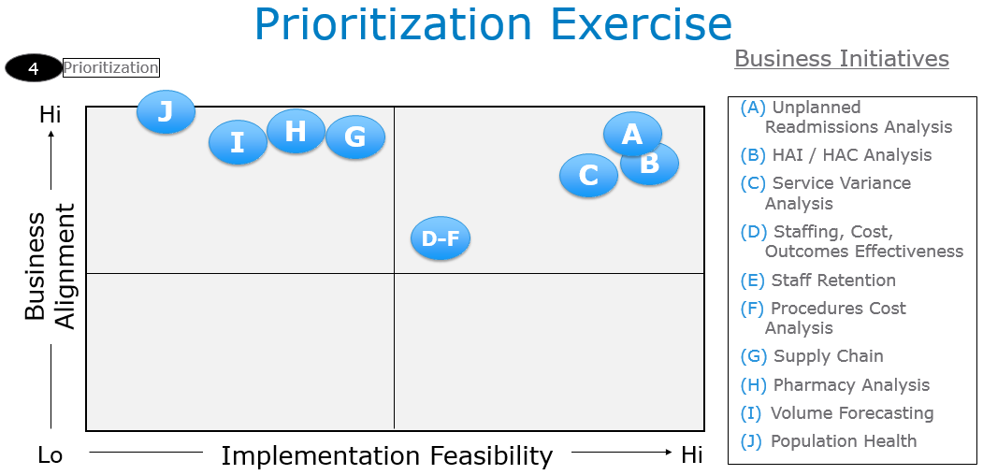
Example Use Cases

Slide 21
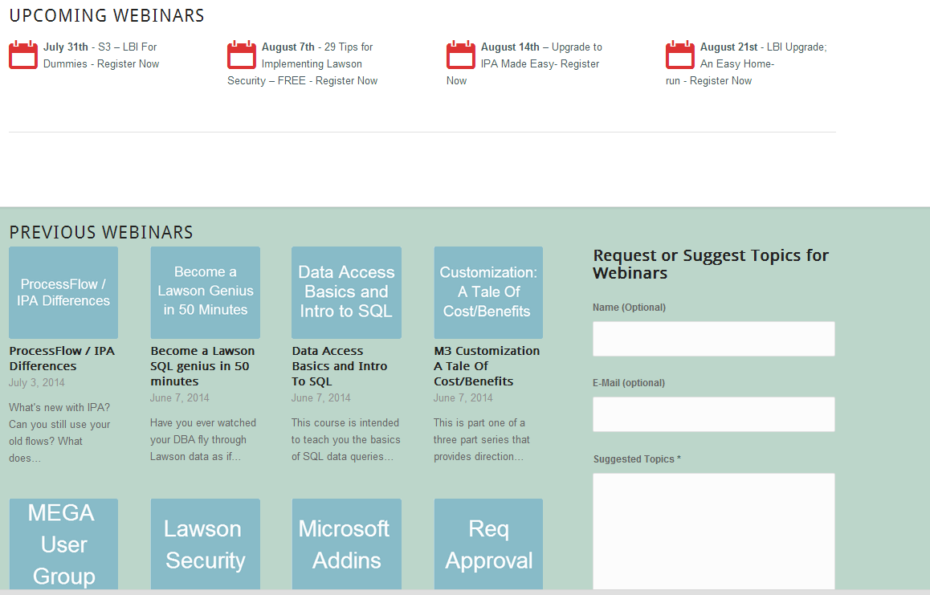
Free Education
www.nogalis.com/education

Slide 22
Q/A
@nogalisinc

Slide 23
Some Questions to Frame your Approach to Big Data
How well does your organization leverage big data and analytics to run the business?
Can you quantify the economic value of your data and how that affects your technology and business investments?
Do you understand how to create a platform that exploits the economic value of your data?

