Slide 1
Data Access Basics
Intro to basic SQL

Slide 2
Have you used SQL?
Yes
No
Es Que What?

Slide 3
What is covered
Overview of Databases
Introduction to SQL
Introduction to Select statements
Examples (Grouping, Sorting …)
Tools and getting started

Slide 4
What is a Database?
Organized collection of data held in a computer, especially one that is accessible in various ways.
The data are typically organized to model relevant aspects of reality in a way that supports processes requiring this information. For example, modelling the availability of rooms in hotels in a way that supports finding a hotel with vacancies.

Slide 5
What is SQL
SQL stands for Structured Query Language
SQL lets you access and manipulate databases
SQL is an ANSI (American National Standards Institute) standard

Slide 6
What can it do?
SQL can retrieve data from a database
SQL can insert records in a database
SQL can update records in a database
SQL can delete records from a database
And much more

Slide 7
Structure
User
Application
Data
HR00
PR12
HR01
PR13
HR04
PR51
HR07
PR52
HR09
PR67
HR10
PR68
HR11
HR12
PA52
PA100

Slide 8
Structure
User
Application
Data
HR00
PR12
HR01
PR13
HR04
PR51
HR07
PR52
HR09
PR67
HR10
PR68
HR11
HR12
PA52
PA100

Slide 9
Direct Access
User
Application
Data
HR00
PR12
HR01
PR13
HR04
PR51
HR07
PR52
HR09
PR67
HR10
PR68
HR11
HR12
PA52
PA100

Slide 10
You can use SQL
SELECT - extracts data from a database
UPDATE - updates data in a database
DELETE - deletes data from a database
INSERT INTO - inserts new data into a database

Slide 11
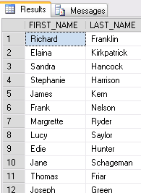
Select
SELECT FIRST_NAME, LAST_NAME FROM EMPLOYEE
Fields to return
Table

Slide 12
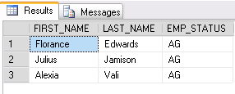
Conditions
SELECT FIRST_NAME, LAST_NAME, EMP_STATUS FROM EMPLOYEE WHERE EMP_STATUS = ‘AG’
Condition

Slide 13
Join
SELECT EMPLOYEE.FIRST_NAME, EMPLOYEE.LAST_NAME, EMPLOYEE.EMP_STATUS, EMSTATUS.DESCRIPTION
FROM EMPLOYEE, EMSTATUS
WHERE EMPLOYEE.EMP_STATUS='AG'
AND EMPLOYEE.EMP_STATUS=EMSTATUS.EMP_STATUS

Slide 14
Alias
SELECT EMP.FIRST_NAME, EMP.LAST_NAME, EMP.EMP_STATUS, STS.DESCRIPTION
FROM EMPLOYEE EMP, EMSTATUS STS
WHERE EMP.EMP_STATUS='AG'
AND EMP.EMP_STATUS=STS.EMP_STATUS

Slide 15
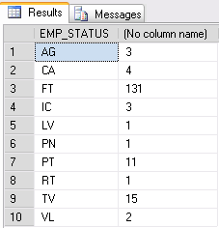
Grouping
SELECT EMP.EMP_STATUS, COUNT(EMP.EMP_STATUS)
FROM EMPLOYEE EMP
GROUP BY EMP.EMP_STATUS

Slide 16
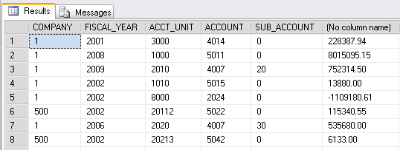
Grouping
SELECT COMPANY, FISCAL_YEAR, ACCT_UNIT, ACCOUNT, SUB_ACCOUNT, SUM(TRAN_AMOUNT) FROM GLTRANS
GROUP BY COMPANY, FISCAL_YEAR,ACCT_UNIT,ACCOUNT, SUB_ACCOUNT

Slide 17
Wildcards
SELECT * FROM EMSTATUS

Slide 18
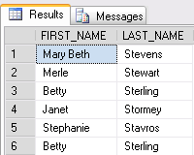
Pattern RegEx
SELECT FIRST_NAME,LAST_NAME FROM EMPLOYEE WHERE LAST_NAME LIKE 'St%'

Slide 19
WHERE Clause Operators
Operator | Description
= | Equal
!= OR <> | Not equal. Note: In some versions of SQL this operator may be written as !=
> | Greater than
< | Less than
>= | Greater than or equal
<= | Less than or equal
BETWEEN | Between an inclusive range
LIKE | Search for a pattern
IN | To specify multiple possible values for a column

Slide 20
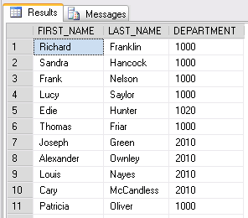
Example
SELECT FIRST_NAME,LAST_NAME, DEPARTMENT FROM EMPLOYEE WHERE DEPARTMENT IN (1000,1020,2010)

Slide 21
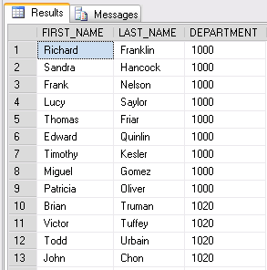
Sorting
SELECT FIRST_NAME,LAST_NAME, DEPARTMENT FROM EMPLOYEE WHERE DEPARTMENT IN (1000,1020,2010) ORDER BY DEPARTMENT ASC

Slide 22
What You Need
A SQL Client (SQL Server Management Studio, Toad, WinSQL )
Connection information
Server Address (IP Address or Server Name)
Port Number
Username and Password
User credentials (User needs at least “Select” rights)

Slide 23
Next Event
10x Upgrade Bootcamp
The one day event that will ensure a successful upgrade
Jun
18
www.nogalis.com/education

Slide 24
Q/A
@nogalisinc

